Slide 1







Birmingham & Solihull - Children and Young People’s Asthma Network
Plans, Priorities & Achievements
Establishment of a Regional Asthma Network (Sept 2021)
Establishment of a BSOL Asthma Network (Oct 2021)
Plans to benchmark against the recommendations from the National Asthma Bundle of Care & secure implementation of any gaps.
Commenced Primary Care Asthma Pilot:
  Integrated Approach - collaborative working between B’ham Women's & Children’s Hospital & Primary Care
  Will extend to involve UHB with Primary Care
  Asthma clinics in Primary Care
  MDT meetings - Doctors, practice nurses, school nurses, HV, family support workers to build capacity and improve outcomes.
Intelligence driven – looked at micro & macro factors, inequalities, air pollution, deprivation etc
Plan to assist in joining up pathways of care to achieve better outcomes for CYP
Training and Education

Slide 2
Black Country & West Birmingham CCG plans
Merge of CCG from 4 pre-existing CCG’s from April 21
Exciting activity to unify Asthma Care across the footprint
Planning to increase education and awareness of asthma diagnosis, management particularly CY&P
Review and develop Spirometry for Children alongside the restoration programme for adults
Re-launch of the Wheeze plan for Children developed historically
Unify the use of Asthma Management Plans, with better education for primary care staff how to complete one
Review of environmental issues from inhaler recommendations to public health issues.
Review of the local Incentive schemes to ensure equality across the diverse ICS population
Building on the referrals to adult difficult asthma clinic
Pathway for referral of C&YP to Difficult asthma clinic
Black Country Wide C & YP sub-group development from main Respiratory Group

Slide 3





SEL 2021 Asthma update
Achievements
Guidance developed for remote asthma consultations
Hosted on-line multi-disciplinary training events
Successful post COVID relaunch of the asthma network and identification of local priorities
Deliverables
Recruitment of CYP leadership team to prioritise asthma action plan
Implementation of the asthma action plan in-line with the release of the national care bundle and local priorities identified by the asthma network (inclusive of digital strategy)
Delivery of intensive online 6 week training programme for multi-disciplinary access
Asthma incorporated into the SEL operational toolkit for population health management and delivery and audit plan for targeted health management to be implemented

Slide 4
Tackling Asthma in Staffordshire &
Stoke-on-Trent
Research
Conducting and leading NIHR supported research into children's severe asthma and asthma adherence. Examples include the NIHR funded TREAT study, the NIHR-supported OUTER-SPACERS study where our local acute Trust, University Hospital of North Midlands (UHNM) Foundation Trust, is a sponsor and lead.
Education
Continual cycle of education with respiratory teams, colleagues and our patients. Internal research highlights that this can make a difference. Additionally, there is pro-active teaching at every level including local, regional and national meetings.
Governance
Continual monitoring and review of our services, seeking marginal improvements. The Children's Asthma service is consistently in the top decile for performance in the National Asthma Audit. Additionally, Dr John Alexander, Paediatric Consultant at UHNM has led the development of the NICE guideline for Asthma and our Clinical Lead Dr Will Carroll has led the development of the CYP National Asthma Bundle.
Caring
Our clinicians believe that the best care requires a compassionate response to our families. They listen, seek to understand and then adapt our asthma care to the needs of children and families.
Big 6
Extensive engagement across the region took place to support the development of the Big 6 documentation and development of pathways of which asthma was identified as a priority area. We plan to revisit this work to review the aims and objectives and ensure these meet the needs of our local population
Spirometry
Planned implementation during 2021 of a primary care spirometry led service to ensure universal access to quality assured spirometry services to address the inequitable service offer currently in place.
Asthma Nurse
Review of the community asthma nurse post to ensure that support is aligned to patients needs and outcomes. Presently commissioned for Stoke-on-Trent CCG only however consideration for wider roll out dependant on the review outcomes.

Slide 5





Children’s Asthma in Leicestershire – Our Priorities for 2022:
Improve asthma diagnosis in the community
  Work collaboratively with ICS to develop primary care diagnostic hubs to:
    Improve access to objective testing for children
    Improve asthma diagnostic accuracy
Improve access to specialist expertise
  Develop rapid access hub based within secondary care to:
    Support primary care diagnostic hub with complex cases
    Provide timely reviews of children with poor asthma control and prevent attacks
Expand severe asthma service
  Build on existing severe asthma service and improve patient experience by:
    Appointing psychologist and pharmacist within the team
    Integrate latest technology into routine care to support self-management and remote monitoring
Strengthen paediatric asthma research
    Continue to deliver high quality research focussed on improving asthma care at the interface between primary and secondary care

Slide 6





Consultant nurse partnership clinics
Ward asthma champions
Primary care practices identified for support using asthma case finder based upon prescribing patterns and risk factors for attacks
Children & Young People’s asthma NETwork
Supported by asthma CNS team promote good practice on wards incl. inhaler checks and education post attack
Developing a network for children’s asthma alongside the adult South West Asthma Network

Slide 7
Oldham CCNT Asthma Service
Ensure all children receive a post exacerbation review
Close working relationship with secondary care
Provide asthma education for the child and family
Promote self management and early detection of deteriorating symptoms
Promote early implementation of PAAP yellow section
Reduce hospital attendances

Slide 8



ELHT Paediatric Asthma MDT
Specialist Paediatric Outreach Respiratory Team
New innovative Physiotherapy service which aims to reduce hospital admissions, promote physical activity and improve compliance with medical and non-medical management in asthma care.
Physio’s work collaboratively with the MDT also providing objective measures including spirometry, FeNo and exercise tests.
SPORT work flexibly to ensure equitable access to services for CYP with complex needs inclusive of home and school visits as required.
Achievements:
Nurse led clinics and effective collaborative working between Nurses and Consultants.
Joint clinics between Respiratory Nurses and Physios to reduce number of appointments.
Excellent feedback from CYP and their families who feel this service addresses a previously unmet need.
Emphasis on consistent inhaler technique across difference professions, acute and community.
Highly responsive service offering routine follow ups after asthma exacerbations and admissions and urgent reviews.
ELHT Goals and Priorities
Paediatric Respiratory Consultants and Paediatricians are working to continually improve the rapid asthma assessments on the Paediatric Observation Unit to ensure optimal medical management and reduce length of stay.

Slide 9

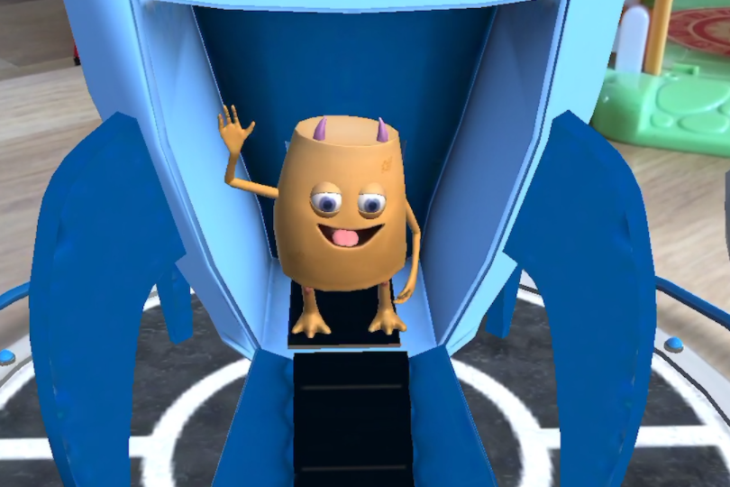
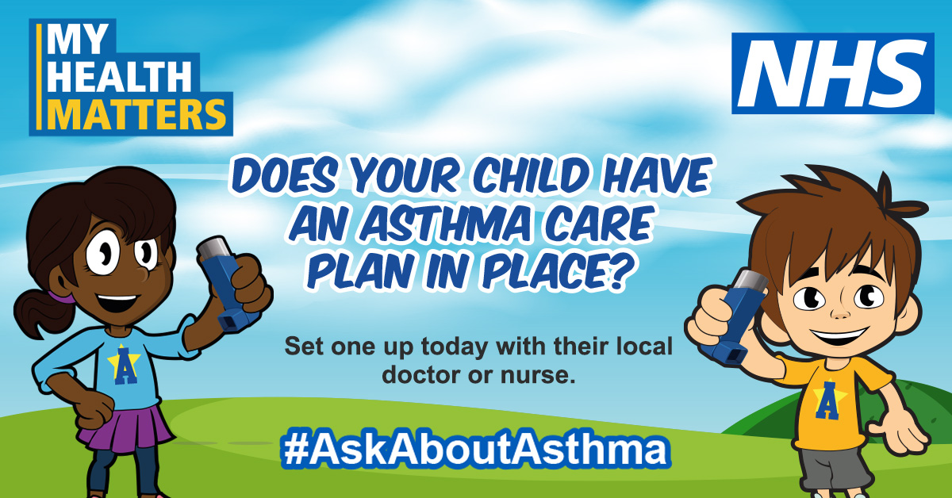
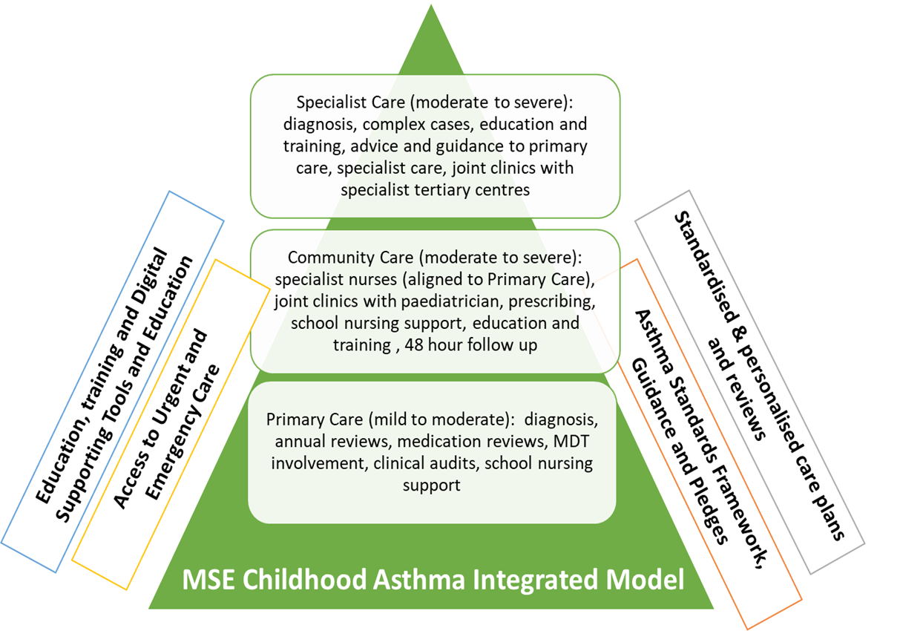
Developing our MSE
Integrated Care Model for Asthma
Establishing our Child Health Clinical Network, as well as engaging with our children
Embedding our organisational pledges and standards framework
Education and training for our frontline clinicians
Mobilising our pilot programme for Asthma, as part of the NHSE/I integrated care programme
Our local #AskAboutAsthma campaign
Multi-platform campaign
Radio & social media
Blogs by our local clinicians
DAX advertising
Bus advertising
Launch of “My Spira” app to teach inhaler technique and educate about asthma

Slide 10
Paediatric Asthma Service
Snapshot of service developments over 2021 and future plans
Developments
Future Plans
Paediatric Respiratory Nurse allocated to lead on asthma and develop Nurse Led asthma service in the Trust.
Professional development time for respiratory nursing team to attend training and conferences relating to asthma to improve knowledge and skills.
Nurse Led Asthma Clinics developed covering York, Scarborough and Selby in addition to consultant Asthma clinics.
Nurse Led review within 4-6weeks of discharge.
Direct referrals from ED to nurse led clinics for frequent attenders.
New equipment purchased for clinic – FeNO, Spirometer and Vitalograph AIM.
Nurse Led clinics with ‘One Stop’ style clinics providing full asthma review, education, personalised asthma action plans, FeNO & Spirometry and Skin prick testing to common aeroallergens (as needed).
Discharge advice and safety netting updated to include smoking, signposting and mental health.
To lead the work stream with the ICS on the implementation of the National Bundle of Care for CYP with Asthma
Continuation of professional development and learning of Paediatric Asthma team.
Non-Medical prescribing as part of the Asthma Nurse role.
Focus on transition and closer working with Adult respiratory team.
Plans to trial an adolescent clinic in partnership with adult nursing team and with transition nurse input.
Feedback from service users to aid service improvements.
To facilitate regular training and updates for ward staff.
To coproduce asthma care packages
To move towards a digital approach for CYP
Contacts:
Gemma Barnes, Paediatric Consultant (lead for Asthma at York Hospital)
Jen Brownbridge, Paediatric Respiratory Specialist Nurse – jennifer.brownbridge@york.nhs.uk

Slide 11

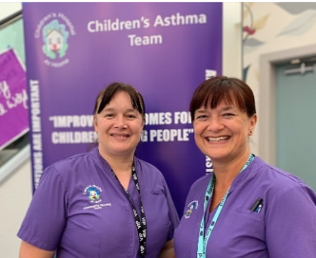


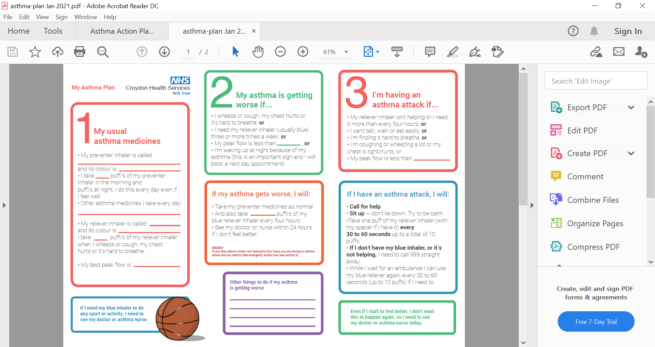
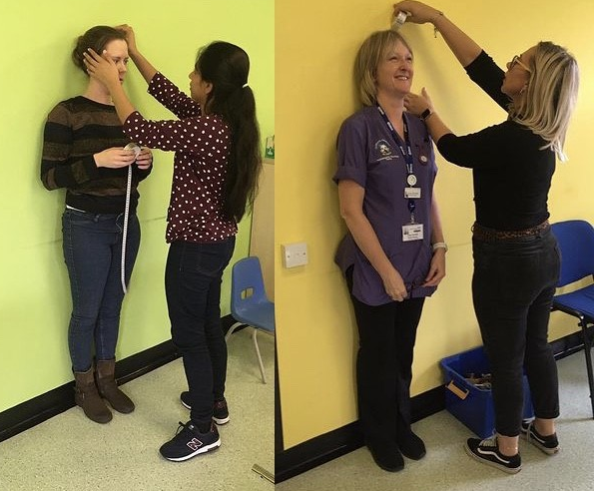
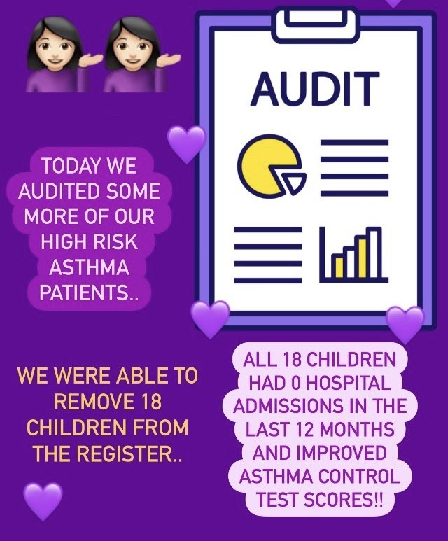


Achievements in Croydon 2021
Phased out Salbutamol weaning regime & implemented ward discharge bundle
30 Croydon Asthma
Champions trained
Development of asthma service High Risk Register
Submitted business case for MDT asthma clinic
Participation in NACAP Asthma Audit

Slide 12





At Bolton we are a team of; Paediatrician's, APNP, Respiratory Nurses and an Assistant Practitioner.
The respiratory team has a wealth of knowledge and experience in asthma care, all nurses are V300 prescribers with the asthma diploma qualification.
What we offer:
Clinics - Consultant Paediatrician, APNP and Respiratory Nurse Led (face to face and telephone review)
Diagnostic clinic - Consultant Paediatrician, One-Stop shop (APNP led) with FENO / SPIROMETRY.
Home Visiting -The respiratory nursing team also carry out respiratory assessments in the home and consider environmental triggers.
In line with the #AskAboutAsthma Campaign the 3 main focus points we provide:
Technique checks – at every contact.
Asthma review – after every exacerbation, review triggers, medications and concordance to treatment and promote annual asthma review in general practice.
Personalised Asthma Action Plan - Ensure all CYP have an up to date asthma action plan at each contact.
Ongoing care – multi-agency working providing training for GP’s and practice nurses, 0-19 public health service, paediatric ward, assessment unit, A&E and outpatient staff.

Slide 13

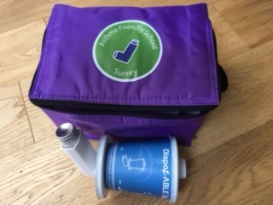

Improving asthma care for children in Surrey
Priorities include:
Reducing admissions for wheeze
Improving management of asthma in children
Providing consistent care and messaging School kit
Work to date
Surrey wide Learning event -2020
Asthma review clinic pilot
Surrey Asthma Toolkit hosted on Healthy Surrey website
Primary Care Asthma webinar facilitated by Secondary care
Creating Asthma Friendly schools including provision of kit and logo
Acute Paediatric Clinic Forums for long term conditions
Links with Public Health and Primary Care regarding air quality and smoking cessation

Slide 14
East of England Children & Young People Clinical Network and Transformation Team
Bringing together the experts across our 6 ICS’s in a CYP Asthma Clinical Network Group – 1st meeting 29th September 2021
And
Prioritising CYP with asthma, by raising awareness about asthma, networking, sharing information, knowledge, learning, innovations and resources such as: #AskAboutAsthma campaign
Supporting Mid & South Essex ICS who have been chosen for a 4 year Integrated care pilot with their innovative model: Integrated Care for CYP with Asthma
Linking with CYP Whole System Urgent & Emergency Care Working Group around respiratory conditions affecting CYP seasonally

Slide 15
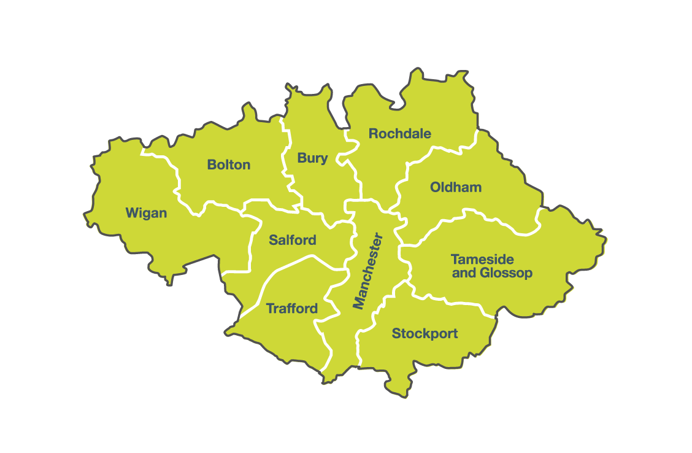
GM Asthma Programme
GM&EC
Strategic Clinical Networks
Priorities:
Asthma is prioritised in the GM Children’s Plan and the GM Children’s Health and Wellbeing Framework as part of the Preventing Avoidable Admissions workstream.
Refresh of the Greater Manchester Strategy to incorporate the Children’s Plan and the Children’s Health and Wellbeing Framework- asthma remains a priority.
We aim to reduce preventable admissions and attendances at ED for CYP with asthma.
Achievements:
GM CYP Asthma Care Pathway and Standards developed.
GM Asthma App pilot- to support self management and access to Asthma Care Plan.
GM Children’s Asthma Clinical Lead appointed in April 2021
Data dashboard on GM Tableau
GM Children’s Asthma Working Group Re-convened April 2021 with refreshed membership to reflect the system-wide response required for Asthma improvement. CYP voice included.
Plans:
Sub-groups of the working group to be established to align with national deliverables.
Evaluation of asthma app pilot.
Further development of the data dashboard.

Slide 16
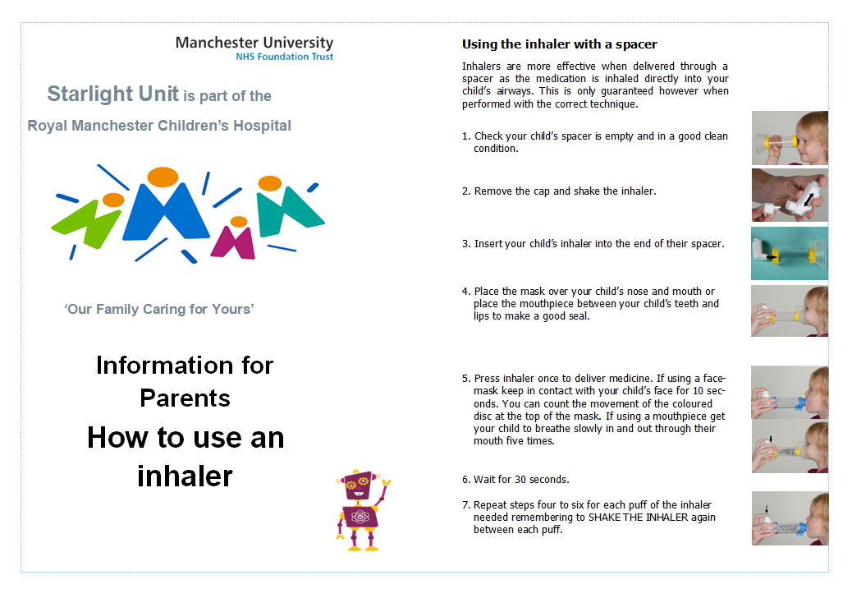
Following an audit of the use of the integrated care pathway on the Starlight Unit at Wythenshawe, it was evident that inhaler technique was not routinely being assessed prior to patient discharge
To ensure good practice and easy consistent advice, we created an information leaflet to share with colleagues, patients and their families.
This example is a shortened version of our leaflet.
Claire Holliday
Paediatric Respiratory Nurse
Kate Barker
Paediatric Respiratory Physiotherapist

Slide 17














South Yorkshire and Bassetlaw
Children and Young Person Alliance
We have connected with all our partner organisations, working together to achieve our goal to support all SYB children and young people to live healthy life's and are able to meet their full potential.
Scouts
Doctors & GPs
Nurses
Community
Care
Public
Health
Schools
Hospitals
Housing

Slide 18

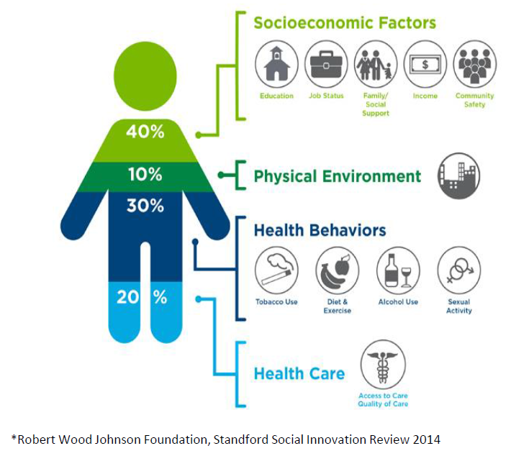


North Central London ICS
1. Young People & Families informed and empowered to manage the condition more effectively into adulthood
2. Enable healthy environments, which support children and young people with asthma to remain as well as possible
3. Enable all children to have access to a full education and activities, unhindered by asthma
4. All children have access to high quality asthma care
5. Earlier identification of children at risk of life threatening asthma attack or those with poor control.
Refreshed Paediatric Asthma Network & revised strategic planning underway
Development and implementation of asthma registry
Recent focus on AAA campaign support
Whole System approach

Slide 19
Derbyshire Children’s Hospital:
Paediatric Asthma Service
Achievements:
-Working with Primary care to increase education on prehospital management of wheeze, increase use of PAAPs and increase access to lung function testing.
-“Wheezy Child” Guideline for primary care implemented.
Priorities:
-Ensuring all acute admissions have documentation of inhaler technique, written PAAP on discharge and discussion about triggers and smoking cessation if needed.
Future plans:
-Supporting Severe Asthma Service with tertiary centre to
deliver treatment locally
-Development of MDT Dysfunctional Breathing assessment clinic
-Re-launch of asthma discharge bundle.

Slide 20




40,000
page views worldwide
North East & North Cumbria
29%
Reduction in unplanned hospital admissions
@NorthNetChild
SUSTAINED CHANGE over 3 years
(10 % increase region-wide)
Centre for Integrated Care Launching 2021
Asthma Fellow and Educators
Healthier Together Implementation
Social prescribing
48% increase use of PAAP in primary care
40% increase use of discharge bundle in secondary care
100%
£67139.55
cost saving over 3 years
positive feedback from all user groups
Notes:
Unplanned admissions to hospital are the single biggest RF for further asthma attacks and a recognised RF for death from asthms
We achieved a 29% decrease
On a background an increase of average of 10% over the same time period across the region, and an almost doubling of admission in the previous 3 years.
And this reduction has been sustained over the last 3 years of our intervention
This is the same as 34 children not having an asthma attack every year in Newcastle alone
Which translates into a cost saving of over £22000 every year in Newcastle alone.
And this doesn’t take into account the lost working days for parents looking after their children, lost school days or emotional impact
We know use of PAAPs are associated with improved asthma control. More than half the deaths in NRAD were primary care patients and the lack of a PAAP was a significant contributing factor in 77% of cases.
We have seen a nearly 50% increase in the use of PAAPs in primary care and similar improvements in secondary care.
But its more than just about asthma attacks -attacks are the final step in a much longer path of overall poor control. The ACT score is a validated score to look at overall asthma control in the last 4 weeks. A top score is between 25 and 31, depending on age, and a score of 19 or less equates to poor control. A change in score of 2 points or more correlates with the clinically significant difference. We saw an average increase in score of 6 points from initial meeting to follow up in 3 mnths In our outpatient follow ups
Thee online resource has had over 20,000 page views since its launch 18 months ago, the majority in the UK but a sprinkling across the world. All trusts in the region have adopted the shared paperwork, and increasing numbers of primary care providers are also using it. This means patients are getting a consistnet message wherever they access care, and this care meets national recommendations. Feedback has been consistently excellent from all users from health professionals to famiies to even teenagers!

Slide 21

North East London
Asthma Network Priorities
The NEL Asthma Network undertook a whiteboard exercise in April 2021 to discuss the range of areas we are working on- and could potentially work on.
This covered a wide range of initiatives across the seven boroughs, but it was agreed that we would focus on the following:
Uptake of Annual Reviews and Personalised Action Plans
Robust follow-up after emergency attendance/admission for asthma
Support local schools to be Asthma Friendly
Learn from past recommendations of Child Death Overview Panels and show improvements based on these.
Development of asthma pathways across the health and care system- ensuring there is sufficient staffing to support the provision of care.

Slide 22
SW London ICS Asthma Plans
Asthma Plans
SW London ICS has developed a Children, Young People and Maternity System Board. The System board is Chaired by the Chief Nurse and Co-Chaired by a Director of Children’s Services
The Children, Young People (CYP) and Maternity System Board is in the process of recruiting the CYP acute and CYP asthma leads. This will then allow set up of SWL CYP asthma network.
SWL are developing a project plan for asthma which aims to include:
Reducing asthma Emergency attendances and admissions by improving asthma diagnosis and control
Improving identification of children at risk for acute attacks
Improving asthma prescribing and appropriate use of inhaler devices
Ensuring all children have a written Personalised Asthma Action Plan
Ensuring all children have a timely (48hr) review following an acute asthma attack
Targeting CYP who would benefit from new high cost drugs.
Ensuring adequate resources to provide AHP support for children with asthma across the sector: physiotherapy, psychology, speech and language therapy and dietetics

Slide 23
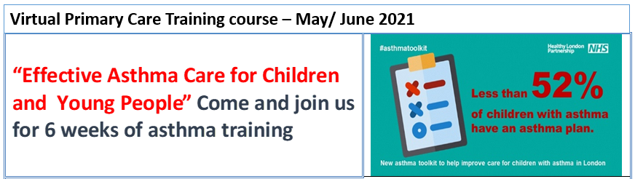

North West London CYP Asthma network
Virtual MDTs for Primary Care
A weekly open access session for pharmacists, practice nurses and GPs – facilitated by our MDT from across the network. 5-30 attendees each week, with incredibly rich and useful discussions on anonymised patients
PCN based virtual MDTs discuss high risk patients, and develop our network relationships
Goodbye to ‘weaning plans’ – network agreed asthma guideline ‘Going Home Plan’ - June 2021
Based on nurse led 48 hour reviews in operation pre and post introduction
Positive feedback from CYP/ families
No increase in re-attendance rate
Staff training key to success
Salbutamol post-discharge reduced
160-180 attendees each week
Excellent feedback
Sparked our weekly open-access asthma MDT for primary care – still running

