Slide 1
Care Provider Webinar: Simplifying Mental Capacity Act including Deprivation of Liberty Safeguards sharing best practice in a COVID-19 world
Hosted by NHS London
Date 2nd December 2020 11am

Slide 2
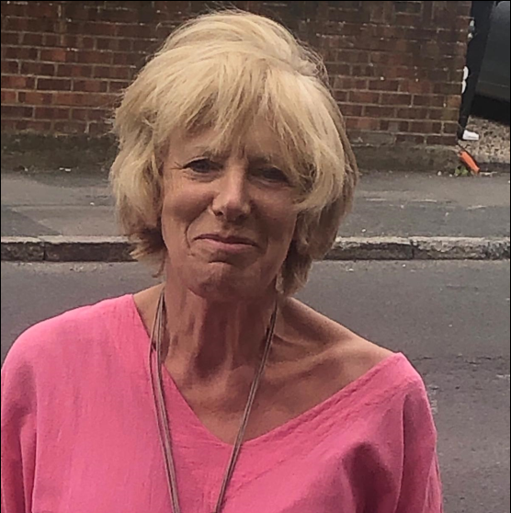
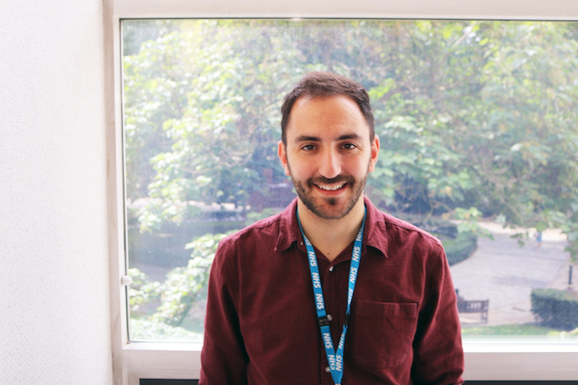
The team hosting you today
Ezra Kanyimo – Panel member
Enhanced Health in Care Homes Lead- London Region
NHS England & NHS Improvement
Aileen Buckton - Chair​
London ADASS
Briony Sloper – Panel member​
Out of Hospital cell lead - Ageing Well, Community Services and Discharge Pathways
London Covid-19 Response Team
NHS England & NHS Improvement
Neena Shah- Chat monitor​
Communications and Engagement Manager
Healthy London Partnership
Dan Heller – Chat monitor
Programme Manager
London Out of Hospital Cell
NHS England & NHS Improvement

Slide 3
Agenda
Timing | Discussion | Lead/ speaker
11:00 | Welcome | Chair
11:05 | Bite size: Mental Capacity Act simplified including DoLS | Chelle Farnan
11:15 | Local practice example 1- testing/swabbing | Chris Lee
11:25 | Local practice example 2- visiting | Michael Fullerton
11:35 | Process flows | Ezra Kanyimo
11:45 | Panel Q & A | Comms team/ Chair
11:55 | Closing Remarks | Chair

Slide 4
Questions to the panel
Please type any questions in the chatbox throughout the webinar
Send your chat box contributions to ‘all participants’
We welcome offers of support and advice – what’s happening locally?
Slides will be shared after the webinar

Slide 5
Bite size: Mental Capacity Act simplified including DoLS
Chelle Farnan
Named Professional Safeguarding Adults and MCA Lead
North East London NHS Foundation Trust

Slide 6
Bite-Size: The Mental Capacity Act 2005 - including the Deprivation of Liberty
Safeguards scheme
Chelle Farnan
#NHSSafeguarding
#MCA_LPS
@Chelleefarnan
December 2020

Slide 7
Current legal context
The Coronavirus Act 2020 has temporarily amended other pieces of legislation such as the Mental Health Act 1983 & the Care Act 2014.
It has not, however, done so for the Mental Capacity Act 2005 (MCA). Therefore the principles of the MCA and the safeguards provided by the Deprivation of Liberty Safeguards (DoLS) scheme still apply.
Similarly, the legal duty to safeguard adults who have care and support needs remains unchanged under the Care Act 2014 despite the ‘easements’ by the Coronavirus Act 2020.
Also unchanged are the Human Rights Act 1998 & the Equality Act 2010.
The next few slides are going to very briefly outline this important legislation and look at an overview of its operation during this pandemic.
Notes:
The Mental capacity (Amendment) Act 2019 that introduced into law the Liberty Protection Safeguards (LPS) scheme were to be officially to be implemented on the 1st October 2020 – however, DHSC have stated that in the current pandemic health and social care should not focus on the preparations for LPS and that the 1st October 2020 is ‘unfeasible’ – Helen Whately MP and Care Minister at DHSC formal announcement to state it is now the ambition to do so by April 2022.

Slide 8
Under what legal framework?
Our society is based on the sense of ‘autonomy of self’ – AKA self-determination and informed choice.
Before any intervention, ask yourself;
“Under what legal framework am I able to do so?”
There must be a basis in law …
Consent
Capacity
Informed Consent is not just the absence of overt protest to the offered intervention – that is just passive acquiesce and does not provide legal authority to the practitioner.
Notes:
Where the person doesn’t have the ability to give informed consent acquiescence is not enough to authorise the intervention, the more significant the proposed intervention the more effort the person proposing it puts into supporting the person to understand and make their own decision. Without consent or any other form of legal authorisation an intervention is illegal and as such could be construed as ‘trespass of person’ / ‘assault’ / ‘battery’.

Slide 9
The 5 Principles of the MCA 2005
After Shropshire Council
@Chelleefarnan #NHSSafeguarding #MCA_LPS
Notes:
The Mental Capacity Act 2005 begins with establishing five key principles to be followed whenever working within the framework of the Act. These are as follows:
1. Presumption of capacity
Start off by thinking that everyone can make their own decisions. Ask yourself, “does it appear that this person can make this decision?” Are you assured that they have understood? If not, apply principle 2.
2. Being supported to make their own decisions
Give the person all the support you can to help them make decisions. To justify an intervention, you must show that you have taken all practicable steps to help them to make the decision. So, take realistic steps to help them make the decision such as explaining the risks and benefits to enable them to make an informed choice and decide whether to give or withhold their consent. This might also include using a different form of communication, treating a medical condition which may be affecting the persons capacity (such as a urinary tract infection), or a structured learning programme to improve the persons capacity.
3. Unwise decisions do not necessarily mean lack of capacity
Keep in mind that just because the person has made a choice in one area of their lives that seems to you unwise it doesn’t automatically mean that they lack capacity in a different choice at a different time. Remember, one person’s seemingly unwise decision is another person’s calculated risk. However, if you have tried all practicable steps to support them to make the choice themselves and this has not been successful apply principles 4 & 5.
4. Decisions must be taken in the person’s best interests
Anytime someone does something or decides for someone who lacks capacity, it must be in the person’s best interests. The MCA provides a non-exhaustive checklist of factors that decision-makers must work through in deciding what is in a person’s best interests:
Find out the person’s views, wishes, feelings and beliefs
Encourage participation
Identify all relevant circumstances
Consult others (anyone engaged in caring for the person, close relatives, friends or others who take an interest in the person’s welfare) with the consent of the person.
Remember, it is person’s best interest. Any decision must be in the persons best interest NOT solely the best interest of services or family or professionals.
5. Carefully consider actions to ensure the least restrictive option is taken
The decision maker should always consider whether it is possible to provide the intervention or support in a less restrictive way. Is there a less restrictive and or intrusive option that will achieve the desired outcome?

Slide 10
The 5 Principles of the MCA 2005
A presumption of capacity.
Start off by thinking that everyone can make their own decisions. Ask yourself, “does it appear that this person can make this decision?” Are you assured that they have understood?
If not, apply principle 2.
1
After Shropshire Council
@Chelleefarnan #NHSSafeguarding #MCA_LPS
Notes:
The Mental Capacity Act 2005 begins with establishing five key principles to be followed whenever working within the framework of the Act. These are as follows:
1. Presumption of capacity
Start off by thinking that everyone can make their own decisions. Ask yourself, “does it appear that this person can make this decision?” Are you assured that they have understood? If not, apply principle 2.

Slide 11
The 5 Principles of the MCA 2005
A presumption of capacity.
Individuals are supported to make their own decision.
To justify any intervention, you must show that you have taken all practicable steps to help them to make the decision.
2
1
After Shropshire Council
@Chelleefarnan #NHSSafeguarding #MCA_LPS
Notes:
2. Being supported to make their own decisions
Give the person all the support you can to help them make decisions. To justify an intervention, you must show that you have taken all practicable steps to help them to make the decision. So, take realistic steps to help them make the decision such as explaining the risks and benefits to enable them to make an informed choice and decide whether to give or withhold their consent. This might also include using a different form of communication, treating a medical condition which may be affecting the persons capacity (such as a urinary tract infection), or a structured learning programme to improve the persons capacity.

Slide 12
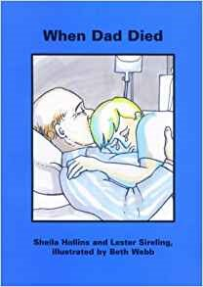
Books Beyond Words
… including new COVID-19 related titles, with further publications expected imminently.
A wide range of resources are available to support Principle 2, such as the invaluable ‘Beyond Words’ series of books and videos that cover many very difficult topics in an accessible pictorial format …
https://booksbeyondwords.co.uk/coping-with-coronavirus
Notes:
Beating the Virus
illustrated by Lucy Bergonzi
A short wordless story, that will help people to understand what to do if you have Coronavirus and how to keep yourself and those who you care about safe.
The story also shows how to safely help others who may be self-isolating.
Supplementary text at the end of the story gives information on where people can seek help if they are unwell and signposts to other useful resources.
https://static1.squarespace.com/static/551cfff9e4b0f74d74cb307e/t/5e95772ed955c310893242f1/1586853700272/Good+Days+and+Bad+Days+During+Lockdown+V1.pdf
Having a Test for Coronavirus: a new wordless story As lockdown measures ease, testing is more important than ever for controlling the spread of coronavirus. We felt, however, that more was needed to support people with learning disabilities and autism to understand what testing involves, how it feels and subsequently to prepare and give informed consent. Working with Lucy Bergonzi who illustrated Beating the Virus, we've published: Having a Test for Coronavirus. The new story illustrates both a drive through testing centre and a home test, so that a person can decide which option is right for them and prepare. We've also published a shorter version of the story which shows just the home test option, as well as an A4 picture sheet illustrating just the drive through testing process. On the reverse of the picture sheet there is information for health professionals/ testers on how to make the test accessible. As with all our coronavirus support resources, these are all completely free to download from our website: https://booksbeyondwords.co.uk/coping-with-coronavirus/#testing

Slide 13
The 5 Principles of the MCA 2005
A presumption of capacity.
Individuals are supported to make their own decision.
Unwise Decisions.
These do not necessarily mean a lack of capacity
3
2
1
After Shropshire Council
@Chelleefarnan #NHSSafeguarding #MCA_LPS
Notes:
3. Unwise decisions do not necessarily mean lack of capacity
Keep in mind that just because the person has made a choice in one area of their lives that seems to you unwise it doesn’t automatically mean that they lack capacity in a different choice at a different time. Remember, one person’s seemingly unwise decision is another person’s calculated risk. However, if you have tried all practicable steps to support them to make the choice themselves and this has not been successful apply principles 4 & 5.

Slide 14
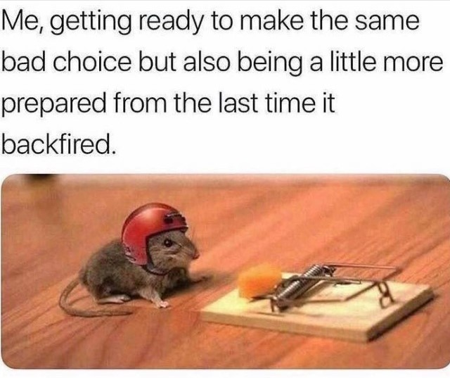
The unwise decision mouse!
One person’s (so called) unwise decision is another person’s calculated risk …
@Chelleefarnan @safeguardingNELFT #NHSSafeguarding #MCA_LPS

Slide 15
The 5 Principles of the MCA 2005
A presumption of capacity.
Individuals are supported to make their own decision.
Unwise decisions.
Best interests.
This must be in the person’s best interests, not others.
3
4
2
1
After Shropshire Council
@Chelleefarnan #NHSSafeguarding #MCA_LPS
Notes:
4. Decisions must be taken in the person’s Best Interests
Anytime someone does something or decides for someone who lacks capacity, it must be in the person’s best interests. The MCA Code of Practice provides a non-exhaustive checklist of factors that decision-makers must work through in deciding what is in a person’s best interests:
Find out the person’s views, wishes, feelings and beliefs
Encourage participation
Identify all relevant circumstances
Consult others (anyone engaged in caring for the person, close relatives, friends or others who take an interest in the person’s welfare) with the consent of the person.
Section 5 of the MCA affords professionals protection from possible charges of ‘assault’ or ‘battery’ when they carry out an intervention in someone’s Best Interest.

Slide 16
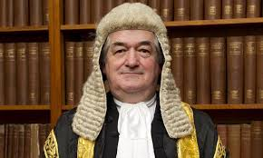
Best interest decisions include considering the persons emotional wellbeing .
Local Authority X v MM & Anor (No. 1) (2007)
Notes:
“What good is it making someone safer if it merely makes them miserable?”
https://thesmallplaces.wordpress.com/2014/11/14/what-good-is-it-making-someone-safer-if-

Slide 17
The 5 Principles of the MCA 2005
A presumption of capacity.
Individuals are supported to make their own decision.
Unwise decisions.
Best interests.
Less restrictive option.
3
4
2
1
5
After Shropshire Council
@Chelleefarnan #NHSSafeguarding #MCA_LPS
Notes:
5. Carefully consider actions to ensure the less restrictive option is
The decision maker should always consider whether it is possible to provide the intervention or support in a less restrictive way. Is there a less restrictive and or intrusive option that will achieve the desired outcome?

Slide 19
Mental Capacity Act 2005
The Deprivation of Liberty Safeguards (DoLS) scheme is parasitic the it’s parent, the Mental Capacity Act 2005. It is literally an ‘add-on’.
To consider DoLS as legislation in its own right is allowing the ‘tail to wag the dog’.
You cannot apply for a DoLS authorisation UNLESS and UNTIL you have assessed the person’s ability to give (or withhold) informed consent to be admitted in order to receive care and treatment, and
found it lacking, and
it is the less restrictive option to achieve the desired outcome, and
such an admission is agreed to be in the person’s best interest.

Slide 20
The Deprivation of Liberty Safeguards (DoLS) scheme
DoLS applies to those in hospitals and residential care homes aged 18 and above
Are they confined?
Do they lack the mental capacity to give informed consent to the arrangements for them to receive care and/or treatment?
Are these said arrangements imputable to the state?
In order to answer this apply the ‘Acid Test’ from Cheshire West as follows:
Do they lack the mental capacity to give informed consent to the arrangements for them to receive care and/or treatment?
Are they under continuous supervision and control (or ‘good nursing care’ as I like to call it).
Are they not free to leave; free to leave as in ‘go to live somewhere else’ if they so choose, not going to the shop and back. Also, it’s a hypothetical question, they don’t actually have to be actively trying to do so, it is what would happen if they were to try?
All elements must be present.
Notes:
The Deprivation of Liberty Safeguards (DoLS) came about due to European law identifying there was a gap in English and Welsh law in that there was no system prescribed by law to authorise the detention of individuals who could not give informed consent to an informal admission into a hospital or care home – known as the ‘Bournewood-gap’ named after the hospital the person was being illegally held in. This contravened Article 5 of the European Convention of Human Rights - Right to liberty and Security. https://www.echr.coe.int/Documents/Guide_Art_5_ENG.pdf
DoLS came into statute in 2007 by way of amendment to Section 50 of the Mental Health Act (MHA) and was implemented in 2009. Whilst technically part of the MHA it is to be taken as part of the Mental Capacity Act (MCA).

Slide 21
Notes:
Any questions please email me at:-
Chellè dot Far Nan at NELFT dot NHS dot UK

Slide 22
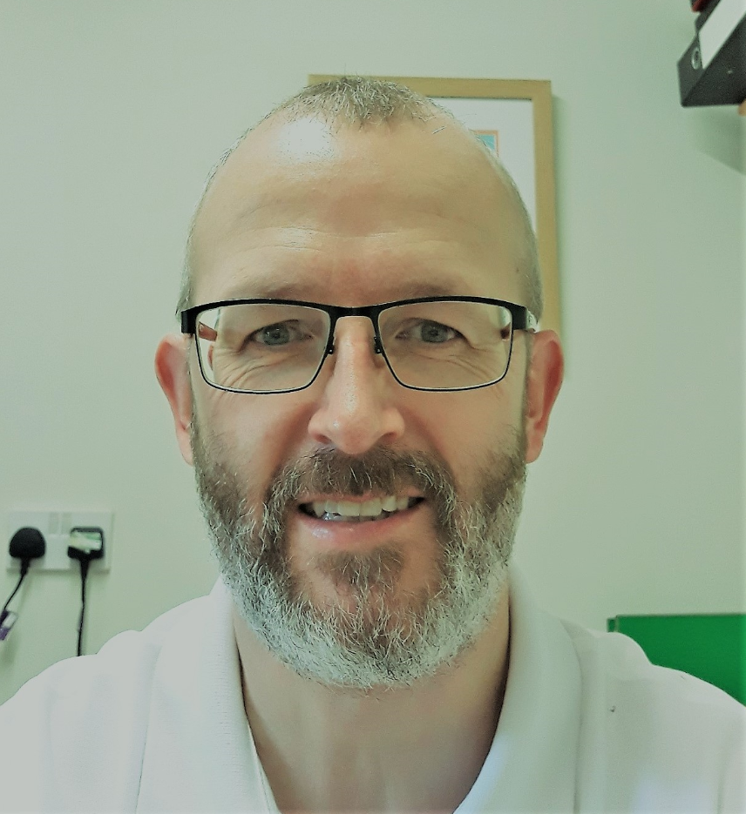
Swabbing residents during Covid-19- Local example 1
Chris Lee
Care Quality Manager
HC-One

Slide 23
HC-One
Swab-testing for Covid19
80+ Residents
Potentially restrictive / invasive procedure – swab-testing
Basic ‘best interest’ premise – starting point (least restriction etc.)

Slide 24
Process
Residents able to consent / decide for themselves
Either gain their consent or record their refusal
Residents who do not have mental capacity to consent / refuse
Gain valid ‘consent’ (LPoA Health and Welfare or Court Appointed Deputy), or
Complete formal ‘Best Interest’ decision, involving NoK, colleagues, advocacy
Ensure ‘least restrictive’ is applied when testing
Take swab in least invasive way possible, maintaining efficacy of test
Any sign of distress, stop the test and do not complete.

Slide 25
Future vaccination
Assuming non-compulsory
Starting again with a ‘best interest’ premise
Repeat of the process for testing, but…
Ensuring we are fully (better!) prepared

Slide 26
Managing visits during Covid-19- Local example 2
Michael Fullerton
Director of Health and Wellbeing
Achieve Together

Slide 27
MCA Simplified and DoLS: Managing visits
December 2020
Michael Fullerton,
Director of Health & Wellbeing

Slide 28
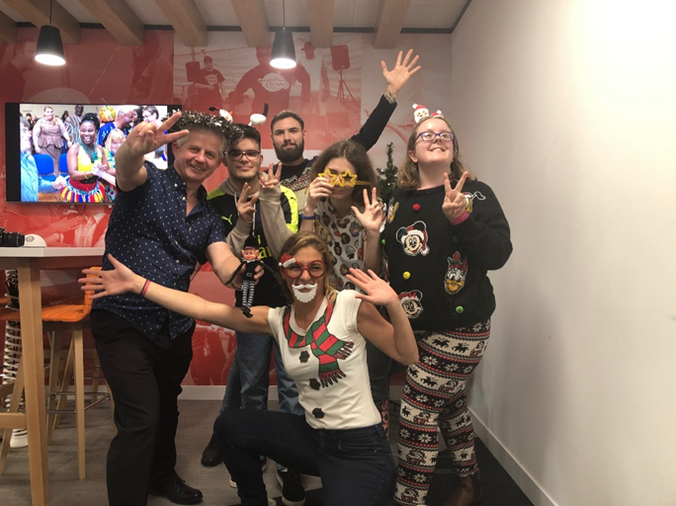
Achieve together
National learning disability and/or autism social support provider – supporting adults aged 18+
Range of supported living, residential care and outreach support
Supporting 2100 people across England and Wales
Workforce of 6000 support staff

Slide 29
Social Care Covid-19 Headline
In May 2019 the National Medical Director, Professor Stephen Powis, wrote with regard to Learning disability, death certification and DNACPR orders, emphasising that:
“The terms “learning disability” and “Down’s syndrome” should never be a reason for issuing a DNACPR order or be used to describe the underlying, or only, cause of death … Learning disabilities are not fatal conditions.”
Learning disability Covid deaths 'six times higher'
People with learning disabilities were up to six times more likely to die from Covid-19 during the first wave of the pandemic, Public Health England analysis suggests. It has prompted the charity Mencap to accuse the government of failing to protect a group already experiencing health inequalities. Social Care Minister Helen Whately says more testing is being carried out in care homes and among those most at risk.
Elderly people and social care workers could be prioritised for COVID-19 vaccine

Slide 30
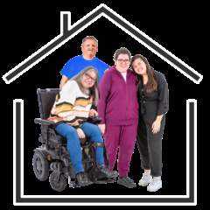
Challenges for learning disability social care
Range of age and need being supported, in differing types of accommodation
Mix of people with and lacking capacity to understand and make decisions about following or not following government guidance
People living in care services and continuing to work
Impact of restrictions on mental and physical health
People, aged 18+, wanting to spend time with family, partners and friends

Slide 31
COVID-19 Risk Consideration Tool
Achieve together in dialogue with families has created a risk-consideration tool to consider the potential for the young adults they support to spend time with their families, indoors at the family home.
This includes:
A flow chart where 14 criteria need to be met to allow a visit to be supported. Considerations include capacity, transport, restricting other visitors in the family home, social distancing, PPE if necessary, cleaning, actions to be taken when returning to supported living, testing and the need to change or cancel plans at short notice if risks change. Any visit and the actions put in place need to be agreed by all parties as well as the funding authority.
A form with details as to how risk will be managed for each individual visit and for each area of risk identified.
A contact plan for the young adults and their families so that everyone understands their role. This plan includes the responsibilities of both the young adult and their family.
https://www.scie.org.uk/care-providers/coronavirus-covid-19/care-homes/supported-living/opening

Slide 32
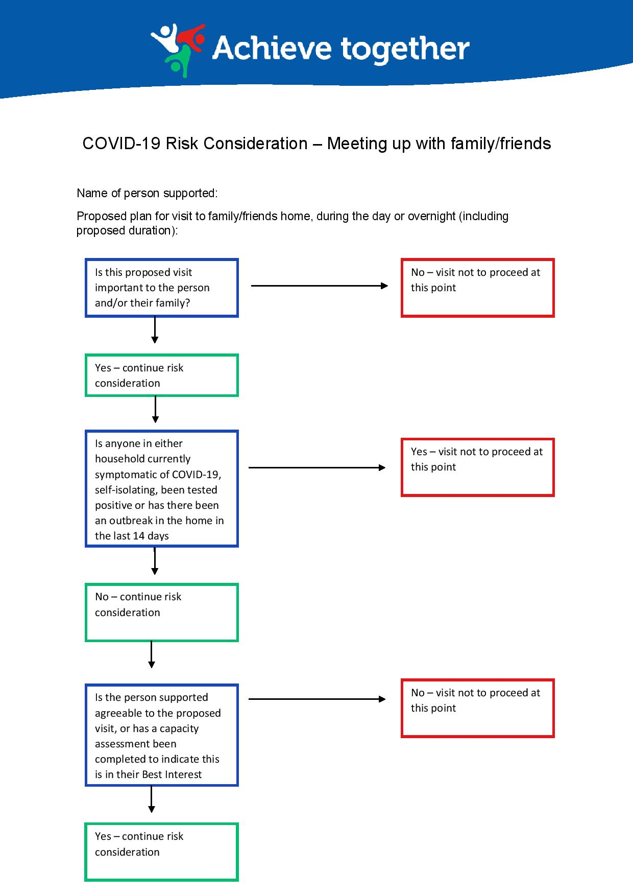
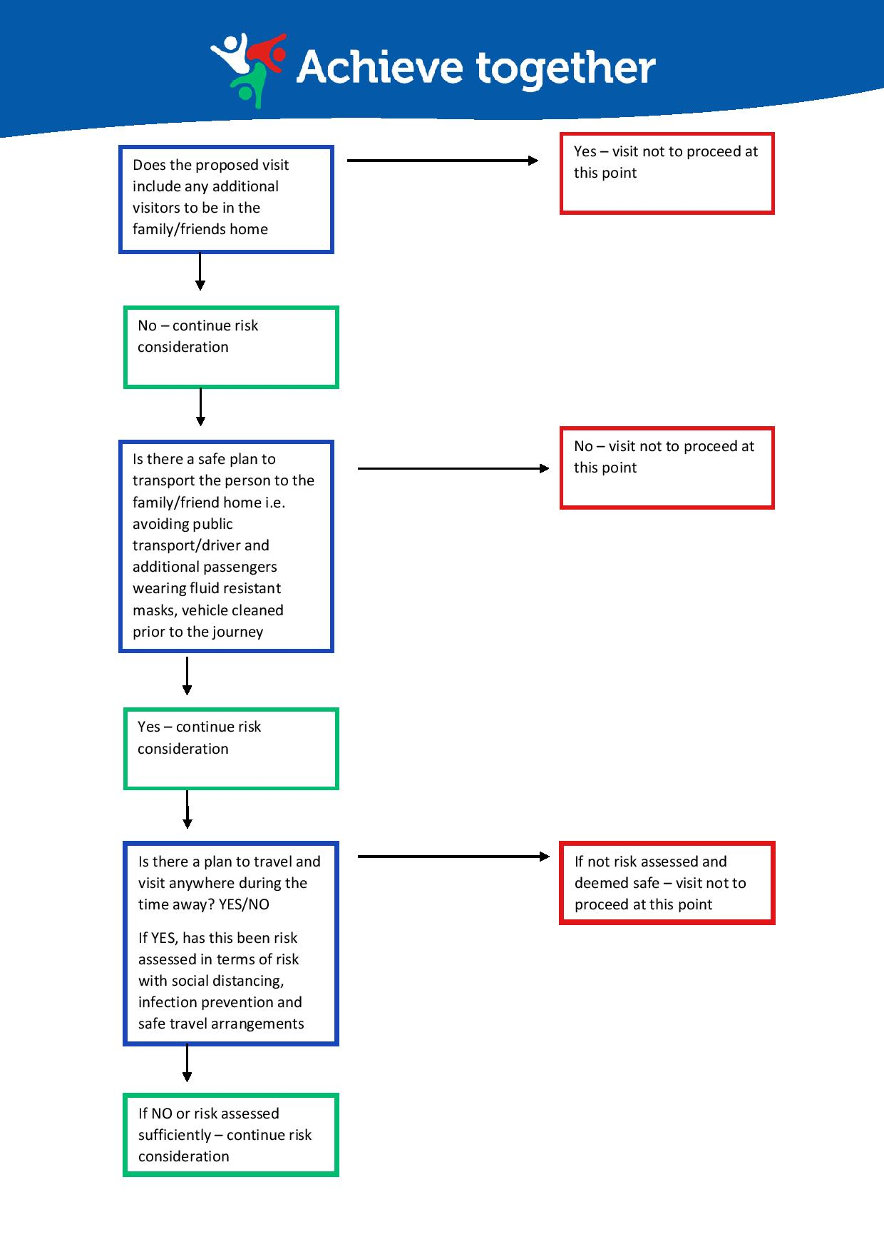

Slide 33
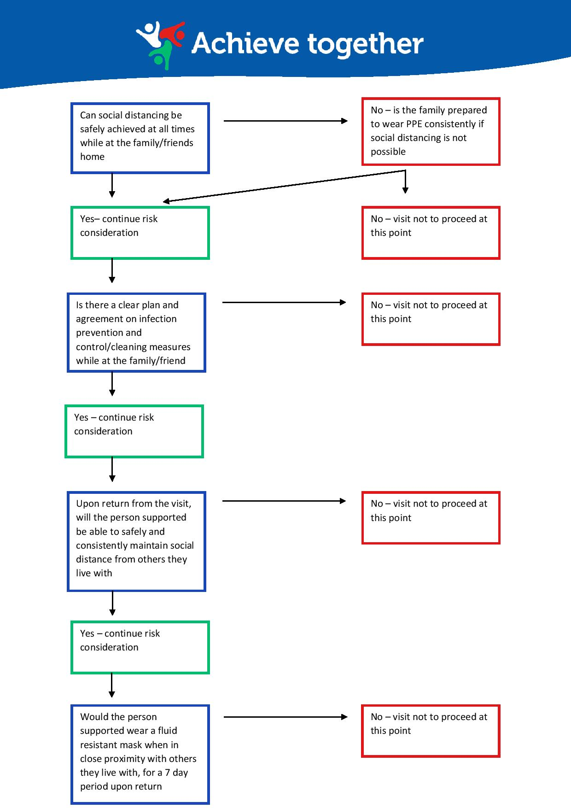
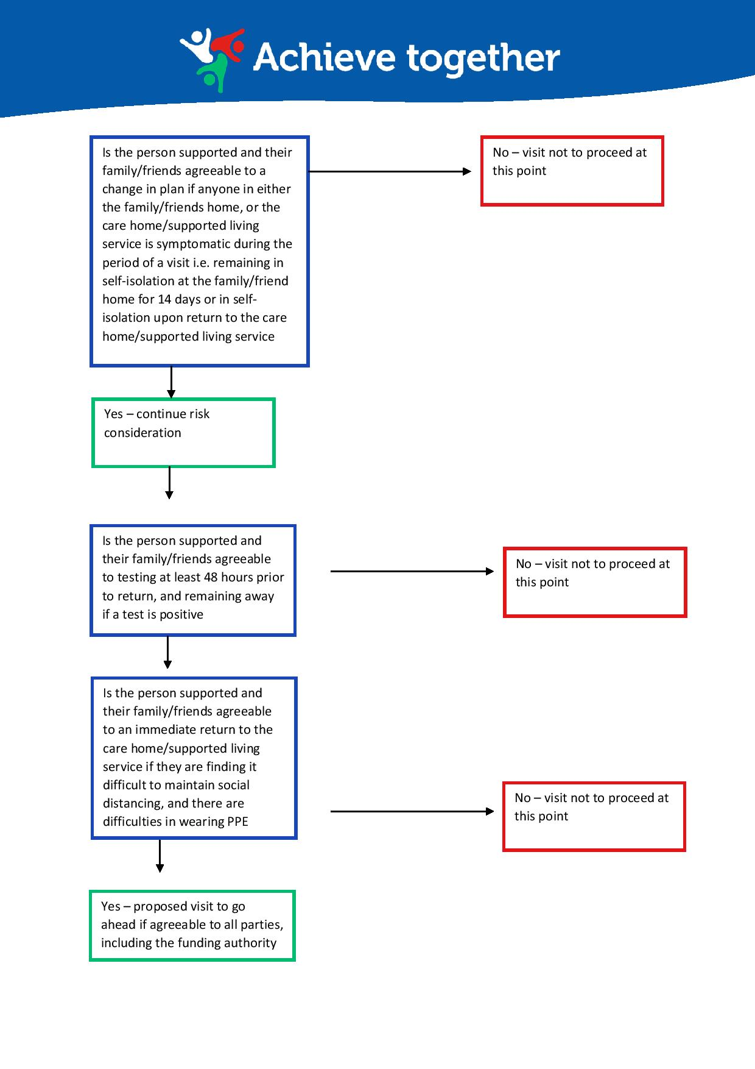

Slide 34
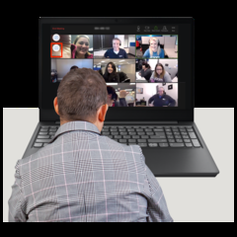
Ongoing Dialogue, Co-production
Internal COVID-19 Sub-Committee reporting to Executive Team
Co-production with people with learning disabilities and/or autism that we support, and their families
Constant lobbying for recognition and support, balancing vulnerabilities and rights of people supported

Slide 35
Merry Christmas
Guidance for the Christmas period - https://bit.ly/guidancechristmasmas
EMG and SPI-B: Mitigating risks of SARS-CoV-2 transmission associated with household social interactions - https://bit.ly/SARSCOV2trans

Slide 36
Thank You
Michael.Fullerton@achievetogether.co.uk
@Achieve_Support @MichaelFullert3
www.achievetogether.co.uk

Slide 37
Process flows
Ezra Kanyimo
Enhanced Health in Care Homes - London Region
NHS England and Improvement

Slide 38
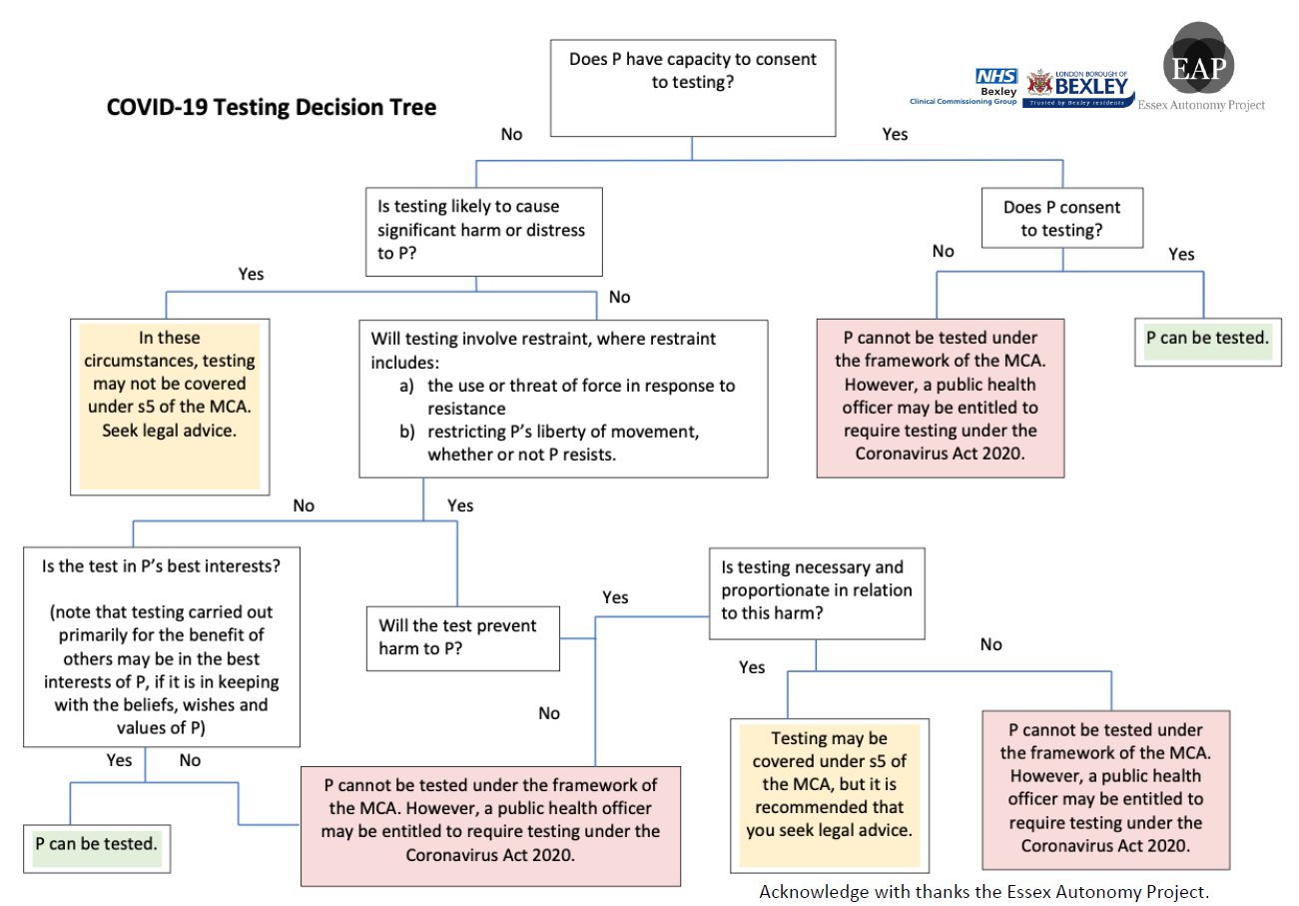

Slide 42
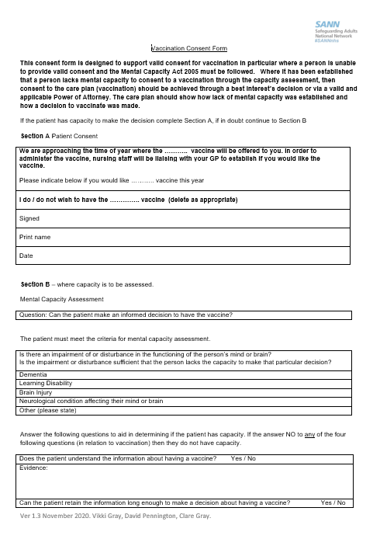
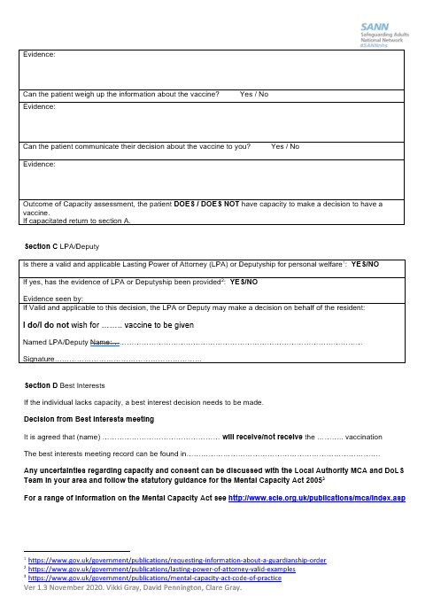
Safeguarding Adults National Network Generic Vaccination Consent Form
https://future.nhs.uk/safeguarding/viewdocument?docid=85145061

Slide 43
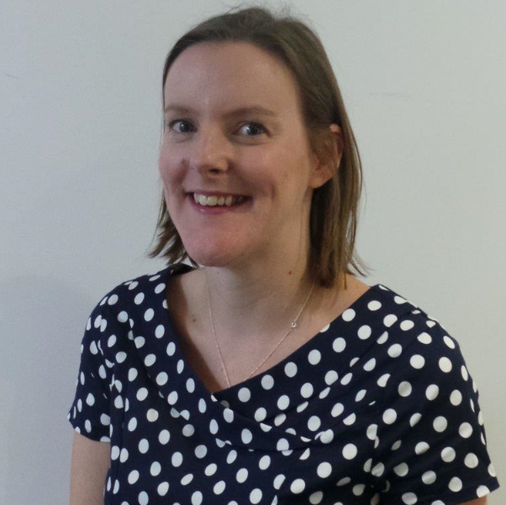
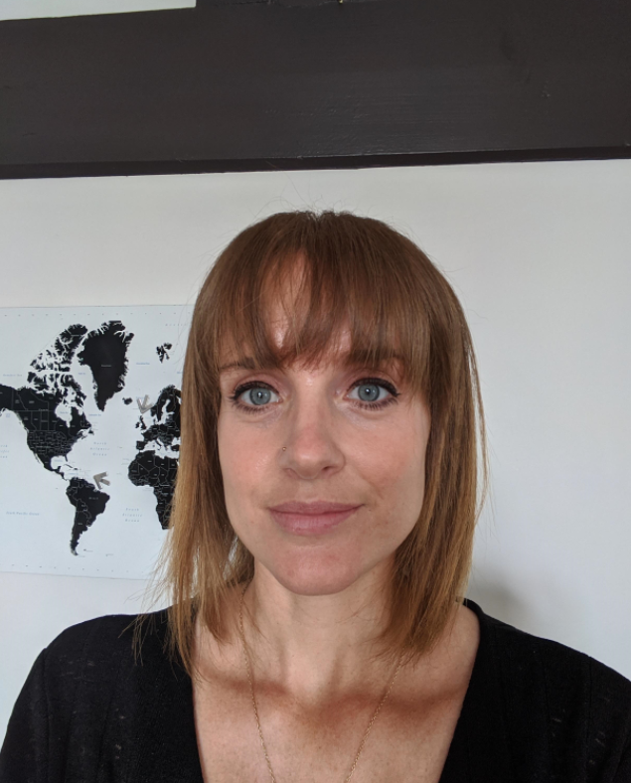
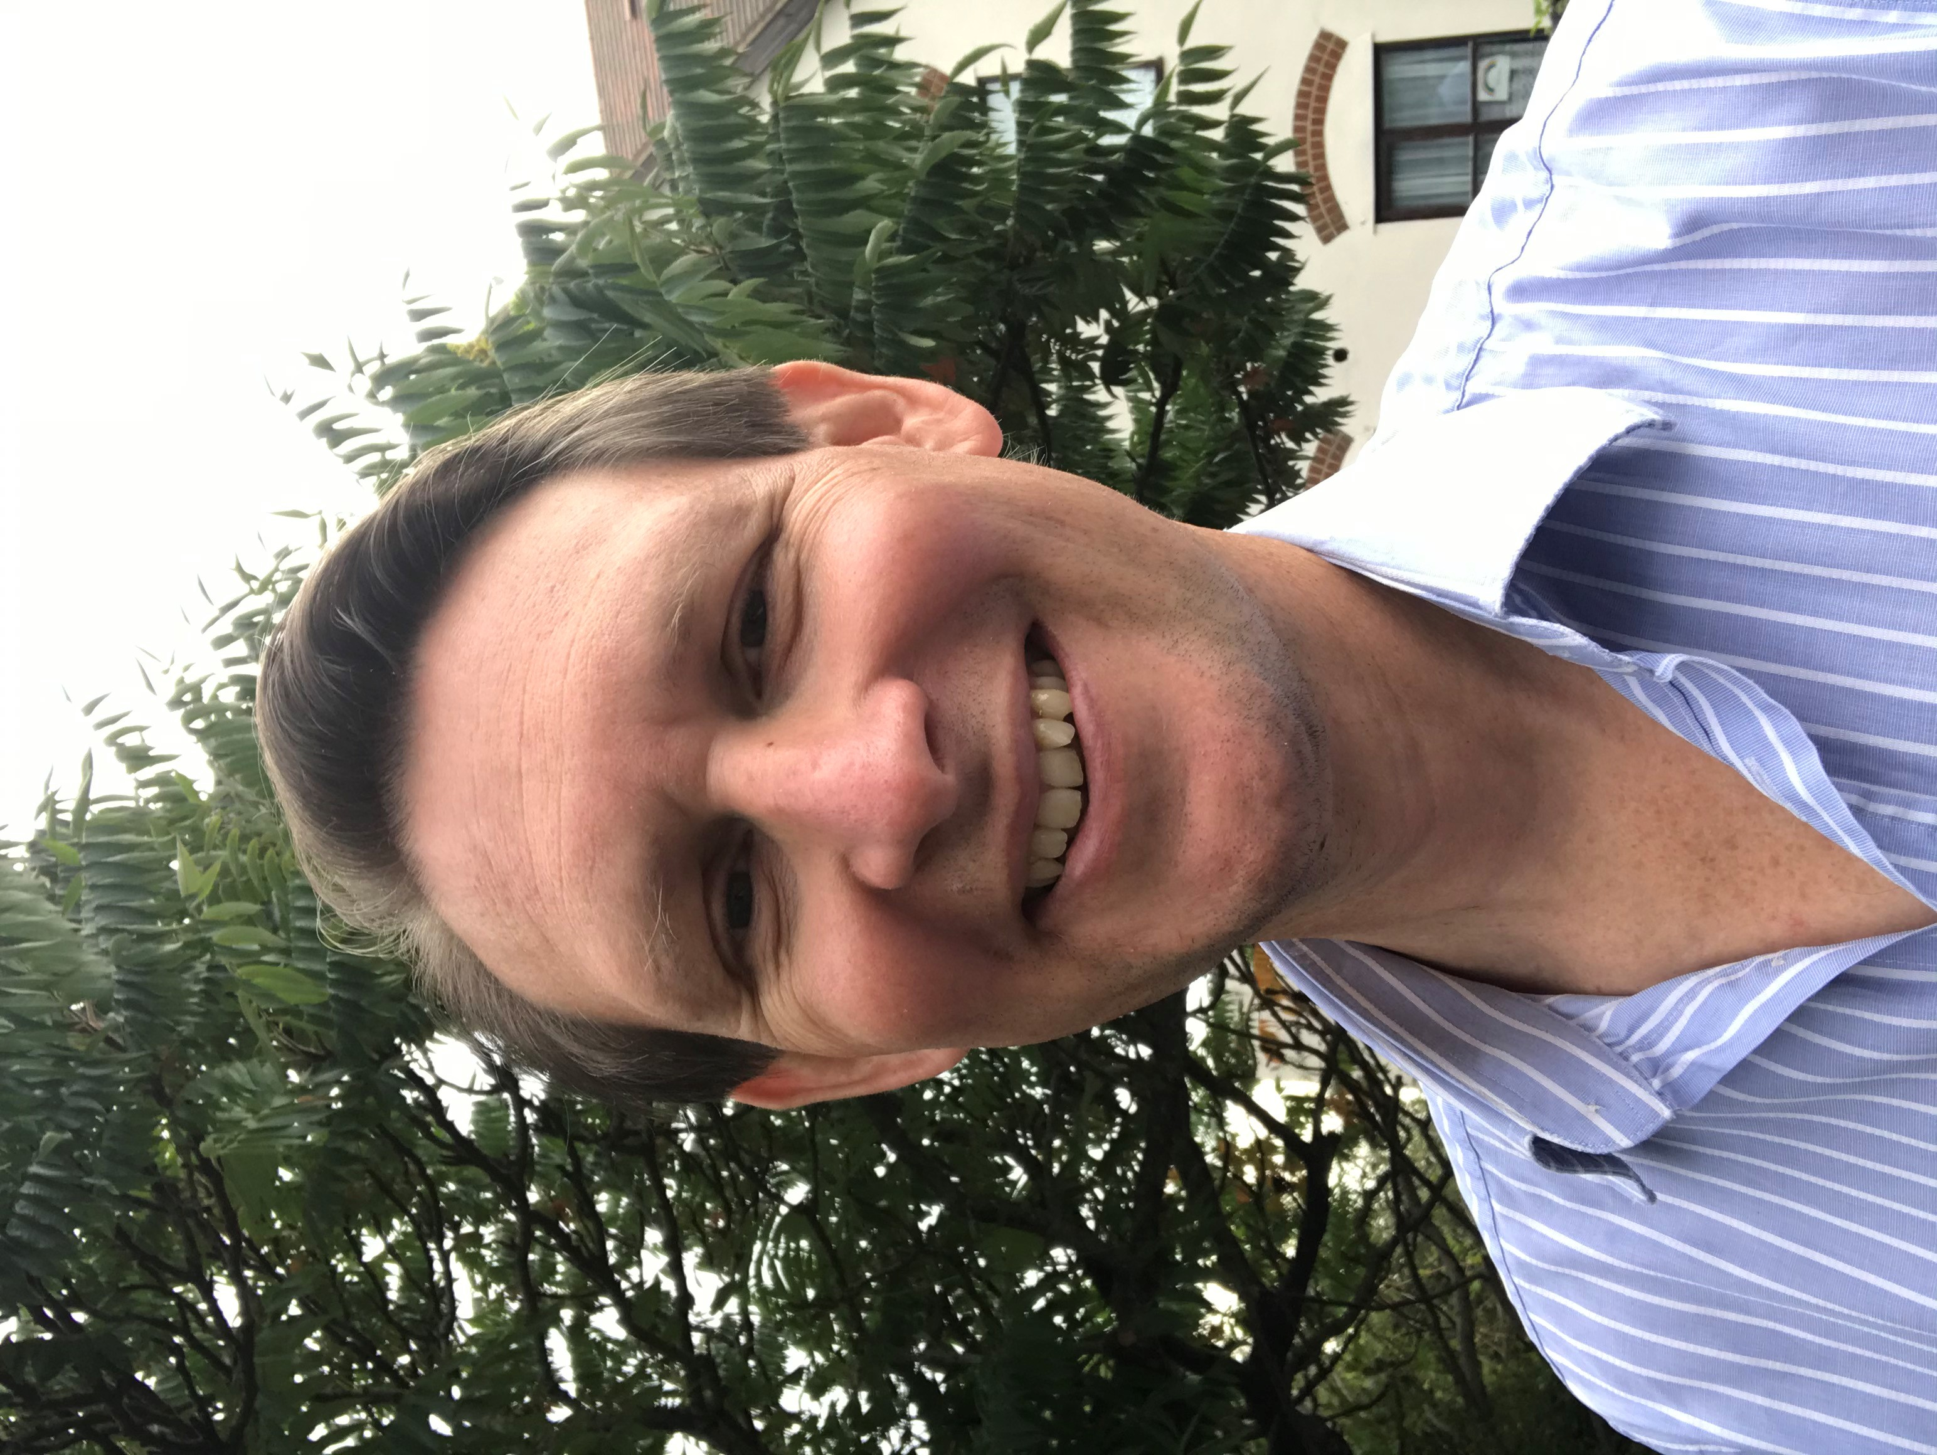
Q & A Panel
Aileen Buckton - Chair
London ADASS
Chelle Farnan- Presenter/Panel member
Named Professional Safeguarding Adults and MCA Lead
NELFT NHS Foundation Trust
Chris Lee - Presenter/Panel member
Care Quality Manager
HC-One
Michael Fullerton - Presenter/Panel member
Director of Health and Wellbeing
Achieve Together
Ezra Kanyimo – Presenter/Panel member
Enhanced Health in Care Homes Lead- London Region
NHS England and Improvement
Laura Cook ​- Panel member​
Clinical Programme Lead
Dementia and EOLC Clinical Networks
NHS England and Improvement
Jemma Sharples - Panel member​
Learning Disability Nurse Advisor
London Region
NHS England and Improvement
Mike Armstrong ​- Panel member​
EHCH Lead Provider- London/ Managing Director
Havering Care Homes
Briony Sloper – Panel member​
Out of Hospital cell lead
London Covid-19 Response Team
NHS England & NHS Improvement

Slide 44
FAQs
 | Question | Answer
1 | A lot of managers are asking why is this so different from other years on Flu, Vaccine programmes, homes are asking why is it more heightened than other years to do more on MCA, BI Dols to what we normally do ? | The application MCA and DoLS has not changed but this year’s context and complexity has made the issue more heightened than before.
2 | Please expand on the Liberty Protection Safeguards. | Please see links below for more information on Liberty Protection Safeguards Liberty Protection Safeguards: overview of the process - GOV.UK (www.gov.uk) Newsletter with more information from DHSC https://dhsc-mail.co.uk/campaign/Sx1iaZDJ/DvX7lRcTZ/442f6438333711eb8a8c801844f00118?wp-linkindex=0&utm_campaign=LPS_newsletter_&utm_content=dhsc-mail.co.uk&utm_medium=email&utm_source=Department_of_Health_and_Social_Care
3 | For a client with acquired traumatic brain injury, does the best interest decision taken under an urgent DoLS extend to financial matters such as taking away alcohol bottles from their room or taking away cash so they can no longer buy alcohol? | DoLS does not authorise care and treatment – it authorises the deprivation of liberty in order to receive care and treatment. All care and treatment decisions need to be taken under Section 5 of the Mental Capacity Act 2005 if there isn’t a Lasting Power of Attorney for Health and Well-being or a Court of Protection appointed Deputy.
4 | In one of the of DoLS application form, under what restriction the person is restricted, should we put Covid19 testing as part of restriction when they don’t have capacity but the LPoA signed consent on their behalf? | See above
5 | In terms of legal framework (NOK has LPoA) what am I bound to in intervening a resident swab wherein the person has no capacity, but the NOK signed best interest decision but the person still refuses to have the test done? With people with dementia, they are unable to consent most of the time, this upset them and we are unable to isolate them because they wander around. In this situation, what is best to do? Our particular GP always advices us to get consent for vaccinations from the N.O.K, knowing that the family do not all have LPA's | NoK cannot sign if not LPA/Deputy There is a dementia slide on the care home resource pack which has information on walking with purpose and useful resources Some top tips for getting a COVID swab in people with dementia: http://www.yhscn.nhs.uk/media/PDFs/mhdn/Dementia/Covid%2019/Top%20Tips%20Getting%20a%20COVID%20Swab%20from%20people%20with%20dementia.pdf
6 | In relation to the question regarding consent for Covid-19 vaccine would we need to involve social workers in the decision? Or just GP, staff and NOK | Who is involved in a best interest decision depends who is involved in the person’s life
7 | I have a resident who due to her mental health will not tolerate and has refuse swabbing. How do we manage this? Also if needed to Isolate due to showing symptoms, she will not comply ,could you advise on how this can be managed? | Engagement and person centred approach; Seek to understand the reasoning for refusal, and the person’s capacity to understand the benefits whilst supporting to enhance mental health stability; seek support from NHS Community Mental Health Services, and advice from the local Health Protection Team regarding difficulties with self isolation. Supporting residents symptomatic/asymptomatic and without relevant mental capacity: https://www.gov.uk/government/publications/coronavirus-covid-19-admission-and-care-of-people-in-care-homes/coronavirus-covid-19-admission-and-care-of-people-in-care-homes#section-2
8 | Is vaccination going to be rolled out to all care homes? | We are currently waiting for more information on this and we will let you know as soon as we receive this

Slide 45
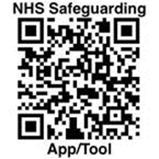
Resources
The green book Guidance for administering vaccines
Care Homes Resource pack
SCIE MCA Directory
Advance Care Planning
Guidance on the use of MCA for decisions regarding clinical treatment and care
Care Homes winter readiness webinar recording and slides
National Mental Capacity forum
NHS safeguarding app

Slide 46
Next steps
Connect with others on the Future NHS platform: Enhanced health in care homes Email: England.carehomes@nhs.net NHS Safeguarding Workspace Email: ENGLAND.safeguarding@nhs.net
For all general queries, email england.londonehchprogramme@nhs.net

