Slide 1
Self Harm in Sutton
Dr Laura Stokes,
Consultant Clinical Psychologist, SWL St Georges
James Holden
Commissioning Manager, Sutton CCG, (Slide Development)
Notes:
JH

Slide 2
Self Harm Trend
Since 2001, higher rates of self harm in girls than boys – 37.4 per 10000 compared with 12.3 in boys
More than a fifth of 14yo girls in the UK have self harmed
Sutton:
Has a population of approximately 205,900 people, a quarter are aged 19 years or younger.
The population of children and young people (aged 0 to 19 years) is expected to increase by 10%.
This increase is higher than London (7%) and England (5%).
Notes:
SC

Slide 3
Key issues in Sutton
1%
2%
3%
5%
1710
5%
6%
6%
8%
943
10%
11%
11%
1013
12%
159
13%
276
14%
14%
16%
17%
19%
25%
26%
40%
53%
Healthwatch Sutton Survey
Notes:
JH

Slide 4
Sutton Self Harm
There is was high incidence of CYP attending A and E for self-harm in Sutton
Notes:
SC

Slide 5
Suggested factors
The rate of presentation to A&E is not linked to the estimated rate of mental health issues in children and young people, so other factors must be involved.
Suggested factors that may be determining the higher rate of presentation for self-harm in Sutton include:
1) Barriers – real or perceived against usage of community services so that presentation is much later and in crisis
2) Differences in pathways and referrer perception of risk, for example, young people are directed towards hospital based services and admission rather than community services.
3) Social and educational pressures in the borough e.g grammar schools?
Notes:
SC

Slide 6
Improvements
Increased capacity of SPA – commissioning investment
Promoted duty system – accessible to schools / GPs
Implemented Urgent 5 day appointment system
Increased robustness of duty protocol for safeguarding
Risk management via telephone – book into urgent
Increased access to services. Access rate for 18/19 of 38% ensuring more able to access CAMHS.
Notes:
JH

Slide 7
Self Harm Nurse
Implemented as of 8th May 2018
Provide advice, assessment and treatment to the borough of Sutton. The role also consists of delivering training to social care, supervision to school nursing team and offering self-harm surgeries to schools.
To offer treatment and intervention to young people and families
Short term intervention, safety planning / emotion regulation
Notes:
SC

Slide 8
Feedback
“To really think about self harm with my young people and be more inquisitive and not be afraid to ask questions” – School Nurse
“I feel things would have been more of a struggle if we did not have this support in place”
“I liked that (therapist name) listened to my problems and didn’t judge on how I dealt with them.”
“I was so grateful for this service it has made a difference and I’m not sure what could of happened without it”
“The unpacking of the cause and the effects gave me a better understanding of my toll in finding solutions”
Notes:
SC

Slide 9
Self Harm Protocol
The protocol is a MA strategic document, to strengthen partnership working when responding to self-harm. It relates to all professionals and volunteers working with children and young people (0 – 18). Aims to:
Support agencies to manage self-harm as it arises;
Improving the response on presentation, disclosure, or suspected signs of self-harm
Assessing suicidal thoughts / knowing when to escalate
Helpful to education colleagues
Notes:
SC

Slide 10
Achievements so far
Transformation programme: self-referral counselling, Online self-referral counselling, drop in services.
Planning for difficult times from the data: Manchester Report findings + peak referrals prior to exams.
Identified exam stress as a major cause
Multi agency working to create prevention leaflets with the voluntary sector – distributed through high schools to all pupils
Increased capacity of drop in services during exam time so young people could easily access services

Slide 11
Achievements so far
A 40% decrease in children and young people presenting to A&E with self-harm in 17/18 compared to 16/17.
Notes:
JH

Slide 12
Future priorities
Deliver an increased support offer to schools to support emotional resilience of pupils and promote mental health understanding of staff.
Build on the reduction in the number of children attending hospital with incidents of self-harm with a continued target of 25% reduction from the baseline
Deliver operating plan access target
Increase capacity of the CBT pathway to decrease waiting times for this service
Strengthen the transition pathway between CAMHS and adult services.
Notes:
JH

Slide 13
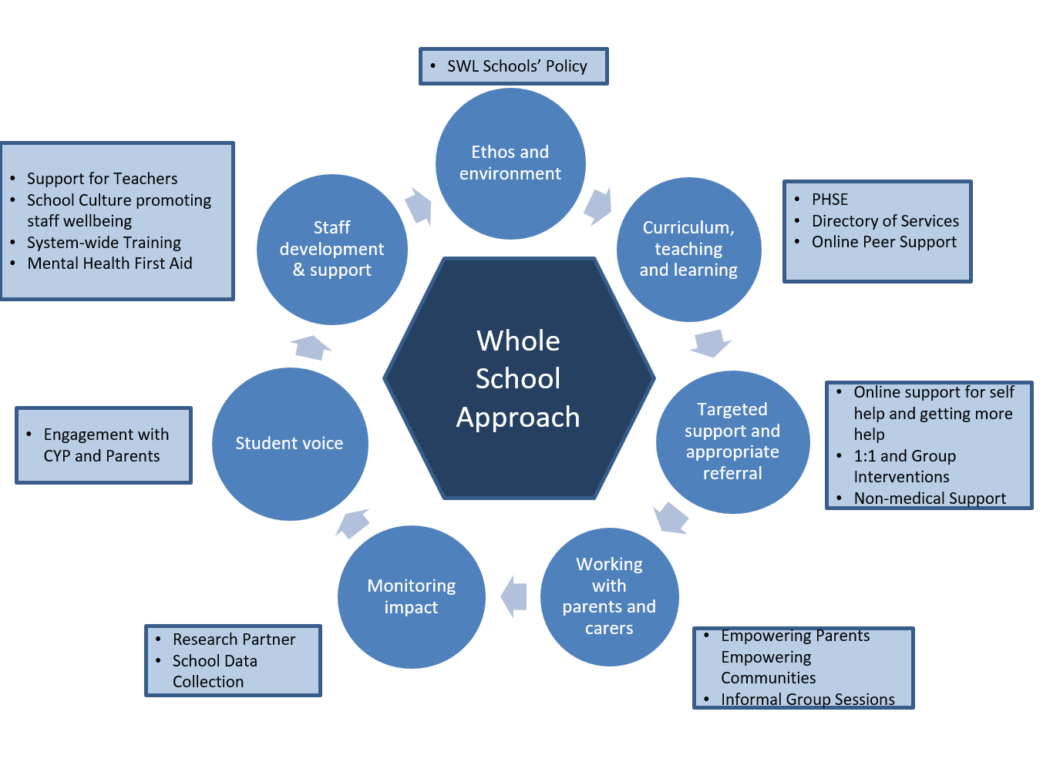
Prevention - Mental Health Support in Schools
Notes:
JH

Slide 14
Any Questions?

