Slide 1
South West London Cancer Inequalities snapshot
TCST 8.10.19

Slide 2
Picture of the SWL population

Slide 3
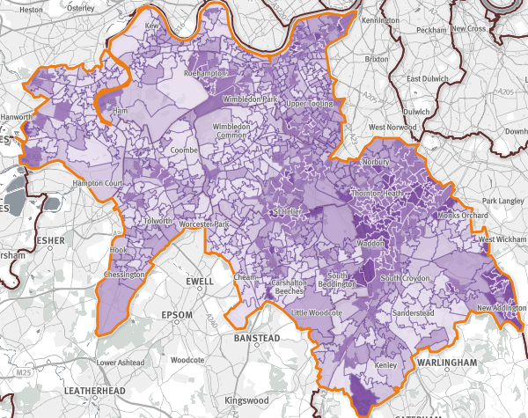
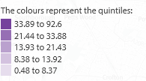
Picture of SW London
1.5m people
Levels of ethnic diversity vary across SWL : 21% BME in Sutton, 39% in Merton and highest at 45% in Croydon
Areas of significant deprivation: Croydon most deprived CCG in SWL (rank 91 out of 326 England LA), next is Wandsworth (rank 147th). There are pockets of deprivation across SWL in every borough. Croydon one of London’s fastest growing boroughs (second only to Barnet in NCL)¹
Prisons and IRC: HMP Wandsworth holds 1700 men; Lunar House Immigration asylum screening centre, Croydon, where people go to register for asylum². Non-residential short term holding facility – approx. 1200 detentions per year, average 5 hours before transfer to another facility
Drugs and alcohol: opiate and crack users estimated at 6285 in SWL using 2016-17 data (highest number in Croydon n=1933 people)
People with severe and enduring mental illness (SMI): Estimated 14,000 people with SMI amongst GP registered population (1%)
Street homeless persons on CHAIN: n=494 in SWL with highest number in Croydon (n=105)
© Crown copyright and database rights 201 Ordnance Survey 100016969
Source: SHAPE https://shapeatlas.net/place/
Notes:
1 https://www.croydonobservatory.org/population/
2 https://www.gov.uk/asylum-screening-centre
London datastore for CHAIN count –2016-17 numbers https://files.datapress.com/london/dataset/chain-reports/2017-06-30T09:03:07.84/Greater%20London%20full%202016-17.pdf
http://www.northlondonpartners.org.uk/downloads/plans/NCL-Case-for-Change-September-2016.pdf
Population mobility - between mid 2011 and mid 2012. churn estimates: http://www.ourhealthiersel.nhs.uk/about/case-for-change/local-needs.htm

Slide 4
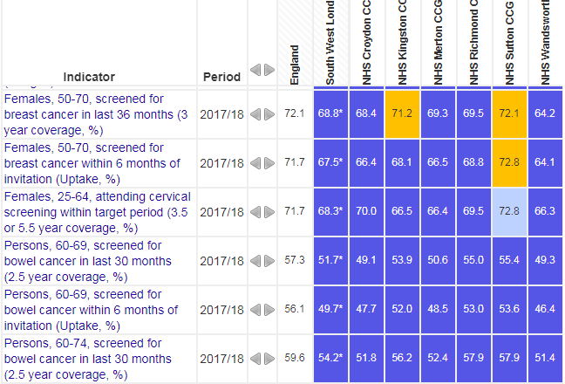
Cancer incidence: risk factors and screening, SWL
Prevalence of modifiable risk factors is not significantly higher than for England in SWL
If we had to focus on groups who are under-using screening services (BME populations, deprived groups):
Largest BME populations are in Croydon at 45% and 39% in Merton
For deprivation we’d focus on Croydon and Wandsworth
Cancer screening coverage in SWL CCGs is below England across all screening programmes, apart from in Sutton where cervical screening is above average
Notes:
Phof deprivation - ?? What is this showing

Slide 5
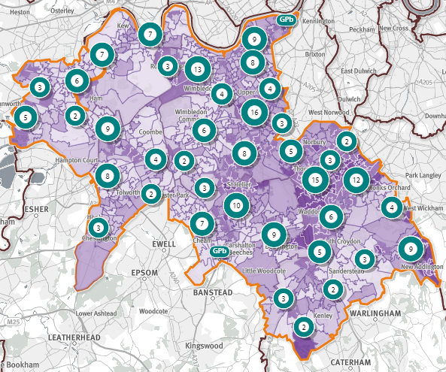
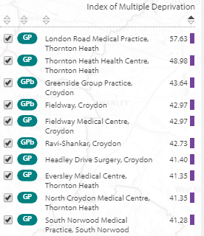
Where would we focus primary and community care efforts for cancer in SWL?
Where is the deprivation?
Which top GPs working in most deprived areas would we focus our efforts on in SWL?
All are in Croydon
Notes:
https://shapeatlas.net/place/E54000028#11/51.6135/-0.1222/l-w18/b-07M,b-07R,b-07X,b-08D,b-08H/sc-pc,s-200/o-d,d/it-all,is-deprivation:,ii-deprivation_2015_IMD/rh-0,rdr-t

Slide 6
Physical health checks for people with severe and enduring mental illness (SMI) - SWL
Physical health checks for people with SMI are a good opportunity in primary care, to address cancer risks such as smoking and alcohol consumption. We can see that the lowest coverage is in Croydon (5%) and the highest is in Kingston (43%).

Slide 7
Cancer mortality SWL
Cancer mortality is decreasing gradually overall since 2001.
The picture is similar for men and women separately.

Slide 8
Summary – SWL population and cancer prevention
If we needed to target deprivation in order to improve cancer screening activity, we’d focus on Wandsworth. To reach BME and Muslim communities we would focus on Croydon and Merton
For key locations to include in STP inequalities plans –include inpatient mental health beds at SWL StG and also HMP Wandsworth
For physical health checks in people with SMI – Croydon has the lowest coverage at 5% of people having checks in primary care

Slide 9
Early diagnosis of cancer in SWL

Slide 10
Early diagnosis content
Screening and deprivation
Stage at diagnosis
Emergency presentations for cancer
One year survival

Slide 11
Early diagnosis - cancer screening and deprivation in SWL
Breast cancer
There is no relationship between CCG deprivation and screening coverage.
The highest coverage is in Sutton (72%) and lowest coverage is in Wandsworth (64%)
Cervical cancer
No relationship between deprivation and screening coverage
The highest coverage is in Sutton (73%) and lowest coverage is in Wandsworth (18%)
Bowel cancer
No relationship between screening coverage and CCG deprivation.
The highest coverage in Richmond and Sutton (58%), the lowest coverage is in Wandsworth (51%)
Notes:
https://fingertips.phe.org.uk/profile/cancerservices

Slide 12
Early diagnosis - Stage of cancer diagnosis in SWL
Data of staged tumours diagnosed between 2012-2017 show that:
A higher proportion of women are diagnosed early at stages 1 & 2 than men
Older people tend to have their cancer at a later stage than younger people
A higher proportion of white people in SWL are diagnosed at a late stage (stages 3 & 4) than amongst other ethnicities
The proportion of Stage 1 or 2 diagnoses for cancer decreases with increasing deprivation (see figure)
Note: unadjusted proportions do not take account of differences in case-mix (e.g. tumour site)
Data for this analysis is based on patient-level information collected by the NHS, as part of the care and support of cancer patients. The data is collated, maintained and quality assured by the National Cancer Registration and Analysis Service, which is part of Public Health England (PHE). http://ncin.org.uk/local_cancer_intelligence/tcst
Notes:
Data from the National Cancer Registration and Analysis Service in PHE were used.
Malignant tumours (C00-C97 excluding C44) diagnosed between 2012-2017 were included
Stage at diagnosis was defined in line with published annual statistics in ‘Stage breakdown by CCG 2017’ http://ncin.org.uk/publications/survival_by_stage

Slide 13
Early diagnosis - Stage at diagnosis SWL
There are differences between CCGs in the proportion of cancers diagnosed early at Stage 1 and 2 (range: 53-56%*)
All SWL boroughs have higher proportion of cancers diagnosed at Stages 1 & 2 than England
The CCG with the lowest proportion of cancers diagnosed early is Sutton (53%).
https://www.cancerdata.nhs.uk/stage_at_diagnoses ; *Includes un-staged tumours in denominator

Slide 14
Early diagnosis - Routes to diagnosis emergency presentations SWL
Data on cancers diagnosed 2012-2016 in SWL showed that:
A higher proportion of men have their cancer diagnosed through emergency presentation (22% vs 20%)
The proportion of cancers diagnosed through emergency presentation was higher with age >75
Those of white and mixed or other ethnicities were more likely to be diagnosed through emergency presentation (22%)
Emergency route to cancer diagnosis increased with increasing deprivation (see figure)
Note: unadjusted proportions do not take account of differences in case-mix (e.g. tumour site)
Data for this analysis is based on patient-level information collected by the NHS, as part of the care and support of cancer patients. The data is collated, maintained and quality assured by the National Cancer Registration and Analysis Service, which is part of Public Health England (PHE). http://ncin.org.uk/local_cancer_intelligence/tcst
Notes:
Data from the National Cancer Registration and Analysis Service in PHE were used.
Malignant tumours (C00-C97 excluding C44) diagnosed between 2012-2016 were included
Routes to diagnosis: http://ncin.org.uk/publications/routes_to_diagnosis

Slide 15
Early diagnosis – cancer diagnosed as an emergency in SWL CCGs
There are differences between CCGs in the proportion of cancers diagnosed through emergency presentation (range: 14-18%)
All SWL boroughs have a lower proportion of cancers diagnosed as an emergency than England
The CCG with the lowest rate of emergency presentations is Croydon (14%). The CCG with the highest proportion of emergency presentations is Wandsworth (18%).
Emergency Presentation by CCG: http://ncin.org.uk/cancer_type_and_topic_specific_work/topic_specific_work/cancer_outcome_metrics

Slide 16
Early diagnosis - Breast cancer in SWL: 1 year survival in 2016
One year breast cancer survival is significantly lower in Croydon (96%) than the SWL average (97%).
1-year survival estimates (%) for breast cancer, by calendar year of diagnosis: all adults (aged 15 to 99 years), Clinical Commissioning Groups 2016
Notes:
https://www.ons.gov.uk/peoplepopulationandcommunity/healthandsocialcare/conditionsanddiseases/bulletins/indexofcancersurvivalforclinicalcommissioninggroupsinengland/adultsdiagnosed2001to2016andfollowedupto2017
Table 16: 1-year survival estimates (%) for breast, colorectal, and lung cancer, by calendar year of diagnosis: all adults (aged 15 to 99 years), Clinical Commissioning Groups, Sustainability and Transformation Partnerships, Cancer Alliances, England, 2001 to 2016, including confidence intervals

Slide 17
Early diagnosis - Colorectal cancer in SWL – 1 year survival
One year colorectal cancer survival is significantly lower in Sutton (79%) than its neighbour Merton, but is not significantly different to the SWL average (82%)

Slide 18
Early diagnosis - 1 year lung cancer survival SWL 2016
1 year lung cancer survival is significantly worse in Sutton than the rest of SWL at 43%.

Slide 19
Summary – Early diagnosis of cancer in SWL
Wandsworth has the lowest screening coverage across all three cancer screening programmes
Sutton has the lowest proportion of cancers diagnosed at Stage 1 or 2, although all are higher than the England average of 52%
The highest proportion of cancers diagnosed as an emergency are found in Wandsworth and Richmond
1year breast cancer survival is significantly worse in Croydon than the SWL average
1 year colorectal cancer survival in Sutton is significantly worse than its neighbour, Merton
1 year lung cancer survival in Sutton is significantly worse than the SWL average

Slide 20
Cancer treatment in SWL

Slide 21
Outcomes for treatment for certain cancers
There are no data specifically on mortality from cancer operations for each hospital trust
However, there are data for different cancer types, which we can use to reflect on certain clinical outcomes:
Breast cancer
For Breast cancer, we used the NABCOP data on breast conserving surgery versus mastectomies for two groups - women aged 50-69 years and then women aged 70+ years
Breast cancer – we also looked at the proportion of women having a clinical nurse specialist CNS
Colorectal cancer
Colorectal cancer from 2018 NBOCA 90 day survival & 2 year survival https://www.nboca.org.uk/content/uploads/2018/12/NBOCA-annual-report2018.pdf
Lung cancer LCCPOP
https://www.rcplondon.ac.uk/projects/outputs/lung-cancer-clinical-outcomes-publication-2018-audit-period-2016
These data sources look at the 30 and 90 day survival data
As well as 1 year survival and length of stay in hospital

Slide 22
Breast cancer in older women – type of surgery
The NABCOP audit 2019 shows that the type of surgery used for older women varies between trusts. Use of breast conserving surgery was highest in Croydon and lowest in Kingston for 50-69yo. For women over 70+ years, BCS was highest SGH.
Rates of mastectomy were highest Kingston for 50-69 yo and Croydon for 70+. Note that these figures do not take patient choice, comorbidity or others factors into account.

Slide 23
Breast cancer - having a named cancer nurse specialist (CNS) in West London
There was variation in having a CNS for younger age women (50-69yo) this was highest in Croydon and Kingston (100%) and lowest at Chelwest with only 67% of women having this support. For older women, the lowest percentage with a CNS was 56% at Chelwest. Please note that these are 2017 data so situation may have changed.

Slide 24
Time from referral to treatment by sex or ethnicity
For tumours diagnosed 2014-2017 on an urgent referral (62 day) pathway for suspected cancer in SWL:
Men were more likely to have longer pathways from referral to treatment than women
People of black ethnicity were more likely to have longer pathways from referral to treatment
Note: unadjusted proportions do not take account of differences in case-mix (e.g. tumour site)
Data for this analysis is based on patient-level information collected by the NHS, as part of the care and support of cancer patients. The data is collated, maintained and quality assured by the National Cancer Registration and Analysis Service, which is part of Public Health England (PHE). http://ncin.org.uk/local_cancer_intelligence/tcst
Notes:
Data from the National Cancer Waiting Times Monitoring Dataset, linked to National Cancer Registrations data, was used
Patients diagnosed with a malignant tumour (C00-C97 excluding C44) 2014-2017 and recorded as being on a 62 day pathway were included
Adjustments were made to waiting times in line with CWT guidance

Slide 25
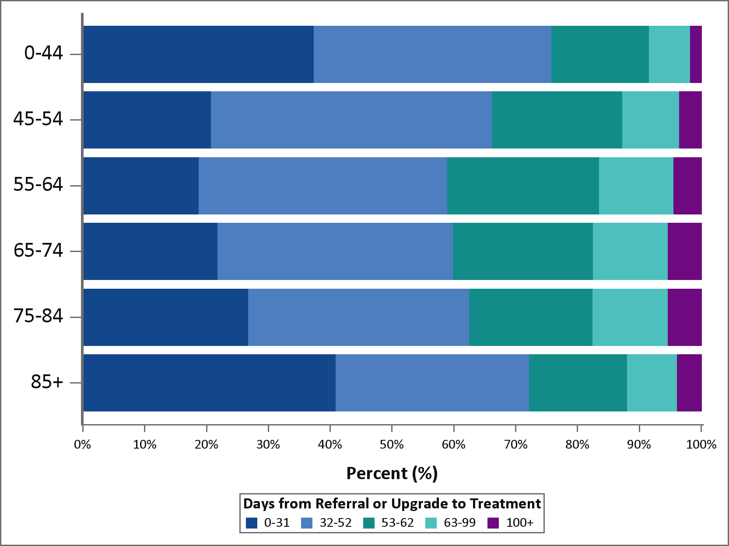
Time from referral to treatment by age or deprivation
For tumours diagnosed 2014-2017 on an urgent referral pathway for suspected cancer:
The oldest (85+) and youngest (0-44) age groups were more likely to have a fewer number of days to treatment than those age groups in between.
Those who were more deprived were more likely to have longer pathways from referral to treatment.
Note: unadjusted proportions do not take account of differences in case-mix (e.g. tumour site)
Data for this analysis is based on patient-level information collected by the NHS, as part of the care and support of cancer patients. The data is collated, maintained and quality assured by the National Cancer Registration and Analysis Service, which is part of Public Health England (PHE). http://ncin.org.uk/local_cancer_intelligence/tcst
Notes:
Data from the National Cancer Waiting Times Monitoring Dataset, linked to National Cancer Registrations data, was used
Patients diagnosed with a malignant tumour (C00-C97 excluding C44) 2014-2017 and recorded as being on a 62 day pathway were included
Adjustments were made to waiting times in line with CWT guidance

Slide 26
Summary – cancer treatment SWL
Use of breast conserving surgery (BCS) varies between trusts. Highest use of BCS is in Croydon and lowest in Kingston for 50-69yo. For 70+, this was highest SGH, and lower in others.
In West London there is variation in having a CNS for younger aged women (50-69yo), and lowest at Chelsea & Westminster. For older women, there was also variation with the lowest coverage at 56% in Chelsea & Westminster.
Women more likely to have fewer number of days from referral to treatment than men. Those of black ethnicity are more likely to have more days to treatment than other ethnicities

Slide 27
Personalised care for cancer SWL

Slide 28
Personalised care – comorbidities SWL
Measuring comorbidity is a good way to understand the complexity of medical needs faced by cancer patients. The Charlson score indicates a burden of comorbidity (combining number of conditions, risk of mortality and/or resource use) where patients with no comorbidities have a zero score and an increasing burden of comorbidity is represented by a higher score. A study of prevalent cases in London & W Essex from 2007-14 showed little differences in comorbidity between different STPs
Across London, comorbidity increases with age, as we would expect: 12% cancer patients overall have comorbidity; 6% of under 60s to 25% of over 80s
The proportion of patients with comorbidities also increases with increasing deprivation. The most deprived groups in Kingston and Merton have the highest proportion comorbidities - this may relate to older age of the population.
Comorbidity at diagnosis for those living with cancer in London: http://ncin.org.uk/local_cancer_intelligence/tcst

Slide 29
Personalised care – household bills arrears GLA data 2018-19
Recent data from the GLA survey highlight the London assembly areas with highest levels of people living with household bills arrears.
For STPs, this might help target support services, and should prompt hospital services to think about debt with patients in particular areas.
For SWL we would focus on Croydon & Sutton, where a high % of people have household bills arrears
Notes:
https://s3-eu-west-1.amazonaws.com/londondatastore-upload/postcode_sectors_combined_2011_A4_v2ii.png

Slide 30
Personalised care – psycho-oncology
Psycho-oncology is a ‘multi-disciplinary speciality focusing on the psychological and mental health care of people affected by cancer, carers and families, contributing through direct and indirect care to improving clinical outcomes, patient experience and quality of life’ (The Psychological impact of cancer: commissioning recommendations, pathway and service specifications on psychosocial support for adults affected by cancer. TCST May 2018)
There is access to Psychological support for cancer patients at each of London’s acute trusts except for:
Epsom St Helier Hospital*
* in discussions April 2019

Slide 31
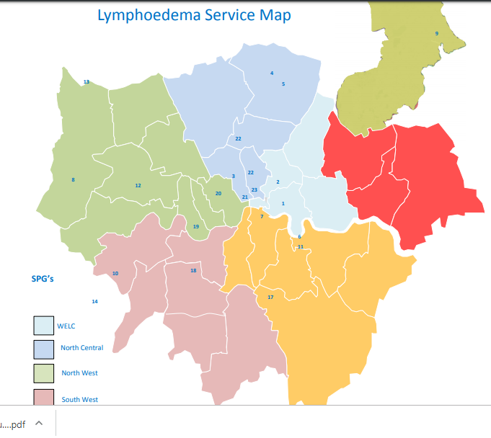
Personalised care – lymphoedema services SWL
Service Mapping by TCST 2016
Using estimates of 1.33 persons with Lymphoedema per 1000 population (cancer and non cancer) we would expect 2000 people living with lymphoedema in SWL
Gaps in service SWL:
Croydon
Notes:
file:///C:/Users/lannik/Downloads/Commissioning%20guidance%20lymphoedema%20August%202016%20(1).pdf

Slide 32
Summary personalised care SWL
Co-morbidity in cancer patients in SWL is highest in deprived groups in Kingston and Merton
High levels of household debt in Croydon and Sutton
There are gaps in psycho-oncology in ESTH although discussions are currently underway
Croydon has a gap in lymphoedema services

Slide 33
All the work we do with our partners moves us closer towards our goal to make London the healthiest global city.
www.healthylondon.org
england.healthylondon@nhs.net
@healthyLDN

