Slide 1
Myth-Busting The Flu

Slide 2
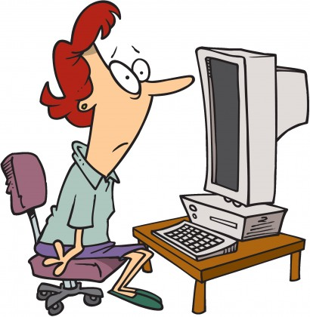
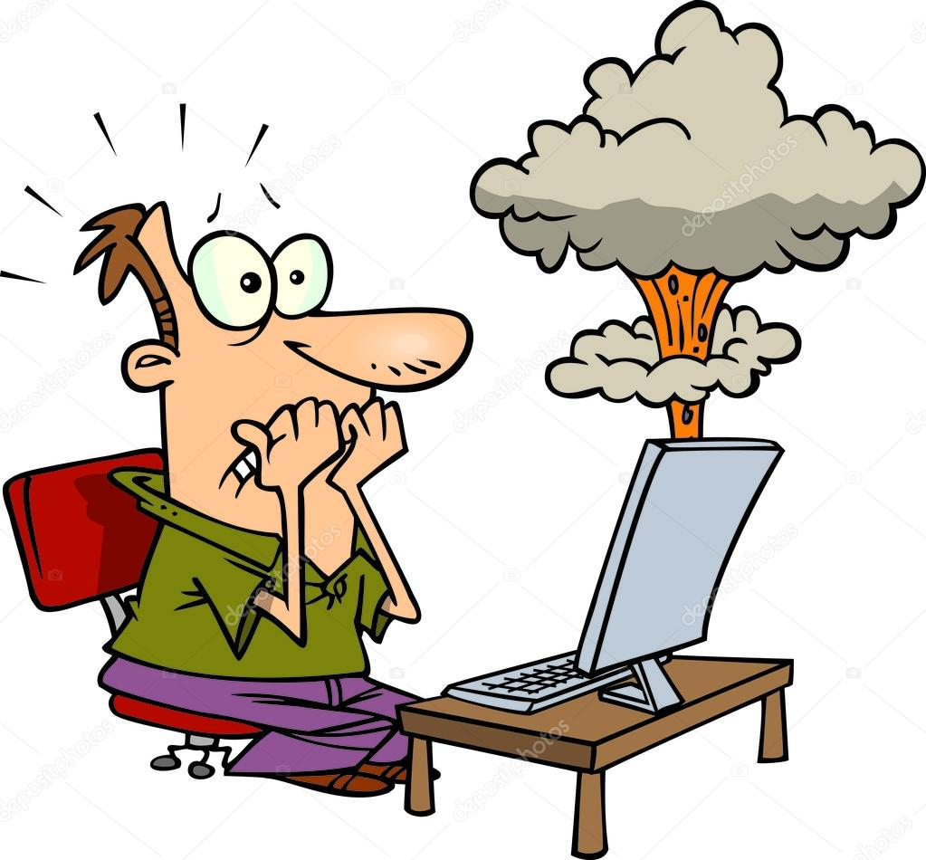
Webinar Tips
Please put your speaker on mute
You can asking questions via the chat box
Slides will be circulated
There will be time for questions at the end

Slide 3
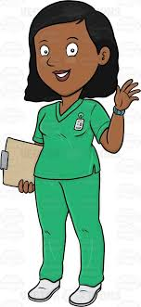
Content
Thank you
Myth-busting Flu vaccination

Slide 4
Thank You all !
This is a thank you from North Central London – for all you did during Covid 19 and continue to do. You make the lives of the residents and families across NCL richer, safer, fun and meaningful.

Slide 5
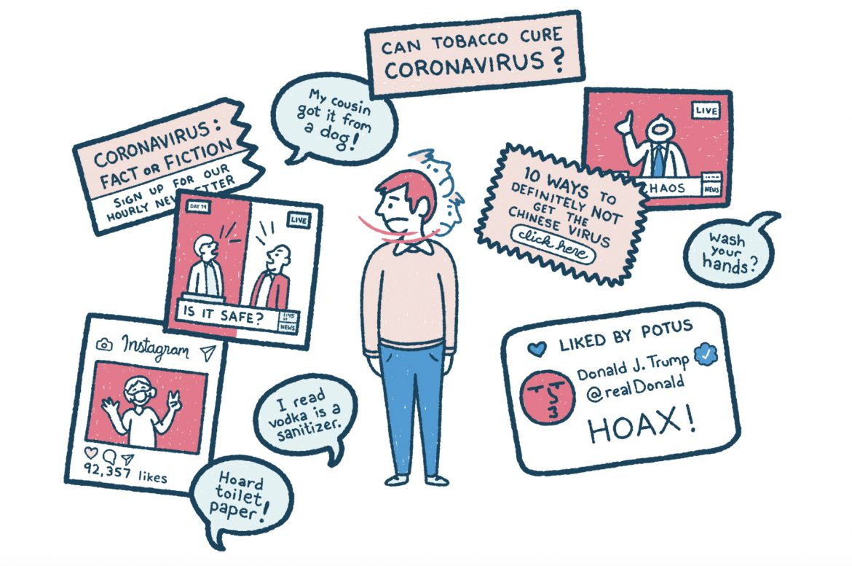
Myths and Social Media

Slide 6
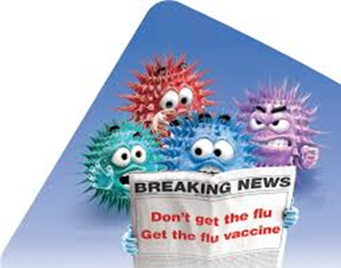
What is Flu Facts did you know?
The word "influenza" was used for the first time in English in 1703.
People with a compromised immune system are over 50 times more likely than a healthy person to die from flu.
Flu is very infectious and easily spread to other people. You're more likely to give it to others in the first 5 days.
Flu is spread by germs from coughs and sneezes, which can live on hands and surfaces for 24 hours.

Slide 7
Myth Number 1 Influenza is not serious so I don’t need the vaccine
FACT:
As many as 650 000 people a year can die of the flu. This only represents respiratory deaths, so the likely impact is even higher. Even healthy people can get the flu, but especially people whose immune systems are vulnerable. Most people will recover within a few weeks, but some can develop complications including sinus and ear infections, pneumonia, heart or brain inflammations.

Slide 8
Myth Number 2 The Flu Vaccine can give me flu FACT: The injected flu vaccine contains an inactivated virus that cannot give you influenza. If you feel achy or slightly feverish, it is a normal reaction of the immune system to the vaccine, and generally lasts only a day or two.

Slide 9
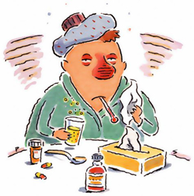
Myth Number 3: The flu vaccine can cause severe side effects
Fact:
The flu vaccine is proven to be safe. Severe side effects are extremely rare. One in a million people may get Guillain-Barré Syndrome (GBS), which cause muscle weakness and paralysis.

Slide 10
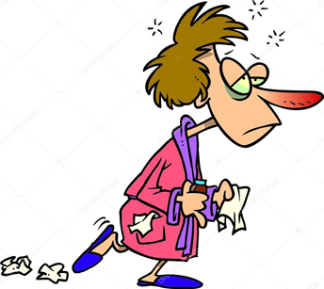
Fact: Several flu viruses are circulating all the time, which is why people may still get the flu despite being vaccinated since the vaccine is specific to one strain. However, being vaccinated improves the chance of being protected from the flu. This is especially important to stop the virus affecting people with vulnerable immune systems both in you work place and at home.
Myth Number 4:
I had the vaccine and still got the flu, so it doesn’t work

Slide 11
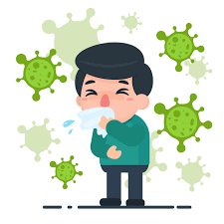
Myth Number 5 Its already too late if you’ve had the flu this year? FACT
While it is better to have the flu vaccine as soon as it becomes available, it’s always worth getting vaccinated before the end of the flu season (March). As there are usually several flu viruses circulating each year, you could go on to catch another strain.

Slide 12
WHY NOT BE A NCL FLU HERO THIS YEAR?
Get your flu jab and protect yourself, your loved ones and those you care for from a virus which you can spread even without symptoms and which kills 11,000 people in this country alone each year:

Slide 13
Thank You Any Questions? https://www.nhs.uk/conditions/vaccinations/flu-influenza-vaccine/ https://campaignresources.phe.gov.uk/resources/campaigns/34-public-flu-vaccination-campaign/resources https://www.who.int/emergencies/diseases/novel-coronavirus-2019/advice-for-public/myth-busters https://www.youtube.com/watch?v=9nS6U88e7zs

