Slide 1
Enhanced Health in Care Homes
London Winter Readiness 2020/21
Care Provider Webinar
Wednesday 23 September, 1400-1500
Presented by NHS London and Public Health England

Slide 2
A collective approach to planning for winter
The London Enhanced Health in Care Homes (EHCH) programme team have been working together with ADASS, Public Health England, Sustainable Transformation Partnership (STP) teams, Clinical Commissioning Groups (CCGs) and Local Authorities (LA) to support care providers across London.
The London EHCH programme provides information and resources to help facilitate a winter planning partnership between social care and health care providers; with the aim to deliver collective system wide resilience for London.
To help raise awareness of the resources available we have planned 2 commissioner focused webinars and 2 care provider webinars – all these resources will be recorded and available to access via the Healthy London Partnership website or Enhanced Health in Care Homes FutureNHS page.
You can use the information shared to complement existing resources for your care providers locally.
Our vision
2

Slide 3
What are we intending to cover today?
01-EHCH framework and London EHCH Network governance
02-Flu Outbreak SOP for London
03-Flu Vaccinations for Care Homes 2020/21
04-Prevention & resources
05-Clinical support for care homes
06-Sharing good practice and questions
An opportunity to share your approach, discuss your challenges and highlight any further topics that we may not have covered

Slide 4
EHCH framework and London EHCH Network Governance
Notes:
An overview of this years Flu Campaign and Vaccinations for Social Care Workers

Slide 5

Enhanced Health in Care Homes framework v2.0 published as Implementation Guidance March 2020
The Enhanced Health in Care Homes framework sets out the top nationally agreed priorities for supporting the health of care home residents
The most recent version of the framework, displayed on this slide, was published in March 2020
Within the framework, the items in red represent new or additional national priorities
Care element | Sub-element
1. Enhanced primary care support | Each care home aligned to a named PCN
 | Medicine reviews
 | Hydration and nutrition support
 | Oral health care
 | Access to out-of-hours/ urgent care when needed
2. Multi-disciplinary team (MDT) support including coordinated health and social care | Expert advice and care for those with the most complex needs
 | Continence promotion and management
 | Flu prevention and management
 | Wound care – leg and foot ulcers
 | Helping professionals, carers and individuals with needs navigate the health and care system
3. Falls prevention, reablement and rehabilitation including strength and balance | Rehabilitation/ reablement services
 | Falls, strength & balance
 | Developing community assets to support resilience and independence
4. High quality palliative and end-of-life care, Mental Health and dementia care | Palliative and end-of-life care
 | Mental health care
 | Dementia care
5. Joined-up commissioning and collaboration between health and social care | Co-production with providers and networked care homes
 | Shared contractual mechanisms to promote integration (including Continuing Healthcare)
 | Access to appropriate housing options
6. Workforce development | Training and development for social care provider staff
 | Joint workforce planning across all sectors
7. Data, IT and technology | Linked health and social care sets
 | Access to the care record and secure email
 | Better use of technology in care homes

Slide 6
Enhanced Health in Care Homes additional, and changing priorities
COVID-19 changed our plans
Immediate priorities became:
Revised 2020/21 priorities
Support to systems to develop and run their weekly care home rounds
Rapid roll out of NHSMail (currently approx. 75% of care homes)
Capacity Tracker 98% coverage
Recognition of hypoxia in elderly not being detected early & deployment of pulse oximeters
Digital agenda
Wider roll out of training and support to care homes on recognising and managing the deteriorating person
Foundation dentists national pilot
Quality Improvement focus from Ageing Well and Patient Safety Collaborative
Going forward, some national priorities will change for Enhanced Health in Care Homes

Slide 7
Flu Vaccinations for Care Homes – plans for London

Slide 8
Flu
Flu affects 5-15% of the worldwide population every year
It usually causes mild illness in healthy people but it can cause severe complications like pneumonia
Each year, Flu kills 11,000 people and care homes are disproportionally affected
Anyone can contract influenza and being healthy does not protect against infection.
For those at high risk of developing complications from influenza, infection can result in a deterioration of the chronic condition, hospitalisation or even death.
Risk groups commonly include elderly persons (age 65 and above), persons with long-term medical conditions (asthma, diabetes, or heart disease) and pregnant.
Flu can make chronic conditions like diabetes worse - People with diabetes are 3 times more likely to be hospitalised
Best protection is the flu vaccine, it’s easily administered and takes 2 weeks to provide protection
Influenza viruses have a great capacity to mutate and change so a new vaccine is made every year to protect against the current strains.

Slide 9
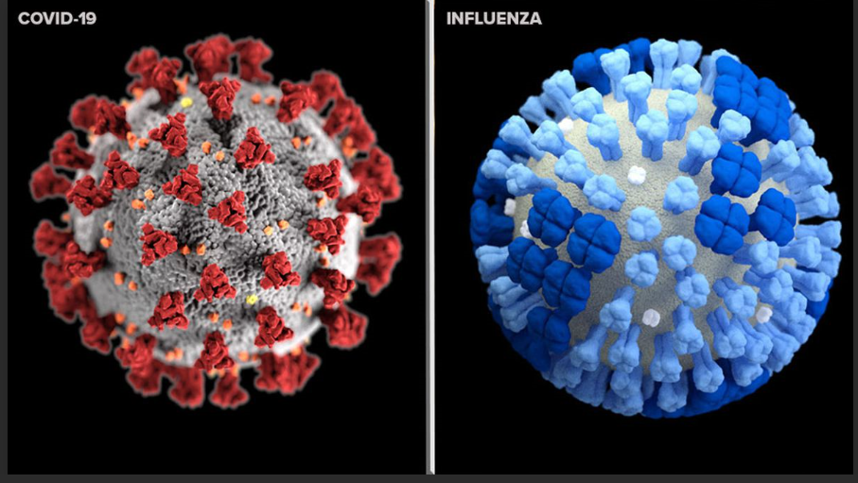
COVID-19 and Influenza Winter 2020
  COVID-19 can co-occur with other viral infections.
  COVID-19 transmission may spike in the early autumn.
  Co-circulation with influenza and RSV may not be an issue until November-December and then there is a risk of a heavier burden on health services.
  The same non-pharmaceutical interventions such as infection prevention and control work for COVID-19 and influenza, so keep up the good work with these!
  Influenza vaccine should be given to reduce the likelihood of co-infection and to reduce burden of influenza on health services.
  Care homes are vulnerable to both viruses.

Slide 10
How influenza vaccine works
Influenza vaccines against seasonal influenza take advantage of the adaptive immune system by exposing the body before the seasonal influenza epidemic starts, through vaccination with viruses in an inactivated or weakened form or their relevant components.
Instead of suffering the natural virus infection and risking its consequences, vaccines induce immune and memory responses similar to those of the natural virus infections.
This results in immunity towards the influenza viruses that are expected to circulate in the following seasons.
The influenza vaccine can reduce the chances of getting the flu by 70%-90% in healthy adults, which not only protects you, but those that you love, work with, and care for.

Slide 11
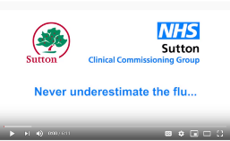
Why should I be vaccinated?
“A care home can be a centre for infection to flourish!”
There were 2,751 flu outbreaks in care homes in 2019/20, around 70% of all outbreaks in England. However, less than a third of eligible care home staff were vaccinated for flu last winter. In 2017 a care home in Sutton experienced a flu outbreak in their home. This short film based on true events, shows the impact of the flu outbreak to staff and residents at the home.
With the circulation of coronavirus, this year’s flu vaccination is more important than ever. The largest ever flu vaccination programme is being planned.
The flu vaccine is an extension of the PPE you have been using to protect yourself and others
By vaccinating staff, you are protecting the people you look after. You are interrupting the spread of flu by not passing flu onto the people in your care.
By getting vaccinated you are also helping your co-workers by not being off sick – which can increase their workload. They will be doing the same for you.
By getting vaccinated you are reducing the risk of flu outbreaks in the care home.
By getting vaccinated, you are also protecting yourself and your family from flu and the possibility of co-infection with COVID-19
The protective measures we all take against flu, by getting vaccinated, are as important for protecting ourselves, our loved ones and those we care for, as wearing PPE is for protecting against COVID-19

Slide 12
Get the flu vaccination, stay well and protect the NHS – Frequently Asked Questions (1)
Some people have concerns about getting a flu vaccination. Here are some helpful discussion points you can use:
Is the flu vaccination safe? The flu vaccination is safe and effective and must be given annually. It cannot give you the flu. It does not protect you from COVID-19 or seasonal coughs and colds, but it does give protection against the strains of flu virus that will be circulating this year. Adults usually receive the flu vaccination in injection form, and children usually receive a nasal spray.
When can I get the flu vaccination? We expect that the flu vaccination will be available from autumn 2020 onwards. You will be invited to book a vaccination appointment at around this time, but please contact your GP practice if not. It’s important that you have your vaccination as soon as possible.
Where can I get the flu vaccination? Many people will receive their flu vaccination at a GP surgery as usual. Others may go to a pharmacy or another location in their community. School-aged children will receive their vaccination from a trained health professional at school or in their community. Health professionals will also vaccinate care home staff and residents on-site.
Is it safe to attend appointments at health clinics? The NHS is doing everything it can to make sure that vaccinations are given in safe environments. All possible precautions will be to taken to make sure you, and staff, are protected. If you have COVID-19 symptoms, do not attend your vaccination appointment but instead self-isolate and book a coronavirus test at nhs.uk/coronavirus or by calling 119. You can rebook your flu vaccination appointment at a later date.
How will I know if I have the flu or COVID-19? The flu virus and COVID-19 have symptoms which overlap, such a high temperature or persistent cough. It may be difficult to tell which virus you have. For this reason, it’s really important that you have a flu vaccination if you are eligible, and that you continue to follow the guidance on self-isolation and testing at nhs.uk/coronavirus if you have any of the symptoms of COVID-19.
GOV.UK have published a leaflet explaining the importance of the flu vaccination this winter, and Easy Read guides to flu vaccination for people with a learning disability.

Slide 13
Get the flu vaccination, stay well and protect the NHS – Frequently Asked Questions (2)
Some people have concerns about getting a flu vaccination. Here are some helpful discussion points you can use:
Can you catch flu from the vaccine? The vaccine contains an inactivated virus which cannot give you flu.
Does the flu vaccine cause serious side effects? Only one in a million people get serious side effects. Mild side effects such as soreness around the injection site and aching muscles are more common, but these are far less serious than the effects of contracting flu.
Is flu is just like having a bad cold? Flu is a very serious illness which kills 11,000 people a year and hospitalises many more. It can lead to severe complications including pneumonia and organ failure.
I’ve been vaccinated before so do I need to do it again? The flu virus mutates constantly, and the vaccine is updated every year to counter the latest strains so it is important to get vaccinated annually.
I’m healthy. Do I need to get vaccinated? Flu can cause serious illness or death in healthy people. Getting vaccinated reduces your chance of catching flu by 40-60%.
I’m pregnant. Should I get vaccinated? The flu vaccine is safe at any stage of pregnancy, and is recommended for all pregnant women as they face a higher risk of developing complications from flu.
GOV.UK have published a leaflet explaining the importance of the flu vaccination this winter, and Easy Read guides to flu vaccination for people with a learning disability.

Slide 14
London targets for care home flu immunisation
75% uptake for Care home residents
100% offer in Care home staff
The aim of the annual London plan is to increase uptake of influenza vaccination across the Care home residents and staff to achieve national ambitions and focus on:
  Increasing call/recall
  Building capacity within the system with new models of delivery
  Reducing health inequities and inequalities
  Broadening access to immunisation training
  Engaging stakeholders to champion immunisations and;
  Improving data management improvement (e.g. list cleansing, coding etc).

Slide 15


  Vaccinations: Care home residents
        Flu vaccine – to protect against Influenza
        Pneumococcal vaccine – to protect against invasive Pneumococcal disease
        Shingles vaccine – to protect against Shingles (recommended for those aged >70yrs)
      Each care home’s named GP will arrange the vaccinations for your residents. Care homes need to contact their named GP to make arrangements. Flu vaccinations can also be administered by Community Pharmacy
Have all residents been offered vaccinations this year?
Please ensure care home residents have been offered the following vaccines…
Who will provide the vaccinations for residents?

Slide 16

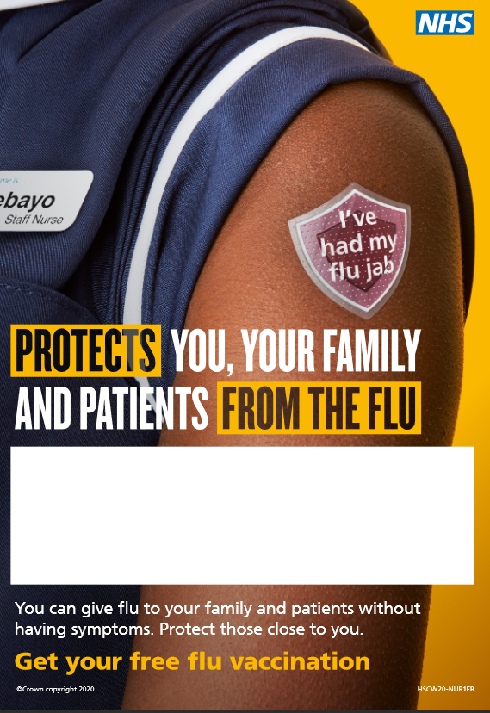
Care Home Flu Vaccine Campaign Toolkit
We encourage all NHS and social care settings to participate by using the branded campaign resources on the following pages, to encourage staff to get their flu vaccinations.
The branded campaign resources can be ordered or downloaded by registering for Public Health England’s Campaign Resource Centre. Its Health and Social Care Staff Flu Campaign Toolkit is free to access and contains a range of print and digital resources to suit your needs. It is easy to register here.
The following resources are available:
  Core messages
  Printed resources
  Digital and social media resources
  Digital and Social Media – example tweets and resources
  Promoting NHS 111 Star 6
  Get the flu vaccination, stay well and protect the NHS – FAQ and myth buster
CARE Social Care Assistant and Nurse editable posters, available in digital and printed formats

Slide 17
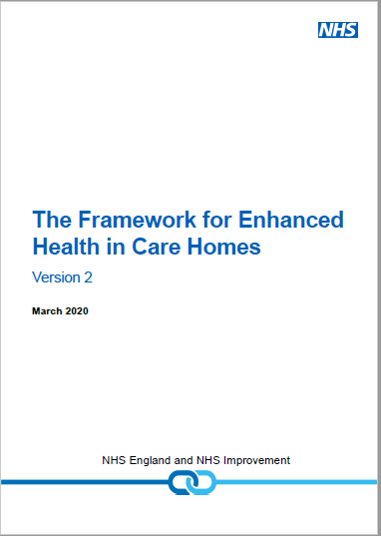
Care Home Flu Vaccine Campaign champions
EHCH Section 5.5.4. Best practice includes:
‘a. Each care home should identify a member of staff with the responsibility for running the flu immunisation campaign. The campaign should not only focus on staff and residents but on family members and visitors too (who may not routinely be vaccinated but could carry the virus unknowingly).
b. Record the number of staff with direct resident contact and the number receiving the flu vaccine so uptake can be measured.
c. Use resources such as posters, leaflets, and digital tools, which can be downloaded from the Public Health England Campaign Resource Centre. ‘

Slide 18
Flu vaccinations- care home staff and residents
All care home staff and residents can get a free flu vaccine under the national flu vaccination scheme.
All residents need to be vaccinated by November 2020
Health and social care staff can get vaccinated in their GP practice or in a community pharmacy in London
It’s a good idea to have both done together:
Pop up clinics by community pharmacies who can do all staff and residents on site
PCN arrangements for staff and residents
To ensure that this happens, there should be a named ‘flu lead who can:
Promote flu vaccination in the care homes
Keep records of the number of staff and residents needing flu vaccination and how many have received flu vaccination
Both of these actions will greatly reduce the risk of influenza outbreak in the home and in the event there was an outbreak of a respiratory virus, the information will help the outbreak response
Non- health care staff (e.g. cleaners) and agency staff can get vaccinated for free in community pharmacies
See www.myvaccinations.co.uk to find your local participating pharmacy and book your free flu vaccine appointment.
Have care home staff and residents been vaccinated?
How can staff and residents receive their vaccination?

Slide 19
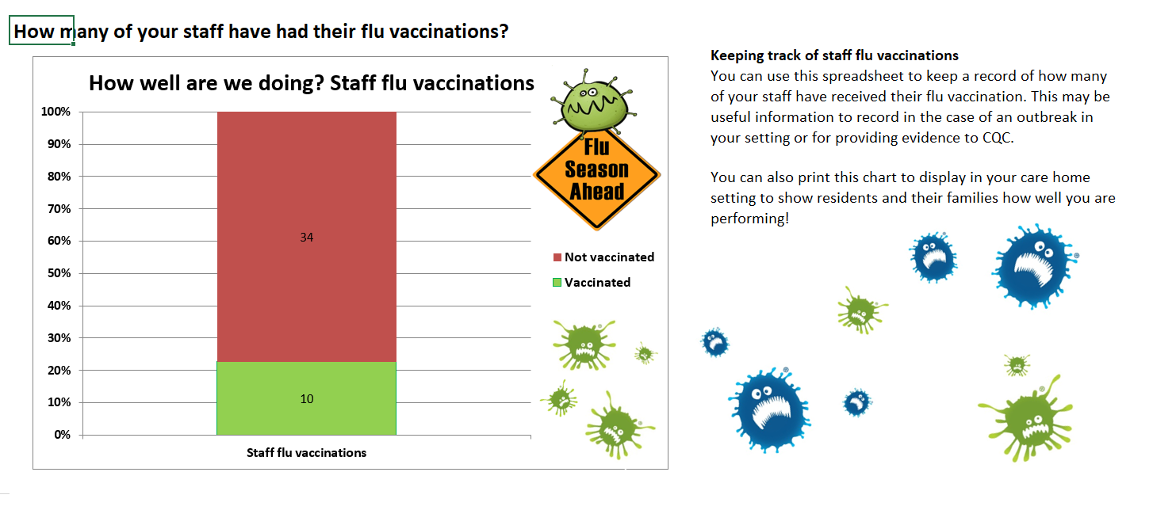
Collecting data for flu vaccinations – Local trackers
Locally collected data will enable you to feel confident that your care homes are preparing to prevent flu this year.
South West England have produced a vaccination tracker to keep a log of staff and residents flu vaccination.
This can be completed and managed by the care home and shared with CCG and Local Authorities as part of regular reporting.
Our vision
19

Slide 20
Managing Outbreaks
Notes:
An overview of this years Flu Campaign and Vaccinations for Social Care Workers

Slide 21
The London Influenza Standard Operating Procedure
What is a standard operating procedure?
Focused on improved safety and quality of care a standard operating procedure (SOP) is a set of step-by-step instructions compiled by an organisation to help support people to carry out complex routine operations. SOPs aim to achieve efficiency, quality output and uniformity of performance, while reducing miscommunication and increasing risk of harm to patients/residents.
Why have we introduced the London Influenza Standard Operating Procedure (SOP)?
Following several outbreaks of flu in care homes in 2017/18; a standard operating procedure (SOP) was developed to support care homes with responding to an outbreak, in collaboration with local health and social care providers and commissioners.
What does it contain?
It outlines the important roles and responsibilities for the following key stakeholders:
Care Home Registered Managers/staff
Resident’s registered GP/GP Practices/GP Out-of-Hour (OOH) services (OOH)/111Integrated Urgent Care (IUC)
Local Health Protection Teams (HPT)
NHS Clinical Commissioning Groups (CCG)
Community Providers
Essentially this guidance aims to ensure an effective and coordinated approach is taken across support services to manage risk assessments and outbreaks in a home.
Care homes will need to be made aware of the steps to follow and who to contact for support if needed – this is where our resources come in. The SOP can support all types of care homes: Nursing, Residential, Learning Disabilities, and Mental Health.
Our vision
21
Notes:
It is really important that everyone know what their role is during a suspected or confirmed outbreak. The SOP helps with this but ideally it would be great if you use this locally to ensure that across both care homes and health and care partners you all know what you can do to help.

Slide 22
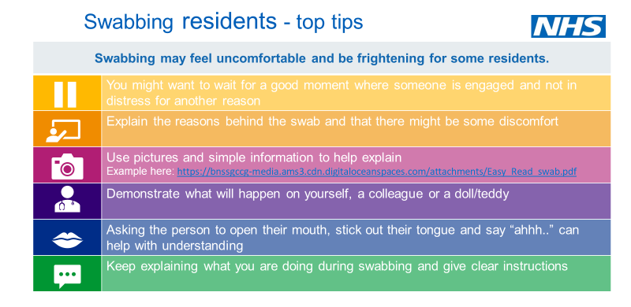
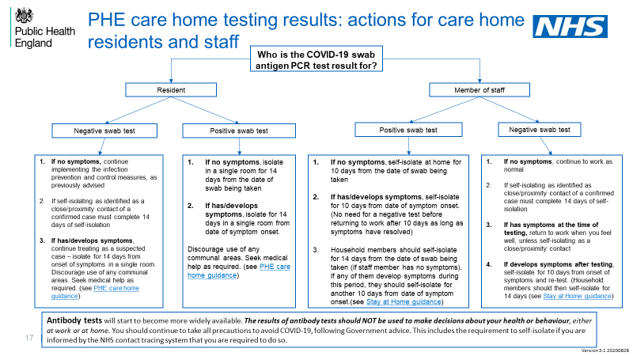
Testing and re-testing
Early testing to determine whether a resident or staff member’s symptoms are COVID-19 is vital to effective outbreak prevention and management, and should be guided by the Health Protection Team who should be informed immediately of any outbreak. Testing to determine whether an outbreak is due to seasonal flu or COVID-19 will permit appropriate administration of Tamiflu to treat, and as prophylaxis. At present, there is no evidence that Tamiflu is of use in treatment of or prophylaxis of COVID -19.
The London Care Homes Resource Pack contains slides with details of how to access testing for residents and staff, including how and when homes should contact the local Health Protection Team and PHE, and how they can help. There are tips on swabbing residents, assessing capacity for testing, and details on how test and trace impacts care homes.
You can access these slides here.
Our vision
22
Notes:
Highlight testing challenges. Resource pack has a number of slides to support care homes with this

Slide 23

Immediate actions to take if a flu outbreak occurs…
  Create a list with the GP, of residents you suspect have flu like symptoms (Highlight all residents who may require antiviral treatment). The list should include…
      Name ✓
      Date of birth ✓
      NHS Number ✓
  Create an additional list of residents who potentially require an antiviral (e.g.: patients with chronic underlying conditions who have not received a flu vaccination this season).
  Send information from both lists to your local Health Protection Team.
  Send prescriptions for residents who require anti-virals to your Community Pharmacy.
  Give residents oral anti-virals as soon as possible, if required, under the guidance of the GP.
  Contact your Local Authority if you need additional support with staffing resources during an outbreak.
Notes:
Create a list with the GP, of residents you suspect have flu like symptoms; send this information to your Local Health Protection Team. You will need to include the following information:
Names, dates of birth and NHS Numbers, highlight all residents who may require antiviral treatment;
Create an additional list of residents who potentially require an antiviral (e.g.: patients with chronic underlying conditions who have not received a flu vaccination this season).
Send prescriptions for residents who require anti-virals to your Community Pharmacy. Give residents oral anti-virals as soon as possible, if required, under the guidance of the GP.
Contact your Local Authority if you need additional support with staffing resources during an outbreak

Slide 24
Immediate actions to take if a flu outbreak occurs…
Step 1
If you have residents showing flu-like signs and symptoms contact your resident’s GP during practice hours or NHS 111 *star 6 for care homes to seek senior clinical advice and guidance on how to manage the clinical care of all symptomatic residents within the home.
Step 2
Contact your Local Health Protection team - PHE London Coronavirus Response Cell (LCRC) Tel 0300 030 0340 email lcrc@phe.gov.uk or phe.lcrc@nhs.net once you have spoken to a GP to inform them about the suspected outbreak.
Step 3: If urgent clinical support required
If you have contacted your residents GP but your resident is starting to deteriorate before their consultation (remote or face to face), contact NHS 111 *star 6 to speak to a GP or Senior Clinician for further advice.

Slide 25
Managing a suspected D&V outbreak – supporting clear processes
Notify the resident’s GP. If an infection is suspected, they may arrange for specimens to be sent to the laboratory
Notify the local Health Protection Team (HPT) if more than two cases, suspected or known to be infectious occur within a few days.
Isolate infected residents and exclude infected staff from work, until 48 hours after the symptoms have settled.
Infected residents should, if possible, have sole use of a designated toilet or commode as long as their symptoms persist.
Prepare information for visitors asking them not to visit if they have had symptoms of diarrhoea or vomiting within the previous 48 hours.
Notify the hospital about the possibility of infection if a resident needs a hospital assessment / admission.
Notify transporting ambulance staff about infection before the resident is collected.
When discharged from hospital within 48 hours of the last symptoms of diarrhoea and vomiting, a single room with a dedicated toilet and appropriate precautions should be provided until they are clear of symptoms for 48 hours
D&V / Norovirus is easily transmitted from one person to another, all key services should be notified if there is an outbreak. The virus can occur at any time of year, but most cases occur October- March.
Helping a care home team to respond to an outbreak is a really important aspect of our roles as health teams supporting care. Here we have a short checklist of steps that need to be taken by a care home in the event of an episode of D&V/Norovirus in their home.
Talking to your care home teams about this can help them prepare. Alongside the PHE guidance what other resources do you have that can support the care homes?
Our vision
25

Slide 26
Managing a suspected D&V outbreak – supporting clear processes
Cleaning regime
An enhanced cleaning regime needs to be carried out on the environment and equipment. A particular focus should be on toilet seats, door/toilet handles and sink taps.
Clean disposable cloths and washable mops should be used to clean frequently hand touched hard surfaces and should occur at least twice daily during an outbreak.
Hand washing with liquid soap and water is vital to minimise the spread of infection and should be actively promoted.
Alcohol hand rub is not effective at deactivating the viruses and bacteria that cause
diarrhoeal outbreaks.
Information on slides Managing a suspected D&V outbreak – supporting clear processes
has been taken from the Department of Health and Health Protection Agency guidance - Prevention and control of infection in care homes – an information resource
Our vision
26

Slide 27
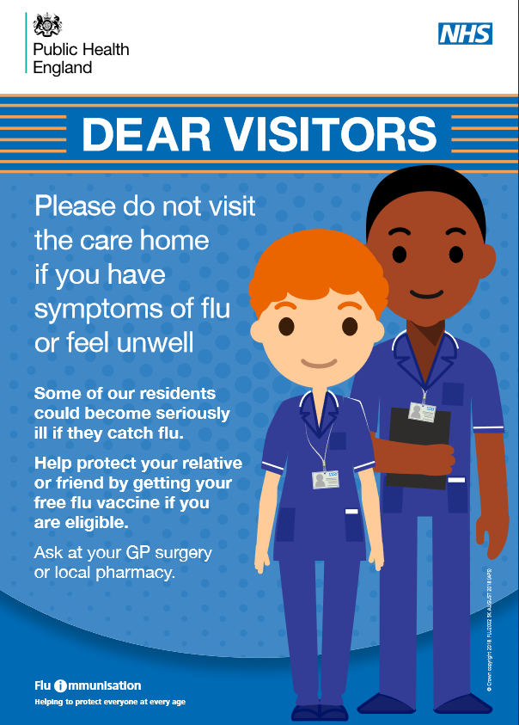
Enabling care home visits
The national care home visiting guidance can be found here. This is being reviewed regularly and may change at short notice.
Prior to visits being allowed in care homes in a local authority area, local authority public health and social care teams will assess the suitability of a specified level of visiting for that area taking into account relevant infection and growth rates – please speak with your local authority commissioning team.
Care homes need to develop a local policy based on a local risk assessment. This policy will need to be communicated/shared with residents and families so they know what to expect. Visiting restrictions will required if there is an outbreak in the home or a local lockdown. You will need to check where visitors are coming from e.g. area of high transmission. Prior to each visit check that each visitor does not have symptoms of COVID-19 and they are not self-isolating. Share poster with families advising them not to visit if they have flu symptoms or feel unwell.
The risks and benefits of visiting each resident need to be discussed with them and their families. Where possible there should be only one consistent visitor per resident. For some residents, such as people with dementia or a learning disability, allowing a family member to visit may reduce distress.
Top tips
Some residents may find social distancing difficult to understand or distressing – explain this to the resident and reassure them prior to and during the visit. Simple language, pictures or social stories may help
Create a visiting appointment system to ensure a manageable number of visitors (dependant on space and staffing) and ensure a record of visitors is kept. Check if the visitor is bringing a gift – wipeable gifts may be acceptable
Where possible visits should happen outdoors (with visitors going directly to the garden) or via a ground floor window. Relevant social distancing, PPE and infection control measures (e.g. wipeable chairs) will apply
If a indoor visit is required e.g. for end of life, visitors should provided with suitable PPE. Where possible use a separate entrance and exit, use a one way system and plan the most direct route to a residents room avoiding communal spaces.
Strongly encourage visitors to maintain social distancing wherever possible.
Resources:
Care Home Provider Alliance visitors protocol
British Geriatric Society care home guidance
MHA booklet on visiting a relative with dementia
National Autistic Society social stories to help someone understand the situation
NHS guidelines on visiting at the end of life
PHE poster on not visiting if unwell or with flu symptoms

Slide 28

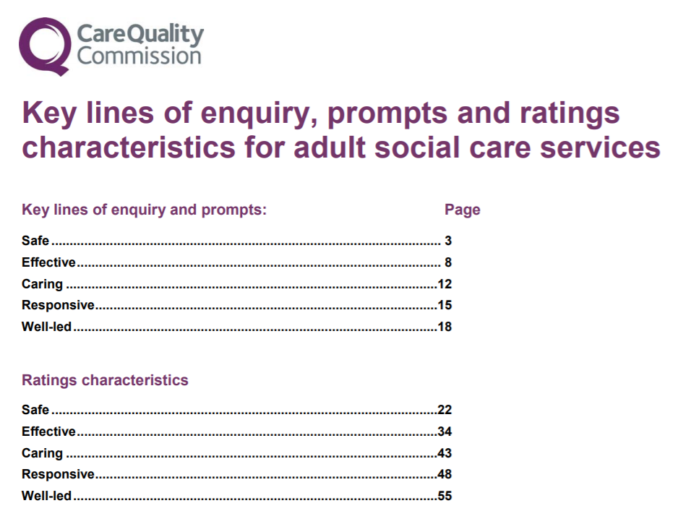
Making a note – the importance of record keeping and local governance
All parties are responsible for ensuring all documentation and communications regarding an outbreak are retained for audit purposes.
This should include…
Records of calls/emails to resident registered GP (In Hours) & GP OOHs via 111 *6, local HPT, local pharmacy and CCGs.
For care homes nursing documentation, this should be in line with the Nursing & Midwifery Council NMC code of conduct (section 10), ensuring that clear and accurate records are kept regarding care delivered to residents.
Health Care Professionals to also update the care home documentation, ensuring real time records are kept during the outbreak.
List of residents who were affected by the outbreak and treatment provided alongside further follow up should be maintained as per local policy.
The CQC KLOE expects good record keeping in line with their KLOE
.
Our vision
28
Notes:
Expectations from the CQC – supporting good record keeping
CQC inspection teams use the Key Lines of Enquiry (KLOEs) framework and prompts, where appropriate, to assess adult social care services
As part of best practice, we recommend Care Homes keep a record of all documentation and lessons learned to support routine CQC inspections.
CQC have updated the KLOE document and added new content to strengthen specific areas and reflect current practice.
The assessment frameworks for healthcare services and adult social care services, have been aligned as much as possible.

Slide 29
Clinical support for Care homes

Slide 30

Role of the Care Homes Clinical lead
PCNs are responsible for nominating the clinical leads. If the clinical lead is from a partner organisation (e.g. a community provider), the PCN still remains responsible for all aspects of the delivery of the EHCH service
The clinical lead:
  Is provided by a lead GP (or GPs)*
  Is responsible for ensuring that the EHCH service is delivered
  Provides oversight of the clinical service provided to care home residents
  Supports residents to access services in a timely way & link with other community service partners as part of a multidisciplinary care home team
  Supports the establishment of MDTs and weekly home rounds
  Help strengthen links between care homes and PCNs
The clinical lead is not medically responsible and accountable for the care of individual care home residents. The responsibility for the service delivery described in the DES lies with the PCN.
*The EHCH service specification states that this position must be held by ‘a lead GP (or GPs)’. The interim arrangements for Covid-19 simply required (any) named clinician. Although we expect that this role will continue to be held by a GP in the vast majority of cases, we know that some alternative models have been established through the Covid-19 response – for example where the position is held by another member of the practice team, or by staff in community trusts. The clinical lead may be a non-GP clinician with appropriate experience of working with care homes, provided this is agreed by the practices in the PCN, the CCG and the relevant community provider.
Notes:
PCNs are responsible for nominating the clinical leads and are accountable for the care of care home residents. But the clinical lead is responsible for ensuring the EHCH spec is delivered, providing oversight for the care delivered, supporting links between care home and services across the PCN, and supporting the establishment and running of the MDT meetings
The EHCH outlines that the Clinical Lead is expected to be a ‘Lead GP or GPs’ but we understand that local interim arrangements have been adopted during Covid
All STPs developing models locally, lots of guidance developed locally on pathways and operating models, Not all areas set up

Slide 31
Prevention & Resources

Slide 32
COVID-19 winter plan 2020 to 2021- ask for providers
Keep the needs and safety of the people they support & their staff at the forefront of all activities
Review and update their business continuity plans for the autumn and winter including workforce
Utilise funding available to implement infection prevention and control measures
Continue to provide data through the Capacity Tracker or other relevant data collection
or escalation routes
Continue to ensure that all relevant guidance is implemented and followed
Those who are ineligible to register for the portal (such as personal assistants) should contact their Local Authority
Proactively encourage & enable people who receive care and social care staff to receive free flu vaccinations & report uptake
Care home providers should develop a policy for limited visits (if appropriate), in line with up-to-date guidance
Care homes should adhere to guidance on regular testing for all staff and care home residents
All eligible care providers can register for and use the new PPE portal
To read the plans please click on the link
https://www.gov.uk/government/publications/adult-social-care-coronavirus-covid-19-winter-plan-2020-to-2021/adult-social-care-our-covid-19-winter-plan-2020-to-2021

Slide 33
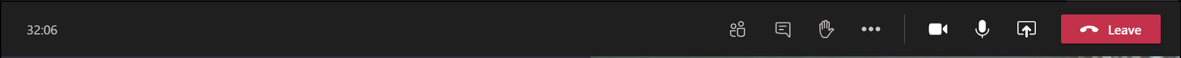
Resources to help you prepare for winter
The next slides will introduce key themes that your care home will need to address ahead of winter, and signpost to further resources that will help you to be prepared.
The topics that we will cover through the conversation:
Infection Prevention and Control
Personal Protective Equipment
Digital
Admission and Discharge
Are you concerned about
a resident
As we go through the session you can add questions to the chat function which will either be on the right hand side or to the top of your screen and one of the team will answer your questions.

Slide 34



London Care Homes Resource Pack
The London Care Homes Resource Pack was first developed by a cross-system working group across London to support care homes to manage challenging aspects of supporting the health of their residents and staff whilst reducing the risks of COVID-19. Much of the information is also of particular use to support the management of flu, and other winter pressures.
As well as some of the topics mentioned in this section, look out in particular for information on the following topics:
Testing residents and staff (COVID-19)
We’ve had positive feedback from a lot of providers saying the pack is helpful but we are still keen for more feedback let us know what you think!
Recognising signs of deterioration
Digital
End of Life
Care
Preventing pressure ulcers
Managing respiratory symptoms
Staff and Resident Wellbeing
MDT working
Falls
prevention
The London Care Homes Resource Pack is updated at regular intervals, to ensure that it remains up to date. It can be found on the Healthy London Partnership website here.

Slide 35




Infection Prevention and Control and PPE
Continue to follow the guidance on handwashing and social distancing, and on using PPE
Regular contact with staff, other residents, family and friends and the shared living space all mean infection can easily be passed around. It is therefore vital to take the steps that can help prevent infection occurring.
For people living in care homes, infections can be serious, and in some cases, life-threatening. They can also make existing medical conditions worse.
2. All staff should wear masks at all times until you take a break from duties (e.g to drink, eat, for your break time if outside of the home or at the end of your shift once leaving the home
3. You can download further guidance and resources to support you with preventing infection in your home via these resources:
Healthy London Partnership resource pages
Infection Control: Guidance
COVID-19 Personal protective equipment use for
non-aerosol generating procedures: Guidance
COVID-19 Personal protective equipment use for
aerosol generating procedures: Guidance
COVID-19 How to work safely in care homes: Guidance
Best practice - How to hand wash: Poster
Have you read the NICE ‘quick guide for managers and staff in care homes’ Helping to prevent infection?
Notes:
Key points:
Hand hygiene for staff, residents and visitors remain the cornerstone of Infection prevention and control
PPE; All staff should be wearing a mask when not on a break. Staff should know what PPE they need to use, when and where to use it and be able to support residents and visitors who need to wear PPE
Social distancing remain key , especially when staff are on breaks/not directly delivering care
Continue to check the National Guidance for updates https://www.gov.uk/government/publications/covid-19-how-to-work-safely-in-care-homes

Slide 36






Let’s get digital!
How are you communicating with your MDT colleagues across Health and Care?
NHSmail
MS Teams
Video Conferencing
Anything else?
What else is helping to support you to deliver care to your residents?
Pulse Oximeters
Thermometers
Remote Monitoring
Care Management Systems
eMARS
Coordinate My Care
How can you get more help?
Digital Social Care is a dedicated space to provide advice and support to the sector on technology and data protection.
Visit their website here
Notes:
Key points:
Hand hygiene for staff, residents and visitors remain the cornerstone of Infection prevention and control
PPE; All staff should be wearing a mask when not on a break. Staff should know what PPE they need to use, when and where to use it and be able to support residents and visitors who need to wear PPE
Social distancing remain key , especially when staff are on breaks/not directly delivering care
Continue to check the National Guidance for updates https://www.gov.uk/government/publications/covid-19-how-to-work-safely-in-care-homes

Slide 37

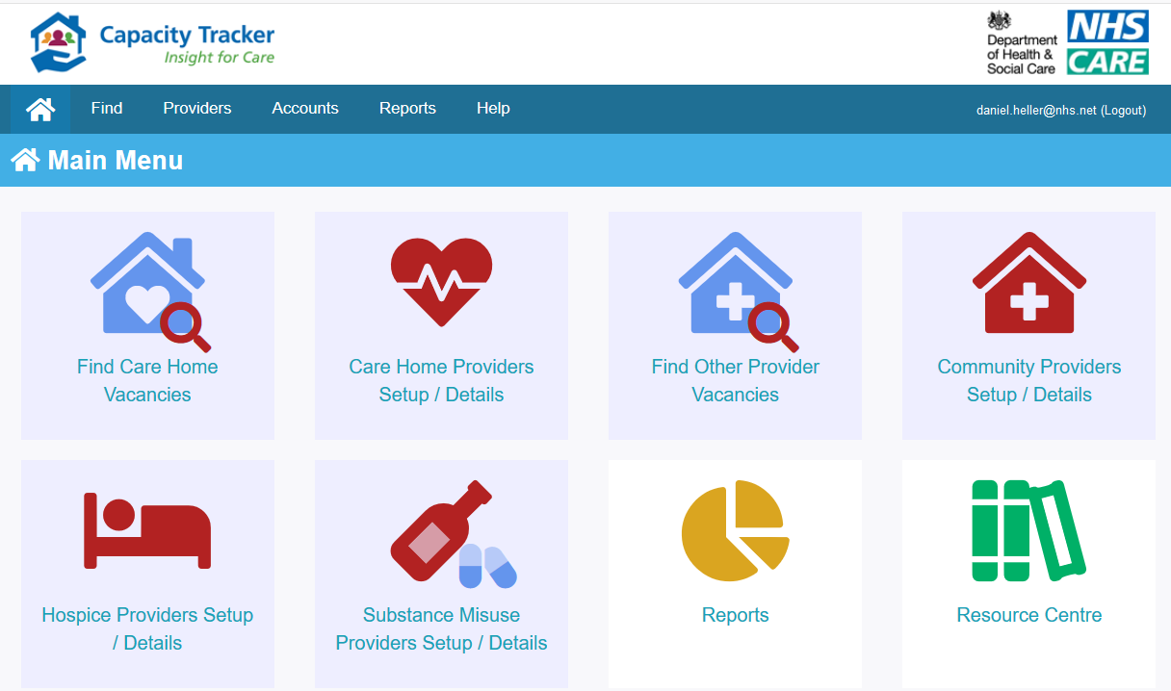

Capacity Tracker
Capacity Tracker is a secure online tool, developed nationally as the single way for care homes to report on key operational information during the COVID-19 outbreak response period.
The information you report allows health and social care partners in your area to understand the challenges you are experiencing, and support you with the right resources, in the right place, at the right time, to save lives.
1. Register
2. Update your bed vacancies and business continuity daily
3. Complete your infection control fund questions weekly
4. For support with Capacity Tracker,
contact the Capacity Tracker Technical
Support Centre via phone (0191 691 3729)
or email (necsu.capacitytracker@nhs.net).
Online Resources
Care Home User Guide (PDF)
Care Home Business Continuity Guide (PDF)
Masterclass Webinar for Care Home Providers (YouTube)
Masterclass Webinar on New Business Continuity Questions (YouTube)

Slide 38









Accessing and Using NHSmail for Care Providers
How to Sign up for NHSmail
Complete the form
Submit the form
Activate NHSmail Account
Complete a simple form for the organisation including details of the site and staff members who need an e mail address.
Attach the completed form to an email, and send it to hlp.londonchnhsmailrequests@nhs.net to be processed. NHS.net credentials will be sent out within 2 days of submitting the form.
Log in using the NHS.net credentials received. For support activating and using the account head to the Digital Social Care website where there are videos and support materials.
Already signed up? How to get started using NHSmail | Use NHSmail for any correspondence between a care providers and GP about residents. This is a great place to start and will help care providers get used to using their NHS.net email. | Remember e mailing between nhs.net and gov.uk account is secure. Check who the local contacts are, note down their e mail and start emailing them with the confidence that information is being transferred securely. | Helping to link in with community teams to support resident care. Think about using nhs.net to send pictures to enable virtual assessments.
Email Your GP
Email Your Local Authority
Contact your community teams
Access to a secure e mail will in turn help involvement in additional digital initiatives :
Proxy Access: on-line ordering system for repeat medicines with an audit trail
Virtual assessments - capability to access a virtual assessment, conducting a virtual assessment with GP and wider multidisciplinary team (MDT)
Remote monitoring – Supporting care homes to recognise signs of deterioration and appropriately escalate
Notes:
Alice to verbally outline the benefits of NHSmail and cover the slide content.

Slide 39



Register for the Data Security and Protection Toolkit now! It’s simple to do following the steps below
Visit Digital Social Care’s Website you can access the website here
Before you register you will need two things:
Your work email address
The ODS code for your organisation – please see ‘How to find your ODS code’ to find this out
Click on this link
https://www.dsptoolkit.nhs.uk/Account/Register
2. Click on “continue to questions”
3. Insert the ODS code for your organisation and press “continue”.
4. Insert your user details. Make sure the email address you provide is a work email address.
5. You will then be sent an email containing a link which you click on and it takes you back to the registration page for you to set up your password.
4. For support with Capacity Tracker,
contact the Capacity Tracker Technical
Support Centre via phone (0191 691 3729)
or email (necsu.capacitytracker@nhs.net).
This is all you have to do before the end of September

Slide 40

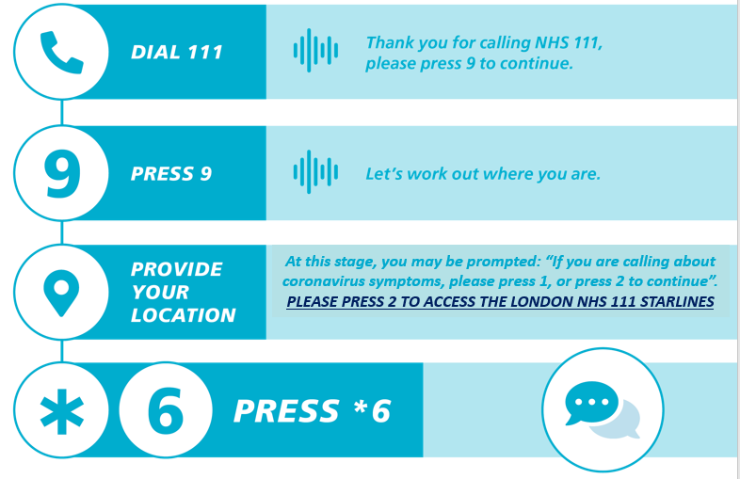
Your direct line to
urgent clinical advice
The NHS 111 Starline service will provide you with fast access to a clinical team who can give you the advice and medical input you need to care for your resident instead of having to call 999 and transfer your resident to hospital.
This service has been relaunched to ensure that you are receiving an enhanced level of support as care providers.
Did you know that our Clinical Advisory Service has GPs, Nurses, Paramedics and Pharmacists working together to provide you with the right clinical advice?
Notes:
When you call 111, there may be messages relating to coronavirus symptoms. In London it is important these messages are disregarded and care home staff concerned about a resident who may have COVID-19 or flu symptoms should access NHS 111 Star*6 for faster access to urgent advice from a senior clinician if they cannot get through to the resident’s own GP.
Before calling, record observations where possible: Date of first symptoms, blood pressure, pulse respiratory rate and temperature (refer to thermometer instructions). If there is a care plan for your resident, for example a CMC or DNAR plan, please have access to it

Slide 41
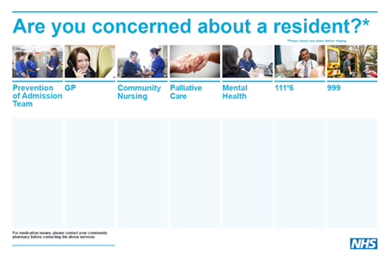
Escalating any concerns you have regarding your resident
Knowing your resident
Recognising signs of deterioration
Our vision
Your CCG, PCN Clinical Lead or GP would be more than happy to help you to complete your poster with local contact details.
Is your care home aware of the support available to help with infection prevention and managing an outbreak?
Escalating your concerns
Effective Handover
Download a copy of the poster to print and complete here.
41

Slide 42
Admission and Discharge
Admissions into care homes
Teams have played a vital role in accepting patients, most of whom are vulnerable to COVID-19, under very challenging circumstances as they are discharged from hospital, providing care that best helps them recuperate away from a hospital environment.
Below is a summary of the current national guidance:
For all admissions to a care home, whether returning residents or new residents, from a hospital or from a community setting, the resident should be managed in isolation for 14 days, regardless of a positive or negative swab from hospital, and regardless of whether they are showing symptoms or not
Residents being discharged from hospital, should be swabbed 48 hours before discharge. But where test results are still awaiting and provided all Infection Prevention and Control advice is followed, it is safe to accept a resident into a care home
The Hospital Discharge Service and staff will clarify with care homes the COVID-19 status of an individual and any COVID-19 symptoms, during the process of transfer from a hospital to the care home
Discharge can still happen while awaiting results, as a negative result is not required to enable discharge
Risk Assessments should be carried out in line with current guidance and recommendations. See example risk assessments and templates
.
Our vision
For more information and resources about admissions into care homes and managing concerns, please see the London Care Homes Resource Pack
42

Slide 43
Admission and Discharge
Concerns about accepting a resident
The guidance makes it clear that no care home will be forced to admit an existing or new resident to their care home if they are unable to provide the isolation for the 14 day period and safely manage any subsequent COVID-19 illness for the duration of the isolation period. This means that there may be grounds for a care home to decline admission if the home feels they are unable to manage the resident’s isolation needs.
Below is a summary of the current national guidance:
If there is a side room with an en-suite, then this is adequate facility for isolation but there may also be staffing challenges which may influence your decision to accept
If you are unable to accommodate a resident in isolation, the national guidance indicates that the Local Authority has some responsibility to help. However, your local CCGs will also support making the necessary arrangements with a joint approach between health and social care in supporting care homes with temporary alternative placements
If alternative provision is required this would be for a period of 14 days.
The key is that there is support when a care home has concerns have concerns about accepting a resident, and assessments need to be completed to ensure the care home can safely admit a resident under CQC requirements.
.
Our vision
For more information and resources about admissions into care homes and managing concerns, please see the London Care Homes Resource Pack
43

Slide 44





Supporting care home staff well-being
Working in care homes in the time of COVID-19 has been stressful, looking ahead to a possible second wave, and dealing with possible flu outbreaks at the same time, this winter may be a another stressful time for care home staff. This year there will be heightened focus on the effect of health and social inequalities on flu vaccination uptake particularly in light of the disproportionate effect of COVID-19 on BAME and older populations.
Please watch and share the webinar from 16th September entitled ‘Care Provider Workforce Risk Assessments’. The webinar shared case studies from care providers showing participants how they have used a Workforce Risk Assessment checklist to ensure that staff health and wellbeing risks are identified, and how they have implemented the required protective measures.
We know that we are often better at looking out for others than we are for ourselves, at times like this is important that we look after ourselves but maybe a good time to find a buddy who will help us look our for ourselves with a little help from them and visa versa. The South London HIN #OnlyHuman resources might be helpful for your teams click here to access the resource
Do your teams need more help and support?
Urgent Support: Good-Thinking’s Urgent Support page has numbers and links to help you
access urgent support
1:1 Mental health support 24 hours a day: Text FRONTLINE to 85258 for a text chat or call 116 123 for a phone conversation
Visit Bereavement Support Online or call the free confidential bereavement support line (Hospice UK), on 0300 303 4434, 8am – 8pm
NHS Psychological Therapy (IAPT): Search here to find out how to get access to NHS psychological therapy (IAPT)
Notes:
Dan to present. This slide is an amalgamation of several, hopefully not too much information

Slide 45
Let’s get ready – your winter checklist
You’ve listened to the webinar now it’s time to check that you and your teams are ready! Remember that more details on all of the topics today are found in the London Care Home Resource Pack
Have you Registered for Capacity Tracker and are updating daily?
Have you got NHSmail or secure email for your home?
Do you and your team know about NHS111 Starlines?
Have you completed your ‘Are you concerned about a resident’ posters?
Have you discussed admission of residents with your team?
If you have any questions, have you discussed these with your local team?

Slide 46
Sharing good practice and questions – this is where we want to hear from you!

Slide 47

Further support during winter
Our vision
47

Slide 48
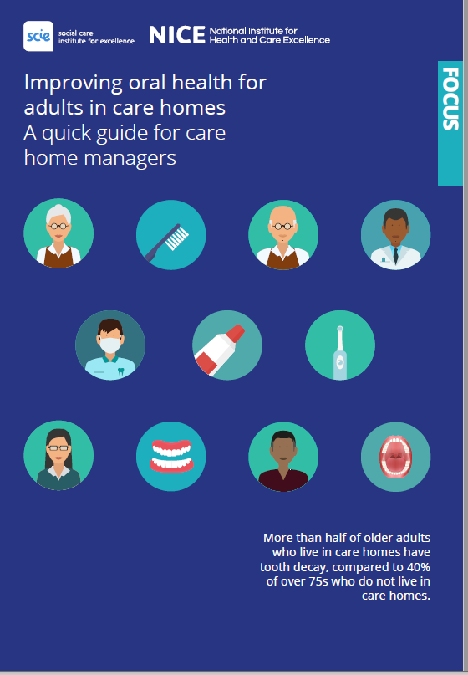
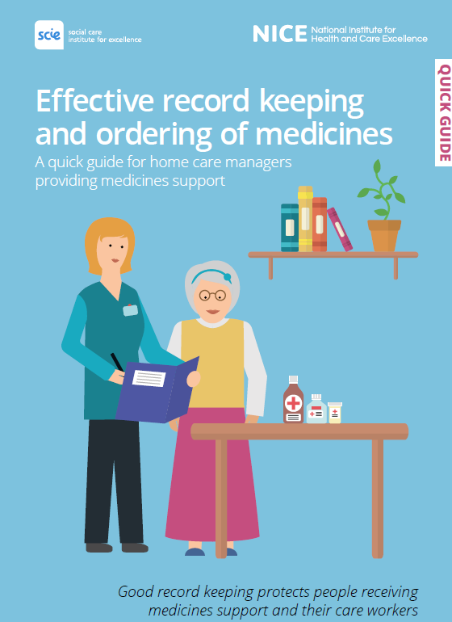
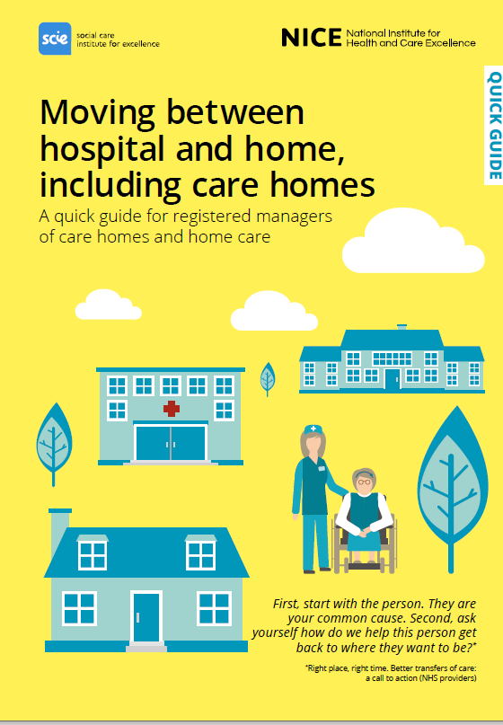
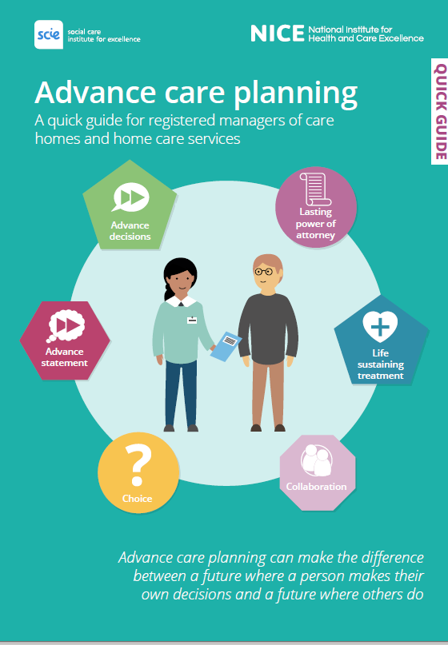
Further support during winter
This pack has provided information on vital topics to help care homes to prepare for winter. Resources are signposted throughout the slide deck, but here are some key links:
How to arrange flu vaccines in your care home – www.myvaccinations.co.uk
Sutton Flu video
Network contract DES Specification – PCN requirements 2020-21
Framework for Enhanced Health in Care Homes
Flu SOP (to follow once approved)
London Flu Campaign Resource Pack (will send with slides)
Flu Vaccine Promotion Resources - on PHE Campaign Resource Centre
London Care Homes resource pack
The National Institute for Health and Social Care (NICE) have developed a series of quick guides, for care home managers and staff to use as a resource for everyday activities and to support them with providing the right level of care for their residents.
For more information or to provide feedback, please contact: england.londonehchprogramme@nhs.net

Slide 49
Thank you for joining!
If you have any further questions, please don’t hesitate to contact the NHS London EHCH team at:
england.londonehchprogramme@nhs.net

