Slide 1
Every Mind Matters campaign
October 2019 sees PHE launch of the first mental health literacy campaign in England with an ambition for 1 million members of the public to be informed and equipped to take care of their own mental health and the mental health of others
Every Mind Matters will deliver this by:
Putting self care at the heart: tips on actions we can all take to improve and maintain wellbeing as well as tackling specific problems.
Personalised guidance: action driven content, with ability to personalise via action planning tool.
High-profile launch: establishing mental health as an issue for all
Engaging content: Case studies, animations and experts
Digital targeting: spotting implicit and explicit signals online.
Amplification through partners: public sector, voluntary and commercial support
Promoting existing services and resources: making links with national initiatives and local offers such as Good Thinking

Slide 2
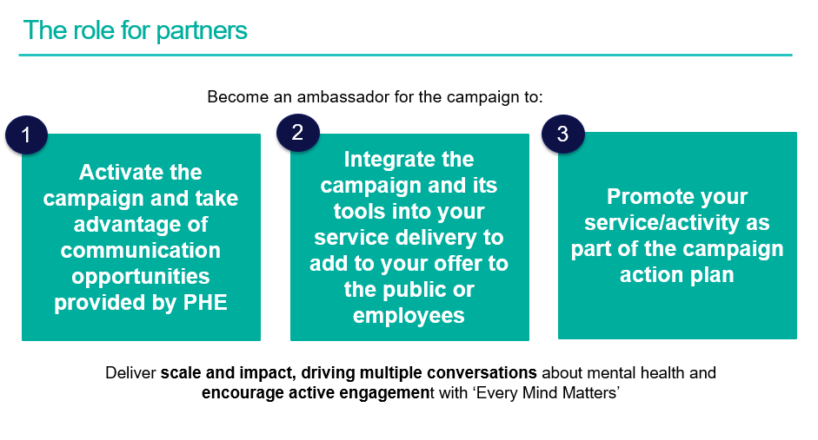
Opportunities for partners
Sign up to the PHE Campaign Resource Centre for updates and early access to campaign materials (selecting “mental health”).

