Slide 1
Southeast London update
Dr Richard Iles, Consultant in Respiratory Paediatrics
Evelina London Children's Hospital
Laura Doolan, Children and Young People’s Health Partnership (CYPHP)

Slide 2
Transforming the care of children and young people with asthma together in SEL
Richard Iles, Consultant in Respiratory Paediatrics
Evelina London Children's Hospital

Slide 3
Setting up our network
CYP Asthma Network for SEL launched with a half day event May’19
First SEL asthma network meeting 8th October
SEL is a member of the London asthma implementation group

Slide 4
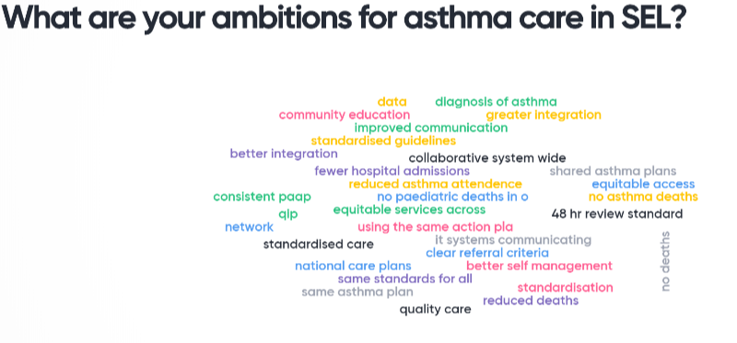
Our ambitions for asthma care in SEL

Slide 5
What would best support us to move these ambitions forward?

Slide 6
What are the priorities for the first year for the network?

Slide 7
Progress in SEL
Bexley
Dec 2018-April 2019, clinical lead visited nearly all practices to review asthma procedures with administrators, practice nurses and GPs
Revealed problems with computer use and provision of consistent asthma action plan
Initial support given and further audit needed
Bromley
Working group set up, Paediatric Lead (Dr Shenoy) has presented audit findings. Schools need to be better informed of high amount of activity currently going on which they could ‘tap into’ for support
Generic Support Plans needed – awaiting final version from Kings
Data reveals a lot on inaccurate coding, suspect nos. to be higher than reported
Presentation to GP Cluster meetings (early September 19) to generate more interest in better identification (although possible QOF implications are relevant)
Greenwich
October’18, training session held with community pharmacist and practice nurses to be trained in administrating inhalers
Referral process has been designed
Next steps to implement the pilot
Lewisham
Dedicated asthma nurse pilot delivered offering clinic appointments or home visits to CYP 0-19 yrs registered with a Lewisham GP who have a diagnosis of asthma
Business case presented

Slide 8
https://www.youtube.com/watch?v=Y4WChnnmHaM
CYPHP model of care

Slide 9
CYPHP model of care
GP
ACT < 20
SDQ >20 or 17-19, with impact >2
Background
Damp house
£ concerns
Food concerns
Lambeth and Southwark
Asthma Health Check
Waiting time
7 days
CYPHP Nurse triage
Waiting time
6 weeks
CYPHP nurse community clinic
From a sample of 1,158 Asthma HCs
42% need intervention
18% emotional/behavioural issues (1,040 SDQs completed)
32% report housing concerns, 12% parental mental health, 6% food concerns
Nursing team
3 x band 6
1 x band 7
8 nurse-led asthma clinics over 6 locations + 2 telephone clinics per fortnight.
Minimum of children offered a review per week – 36
Impact of CYPHP model of care
In the first run of active case finding, about 1 in 5 families who were invited, did complete the Asthma Health Check
Of patients seen by the CYPHP Health team, 61% had significant improvements in asthma symptoms
Currently achieved a 10% reduction in non-elective admissions, forecasted for 30% reduction by end of 2019
GP
Integrated care
planning
£££
Notes:
Children & Young People’s Health Partnership invite the families of children within Southwark & Lambeth with asthma to complete the online asthma health check – includes Asthma control test and Strengths & Difficulties Questionnaire as well as social questions. See outcome percentages taken from a sample of 1,158 asthma heath checks. Within 7 days of completing the health check the scores are triaged by the CYPHP nursing team and child invited to community asthma clinic within 6 weeks if meets threshold. Health check results entered into EMIS. As part of the review there will be a process of deciding and actioning if a child/family need support re. housing, emotional, school and liaison with GP and/or specialist hospital services should it be needed. See impact.

