Slide 1
How can you help improve Air Quality?
Sarah Newman
Environmental Health & Trading Standards
Regulatory Services
Southwark Council

Slide 2
Air quality in Southwark – NO2

Slide 3
Air quality in Southwark – PM10

Slide 4
Air quality in Southwark – PM2.5

Slide 5
Air Quality Management Area
Declared our first AQMA in 2000
Currently covers all of
borough north of South
Circular
Reviewed every 5yrs
Next review – 2020

Slide 6
Map of air quality monitoring locations

Slide 7
Trend monitoring results

Slide 8
Air quality impacts on health
Mortality linked to air pollution is higher in Southwark than in London or England - it accounts for 6.7% of all deaths
45% of people living in Southwark are regularly exposed to high NO₂ levels
Helping people mitigate exposure to air pollution is a priority
Pollutant | Sources | Health effects
Nitrogen dioxide - NO₂ | Road transport (diesel emissions), boilers, power stations & industry | Lung irritation Lung damage
Particulate matter - PM₁₀ & PM_{2.5} | Road transport (diesel emissions, tyre & brake wear), boilers, power stations, industry & construction | Increased chance of respiratory disease Lung damage (cancer) Lung irritation Premature death
1) Public Health England website: https://fingertips.phe.org.uk/search/air#page/4/gid/1/pat/6/par/E12000007/ati/102/are/E09000028/iid/30101/age/230/sex/4

Slide 9
Air quality impacts on health
Approx. 90 Southwark deaths in 2017
Approx. 100 Southwark resident asthma admissions per year
Poor air quality days associated with increased GP and A&E attendance
Approx. 5230 new cases of respiratory disease in Southwark residents due to air pollution in 2017
People’s health may be affected by poor air quality even if they don’t experience noticeable effects
Death
Hospital admission
Emergency department visit
Doctors visit
Asthma attacks, medication use, symptoms
Unnoticed physiological changes

Slide 10
Mortality & ill-health
Proportion of deaths linked to PM_{2.5}
Air pollution can exacerbate respiratory conditions, such as asthma and chronic respiratory disease, and increase the risk of cardiovascular events like heart attacks and stroke
Long-term exposure increases premature mortality risk
The effect of PM_{2.5} on mortality is higher in Southwark than in London or England, but it is decreasing
Trend in proportion of deaths linked to PM_{2.5}
Data source
PHE Public Health Outcomes Framework 2015

Slide 11
Health of vulnerable groups
More than 25% of Southwark population are at an age that makes them more vulnerable to poor air quality
Children
There are 55,500 children in Southwark aged 0-14
Children are more vulnerable as their lungs are still developing
Size for size, each minute, children breathe more air than an adult
Older people
There are 25,000 people in Southwark aged 65+ (projected to increase significantly)
Older people are more vulnerable as their lungs are less elastic and less able to filter out air pollution
Older people are more likely to have a chronic condition that can be exacerbated by air pollution
Data source
ONS mid-year population estimates 2016
ONS population projections 2016
Slide 11

Slide 12
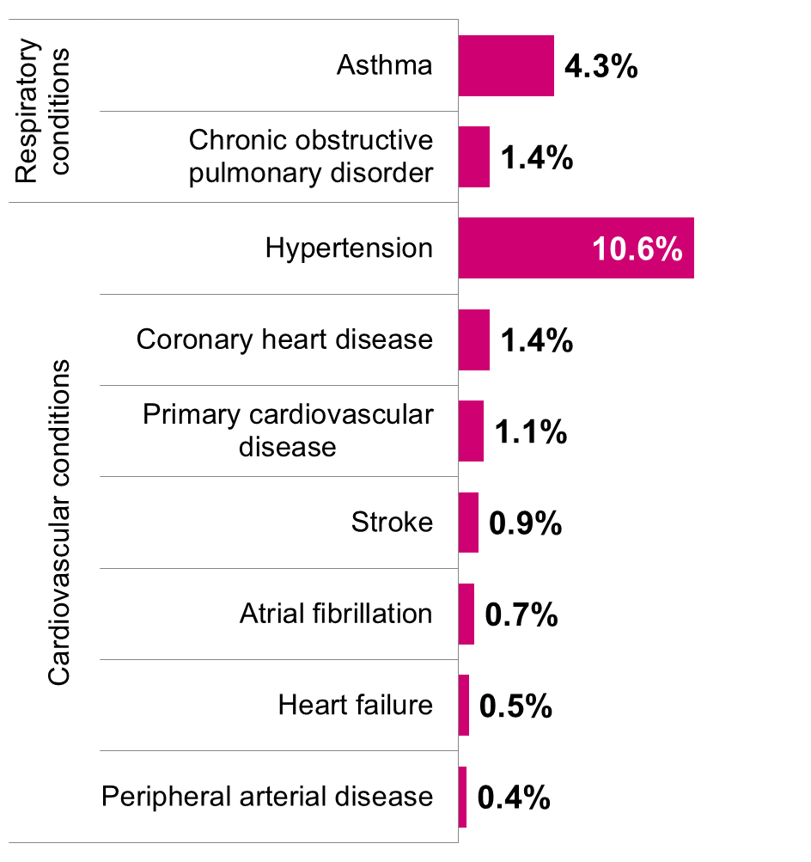
Existing health conditions
4.3% of people registered with a GP in Southwark have diagnosed asthma (13,600 patients)
1.4% of people registered with a GP in Southwark have a COPD diagnosis (4,400 patients)
People with chronic conditions are vulnerable as health impacts can be exacerbated by exposure to air pollutants
Over 60% of asthma sufferers report poor air quality makes their asthma worse (Asthma UK)
Prevalence of cardiovascular conditions and respiratory conditions in Southwark at CCG level shown as % of patients diagnosed with health condition
Data source
NHS Quality and Outcomes Framework 2015/16 - Recorded disease prevalence - cardiovascular group, respiratory group 2015-16, NHS Southwark CCG level & https://www.asthma.org.uk/advice/triggers/pollution/
Slide 12

Slide 13
Opportunities
Reducing emissions – active travel contributes to increasing healthy life expectancy and reducing early death from a range of respiratory and cardio-vascular diseases
Improve air quality – actions impact positively on public health outcomes e.g. physical activity, healthy weight, social isolation, mental health & wellbeing
The benefits of physical activity outweigh the harm of poor air quality
Improved notification – of poor air quality episodes enables more effective self -management of health conditions such as asthma. Use airText app.
University of Copenhagen (2015) Exercise can outweigh harmful effects of air pollution
https://www.sciencedaily.com/releases/2015/03/150330084238.htm

Slide 14
What is the Council doing?
Monitoring
Air Quality Management Area
Air Quality Improvement Action
Plan with 127 actions
Reduce emissions from
buildings
Reduce traffic emissions
Reduce carbon emissions
Rigorous regulation
Support colleagues
(GLA, TfL, PH, CCG)
And…. last but not least
Increase public awareness

Slide 15
Increasing public awareness
#onething Comms Campaign
Adverts on the back of buses – on 4 bus
routes out of Peckham bus station
On-street posters – on bus stops on A roads
70 banners – at schools, busy junctions
and retail areas
Updated the council’s air quality webpage
Pledge – cards and online pledge page
Digital marketing – animated video
on council Facebook and Twitter feeds
and paid for on YouTube
4 page article in Southwark Life spring
‘19 edition with AQ news and tips – goes to
every home

Slide 16
#onething – Message – Travel choice

Slide 17
#one thing – Messages - Idling

Slide 18
#one thing – Messages – Deliveries

Slide 19
Was it effective?
No. of views?
No accurate figures
available
Rough estimate
600,000 – 750,000
Bus-rear adverts – seen by thousands of motorists
Bus stop posters – seen by thousands of motorists
70 Banners at schools and on street were very popular (everyone wanted one) and were seen by thousands of parents, teachers, pupils, travellers on and pedestrians
100’s of pledge cards were handed out during Clean Air Day activities.
Southwark Life goes to every household – but did they read it……or recycle it…..?

Slide 20
Was it effective?
YouTube video – over 117,000 views with 38% of viewers
watching it to the end
The view rate was excellent at 49% – compared with
Government average of 33%
Cost of £0.02 per view – good value for the sector
Overall
There was a 755% increase in hits to Southwark Council
air quality website during the campaign – so yes, it worked.
But hits fell back to normal levels when campaign ended
Need to embed messages in business as usual

Slide 21
Targeting the vulnerable
Prepared air quality information leaflets for NHS practitioners
& patients on:
Protecting yourself from poor air quality
Condensation & mould
Gas & carbon monoxide
General domestic sources
Occupational exposure
Available at https://www.southwark.gov.uk/environment/air-
quality/what-you-can-do?chapter=3

Slide 22
And finally…
What can you do to raise awareness, reduce
atmospheric pollution, improve air quality and
protect respiratory health?
Professionally – with clients
Professionally – within your organisation
3. Personally

