Slide 1
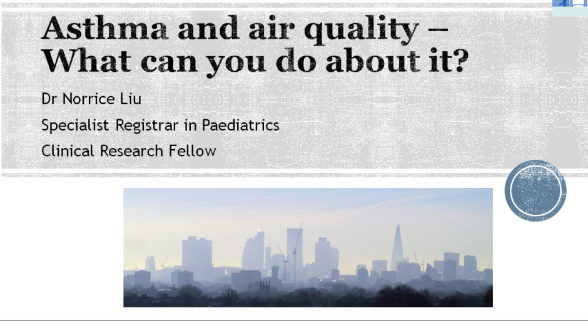

Slide 3
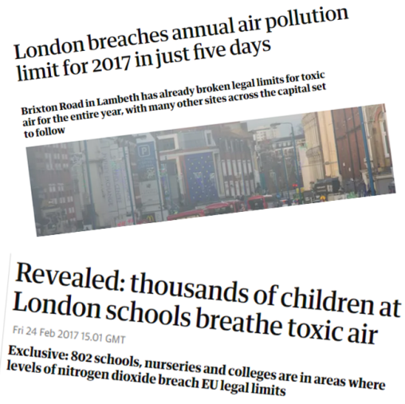
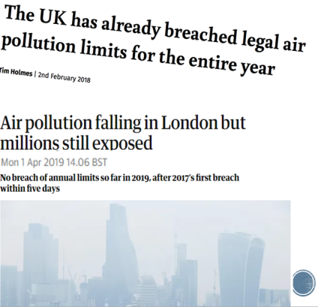

Slide 4
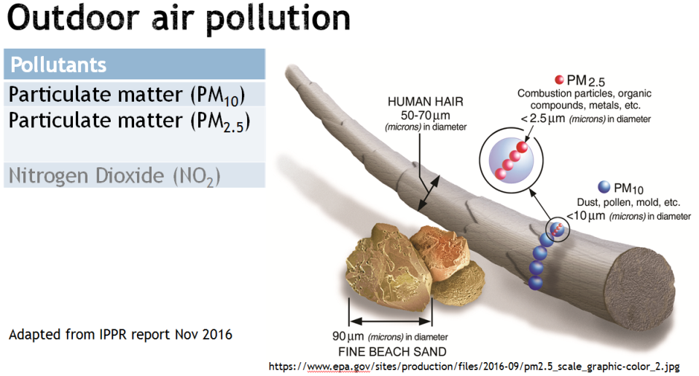

Slide 5
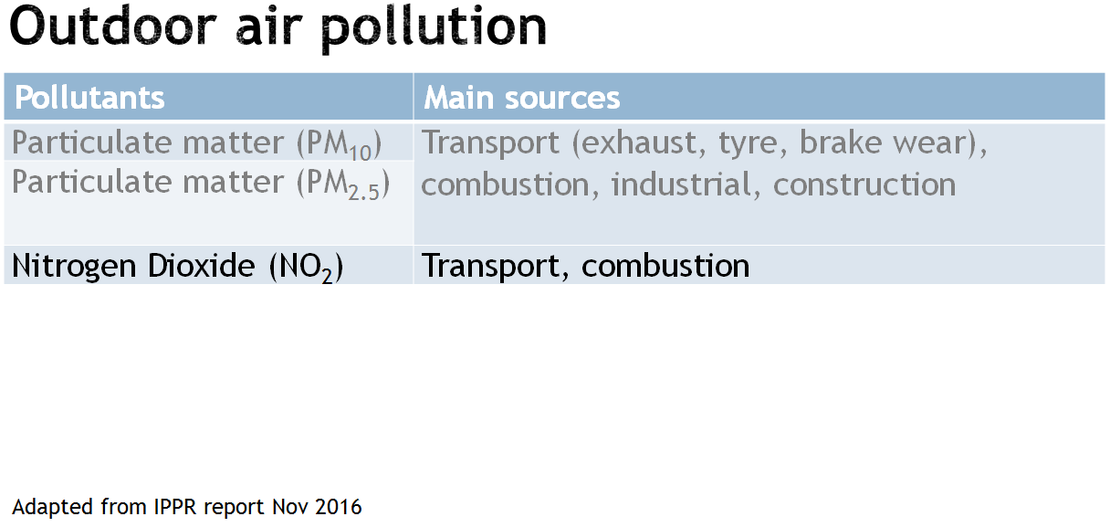

Slide 9
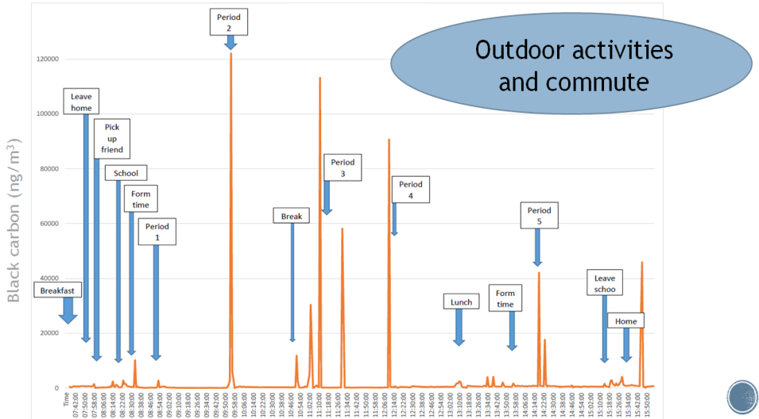

Slide 10
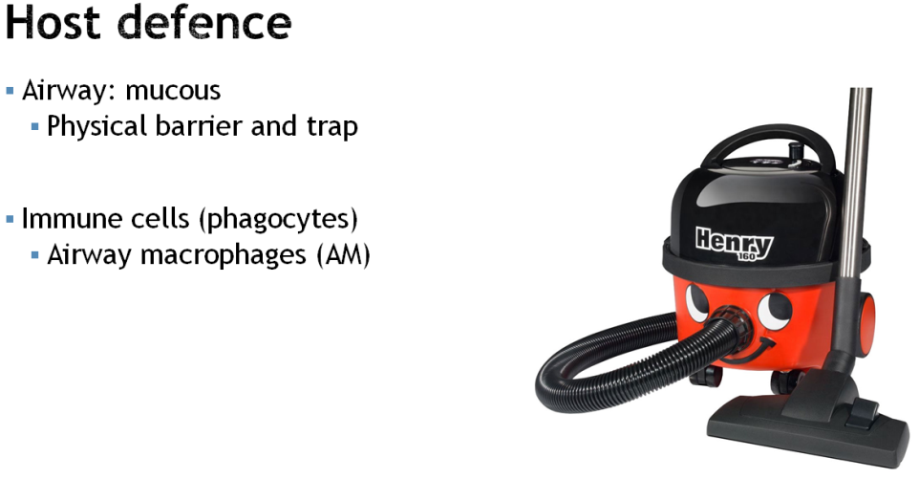

Slide 11
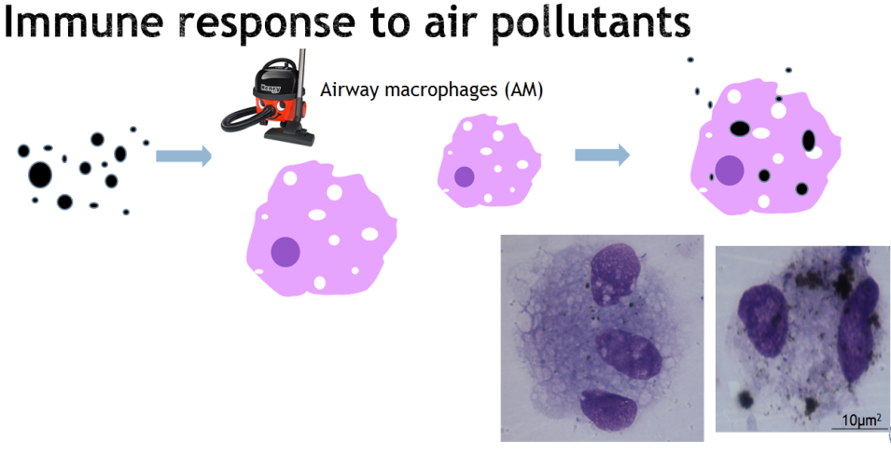

Slide 12
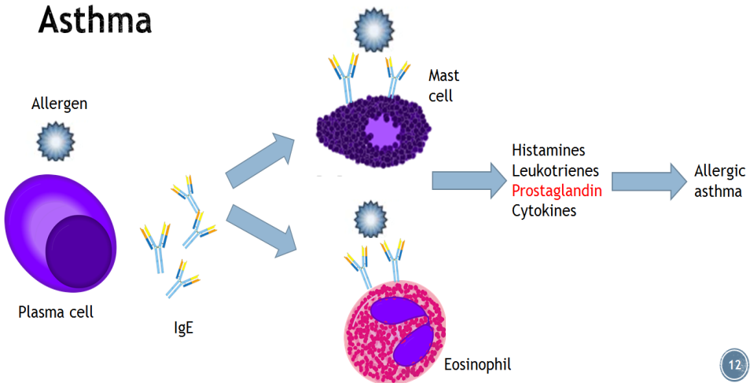

Slide 15
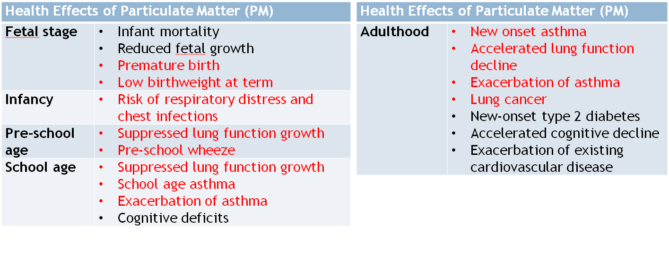
Every Breath We Take, the Lifelong Impact of Air Pollution by RCP and RCPCH, 2016

Slide 18
How to reduce children’s exposure
Pollution level | Measures
Low | Avoid spending long periods of time along busy roads
Moderate | Reduce or avoid strenuous outdoor activities
High | Reduce or avoid strenuous outdoor activities Avoid pollution hotspots Avoid rush hours, travel earlier before pollution levels build up Use less polluted routes when cycling, walking or running Use of reliever inhaler if pollution is a trigger to asthma symptoms ± Seek medical attention
Individual level:
Less busy roads
Walking, cycling, scooting, public transport and carpooling
The Department for Environment Food and Rural Affairs website:
https://uk-air.defra.gov.uk/forecasting/
British Lung Foundation
https://www.blf.org.uk/support-for-you/air-pollution/what-can-i-do
AirText
https://www.airtext.info
London Air Quality Network
https://www.londonair.org.uk/LondonAir/Default.aspx
Notes:
UK breaches EU and WHO regularly
New diseases incidence + exacerbation of existing diseases → 40,000 excess deaths + £20 billion/yr
volatile organic compounds

Slide 21
