Slide 1
Enhanced Health in Care Homes London - Winter Readiness Webinar 3: Managing winter illness 11th November 2019

Slide 2
A collective approach to planning for winter
The London Enhanced Health in Care Homes (EHCH) programme team have been working together with Sustainable Transformation Partnership (STP) teams, Clinical Commissioning Groups (CCGs) and Local Authorities (LA) to support care providers across London.
The London EHCH programme provides information and resources to help facilitate a winter planning partnership between social care and health care providers; with the aim to deliver collective system wide resilience for London.
To help raise awareness of the resources available we have planned 4 commissioner focused webinars and a single provider webinar – all these resources will be recorded and available to access via the Healthy London Partnership website or Enhanced Health in Care Homes FutureNHS page
You can use the information shared to complement existing resources for your care providers locally.
Our vision
2

Slide 3
Enhanced Health in Care Homes Winter Readiness Webinars
Dates | Topics to be covered
Webinar 1 16th September 2019 13:30pm- 14:15pm | Flu Campaign and vaccination approach for London
Webinar 2 14th October 2019 13:30pm- 14:15pm | NHS 111 *Starlines Promotion and campaigning for NHS 111 *Starlines Guidance information on how to use the service Progress with Star Line Evaluation recommendations
Webinar 3 11th November 2019 13:30pm- 14:15pm | Managing winter illness Flu Outbreak Standard Operating Procedure (SoP) for Care Homes- supporting a system wide response to an outbreak Infection prevention Managing D&V in a care home setting
Webinar 4 9th December 2019 13:30pm- 14:15pm | Winter Readiness Recap Review webinars 1 to 3 Updates from each STP area i.e. Flu Campaign, Vaccination uptake, share learning/ solutions
Our vision
3

Slide 4
What are we intending to cover today?
Flu Outbreak SOP for London
Commissioning of Flu vaccinations
Access to free flu vaccinations for social care workers
2019/20
Prevention & Support
Sharing good practice and questions
An opportunity to share your approach, discuss your challenges and highlight any further topics that we may not have covered

Slide 5
“A care home can
be a centre
for infection to flourish!”

Slide 6
Flu Outbreak Standard Operating Procedure (SOP) – for London
Notes:
An overview of this years Flu Campaign and Vaccinations for Social Care Workers

Slide 7
The London Influenza Standard Operating Procedure
What is a standard operating procedure?
Focused on improved safety and quality of care a standard operating procedure (SOP) is a set of step-by-step instructions compiled by an organisation to help support people to carry out complex routine operations. SOPs aim to achieve efficiency, quality output and uniformity of performance, while reducing miscommunication and increasing risk of harm to patients/residents.
Why have we introduced the London Influenza Standard Operating Procedure (SOP)?
Following several outbreaks of flu in care homes in 2017/18; a standard operating procedure (SOP) was developed to support care homes with responding to an outbreak, in collaboration with local health and social care providers and commissioners.
What does it contain?
It outlines the important roles and responsibilities for the following key stakeholders:
Care Home Registered Managers/staff
Resident’s registered GP/GP Practices/GP Out-of-Hour (OOH) services (OOH)/111Integrated Urgent Care (IUC)
Local Health Protection Teams (HPT)
NHS Clinical Commissioning Groups (CCG)
Essentially this guidance aims to ensure an effective and coordinated approach is taken across support services to manage risk assessments and outbreaks in a home.
Care homes will need to be made aware of the steps to follow and who to contact for support if needed – this is where our resources come in. The SOP can support all types of care homes Nursing, Residential, Learning Disabilities and Mental Health.
Our vision
7
Notes:
It is really important that everyone know what their role is during a suspected or confirmed outbreak. The SOP helps with this but ideally it would be great if you use this locally to ensure that across both care homes and health and care partners you all know what you can do to help.

Slide 8
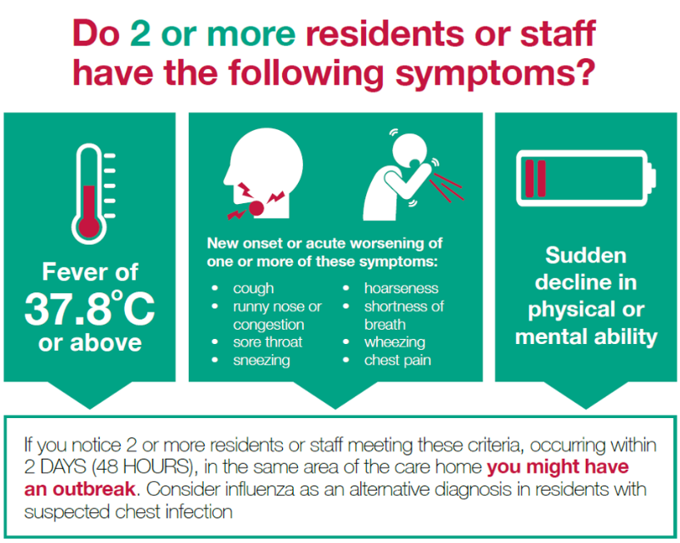
Reporting an outbreak is so important and simple to do
If the answer is yes CALL your local Health Protection Team as it may be an outbreak
Our vision
To find contact details for your local Health Protection Team follow this link:
https://www.gov.uk/guidance/contacts-phe-health-protection-teams
8

Slide 9
How can you help a care home to be ready to act if they do suspect an outbreak?
One of the key challenges that teams who have experienced an outbreak talk about is communication and clear information being available
Their learning has been fed into the SOP meaning that we are proactively approaching learning to help not only one care home but also care homes across London to improve together.
Helping a care home team to be ready is a really important aspect of our roles as health teams supporting care
Talking to your care home teams about this can help them prepare. Alongside the PHE guidance and the SOP what other resources do you have that can support the care homes?
Create a list with the GP, of residents you suspect have flu like symptoms (Highlight all residents who may require antiviral treatment). The list should include…
Name ✓
Date of birth ✓
NHS Number ✓
Create an additional list of residents who potentially require an antiviral (e.g.: patients with chronic underlying conditions who have not received a flu vaccination this season).
Send information from both lists to your local Health Protection Team.
Send prescriptions for residents who require anti-virals to your Community Pharmacy.
Give residents oral anti-virals as soon as possible, if required, under the guidance of the GP.
Contact your Local Authority if you need additional support with staffing resources during an outbreak.
Our vision
9

Slide 10
Making a note – the importance of record keeping and local governance
All parties are responsible for ensuring all documentation and communications regarding an outbreak are retained for audit purposes.
This should include…
Records of calls/emails to resident registered GP (In Hours) & GP OOHs via 111 starline, local HPT, local pharmacy and CCGs.
For care homes nursing documentation, this should be in line with the Nursing & Midwifery Council NMC code of conduct (section 10), ensuring that clear and accurate records are kept regarding care delivered to residents.
Health Care Professionals to also update the care home documentation, ensuring real time records are kept during the outbreak.
List of residents who were affected by the outbreak and treatment provided alongside further follow up should be maintained as per local policy.
The CQC KLOE expects good record keeping in line with their KLOE
.
Our vision
10
Notes:
Expectations from the CQC – supporting good record keeping
CQC inspection teams use the Key Lines of Enquiry (KLOEs) framework and prompts, where appropriate, to assess adult social care services
As part of best practice, we recommend Care Homes keep a record of all documentation and lessons learned to support routine CQC inspections.
CQC have updated the KLOE document and added new content to strengthen specific areas and reflect current practice.
The assessment frameworks for healthcare services and adult social care services, have been aligned as much as possible.

Slide 11
Where to find the Influenza SOP?
You can find the standard operating procedure along with the supporting resources on;
The Healthy London Partnership website
https://www.healthylondon.org/resource/accelerated-improvement-resources/enhanced-health-in-care-homes/seasonal-readiness/winter-readiness/influenza-flu/flu-outbreak-response-care-homes-standard-operating-procedures/
Enhanced Health in Care Homes FutureNHS page
If you do not have access to the EHCH or Ageing Well pages please email hlp.ehchprogramme@nhs.net and the team will help get you set up.
CarePulse
Care Homes can access the quick guide and also the full document on CarePulse. Please encourage your care home teams to claim their profile which in addition to be able to add on their capacity will also allow them access to the Care Home Resource pages
Feedback is really important to the team – please do let us know if there is anything else you feel would be helpful to your local teams
Our vision
11

Slide 12
Supporting Resources
These documents are referenced in the SOP in order to signpost care providers and commissioners to national guidance that should be consulted in in response to an outbreak.
You may have local processes and resources in place too, so these can just support your existing materials!
Our vision
12

Slide 13
Free Flu Vaccinations for Social Care Workers – plans for London

Slide 14
How can your teams access the free flu vaccination?
Your local social care providers can access free flu vaccinations by one of two means
Option 1
Vaccinations can be provided in community pharmacies social care workers just need to take ID into a pharmacy offering vaccinations for information on the nearest pharmacy visit www.londonflu.co.uk
Option 2
Vaccination pop up clinics can be arranged at care homes for >10 staff– for more information or to book your vaccinations visit www.londonflu.co.uk
Our vision
14

Slide 15
Collecting data for flu vaccinations – Local trackers
Locally collected data will enable you to feel confident that your care homes are preparing to prevent flu this year.
South West England have produced a vaccination tracker to keep a log of staff and residents flu vaccination.
This can be completed and managed by the care home and shared with CCG and Local Authorities as part of regular reporting.
Our vision
15

Slide 16
Collecting data for flu vaccinations – Local trackers
Providers are rewarded with a certificate and letter thanking them for working in partnership with health and social care to prevent flu:
>70% of staff - Gold accreditation
60-69% of staff - Silver accreditation
50-59% of staff - Bronze accreditation
Our vision
NHSE North Region have set up an award scheme for care providers who self report and inform commissioners of staff flu vaccinations.
We would like our London network to adopt the same approach and acknowledge care homes who are supporting the flu campaign.
Posters will be available to promote this as part of the campaign (to follow)
16

Slide 17
Prevention & Resources

Slide 18
Helping Care Homes feel confident with Infection Prevention
For people living in care homes, infections can be serious, and in some cases, life-threatening.
They can also make existing medical conditions worse. Regular contact with staff, other residents, family and friends and the shared living space all mean infection can easily be passed around.
It is therefore vital to take the steps that can help prevent infection occurring – NICE: Helping to prevent infection, quick guide
Often we hear that concerns re infection prevention are an issue from care homes when accepting transfers and admissions from hospital – it is worth talking to your local infection control team to see how you can support this in partnership with your acute and CCG teams.
Our vision
18

Slide 19
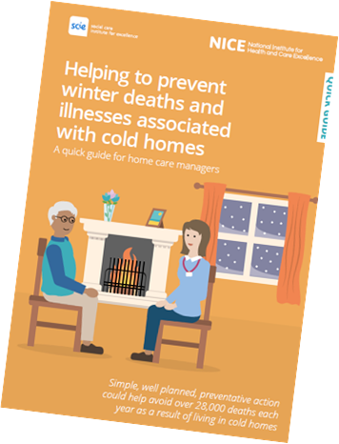
Helping Care Homes feel confident with keeping their residents warm
For a vulnerable person, living in a cold home increases their chance of serious illness or death. They are at higher risk of a heart attack or stroke, breathing problems, flu, depression and falls.
NICE - Helping to prevent winter deaths and illnesses associated with cold homes, quick guide
Although this guide is targeted to home care managers, it is beneficial to share this with care homes to raise awareness on what actions managers and staff need to take to keep their care home and residents warm.
Further information and guidance is also available on the NHS website: NHS - Keep warm, keep well
Keep track of regular weather forecast updates on radio and TV. Severe weather warnings are also issued on the Met Office website, through the Met Office Twitter feed, or you can call the Weather Desk on 0370 900 0100 or 01392 885 680.
Our vision
19

Slide 20
Managing a suspected D&V outbreak – supporting clear processes
D&V / Norovirus is easily transmitted from one person to another, all key services should be notified if there is an outbreak. The virus can occur at any time of year, but most cases occur October- March.
Helping a care home team to respond to an outbreak is a really important aspect of our roles as health teams supporting care. Here we have a short checklist of steps that need to be taken by a care home in the event of an episode of D&V/Norovirus in their home.
Talking to your care home teams about this can help them prepare. Alongside the PHE guidance what other resources do you have that can support the care homes?
Notify the resident’s GP. If an infection is suspected, they may arrange for specimens to be sent to the laboratory
Notify the local Health Protection Team (HPT) if more than two cases, suspected or known to be infectious occur within a few days.
Isolate infected residents and exclude infected staff from work, until 48 hours after the symptoms have settled.
Infected residents should, if possible, have sole use of a designated toilet or commode as long as their symptoms persist.
Prepare information for visitors asking them not to visit if they have had symptoms of diarrhoea or vomiting within the previous 48 hours.
Notify the hospital about the possibility of infection if a resident needs a hospital assessment / admission.
Notify transporting ambulance staff about infection before the resident is collected.
When discharged from hospital within 48 hours of the last symptoms of diarrhoea and vomiting, a single room with a dedicated toilet and appropriate precautions should be provided until they are clear of symptoms for 48 hours
Our vision
20

Slide 21
Managing a suspected D&V outbreak – supporting clear processes
Cleaning regime
An enhanced cleaning regime needs to be carried out on the environment and equipment. A particular focus should be on toilet seats, door/toilet handles and sink taps.
Clean disposable cloths and washable mops should be used to clean frequently hand touched hard surfaces and should occur at least twice daily during an outbreak.
Hand washing with liquid soap and water is vital to minimise the spread of infection and should be actively promoted.
Alcohol hand rub is not effective at deactivating the viruses and bacteria that cause
diarrhoeal outbreaks.
Information on slides 21 & 22 has been taken from the Department of Health and Health Protection Agency guidance - Prevention and control of infection in care homes – an information resource
Our vision
21

Slide 22
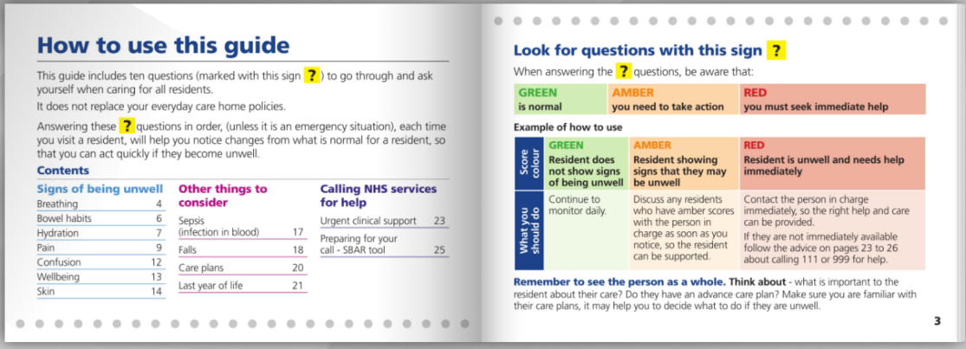
Recognising signs of deterioration – what are you using locally?
Are your care homes using tools to support recognising signs of deterioration?
There are a range of resources available, here are some examples…
NWLCCG
Our vision
22

Slide 23
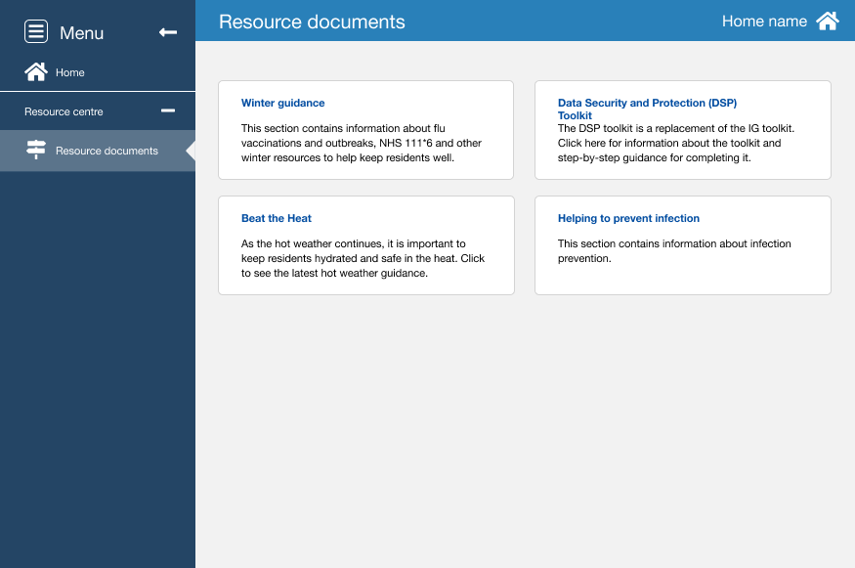
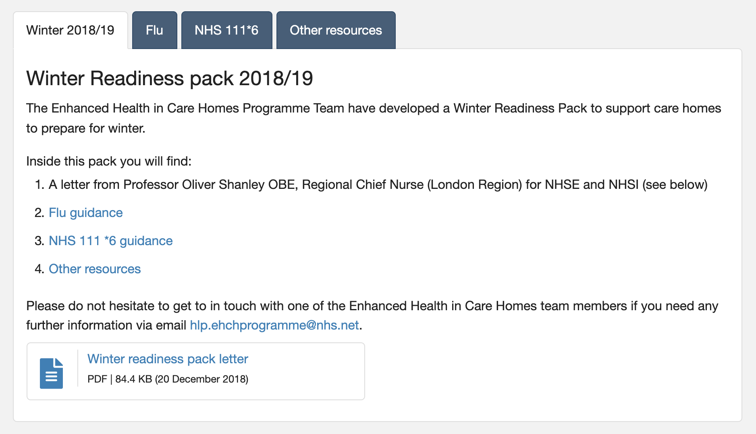
CarePulse – bed capacity management system for London
The resource centre hosts supportive information and guidance for care homes to access to support them during the winter period
www.carepulse.co.uk
Our vision
23

Slide 24
How are you supporting your care homes to know what resources are available locally?
Clear signposting to local resources
We know that care home support services differ across London and this at times may cause confusion. One way to help with this is to support your care home to complete the Are you Concerned about a Resident Poster . This poster would support you to ensure your care homes know who to call at what time getting the help they require to provide great care within the home .
Are your care homes aware of the support available to help with infection prevention and managing an outbreak?
From…
Care home support teams
Local hospitals
Community support services
Local Health Protection Team
Public Health England
NHS England/Improvement
NICE guidance & quick guides
.
Our vision
24

Slide 25
NICE Quick Guides available for care home managers and staff
Our vision
Copies can be found on
the FutureNHS Collaboration platform (Kahootz), EHCH section and the CarePulse resource centre
25

Slide 26
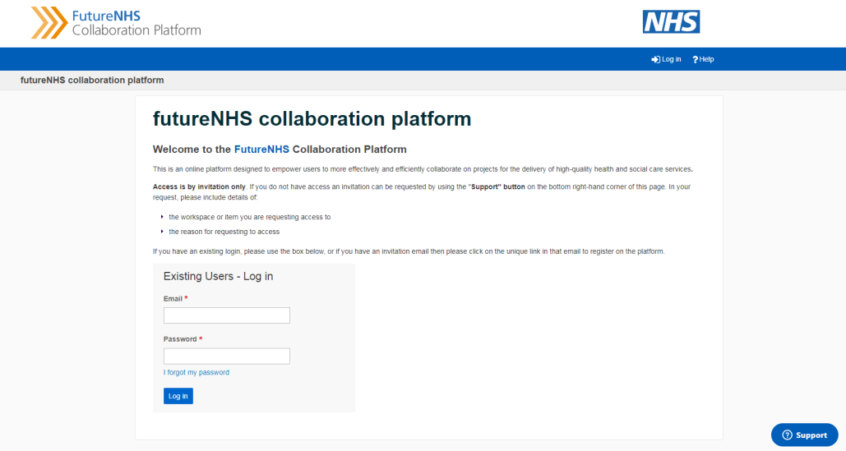
Other resources – what do you have locally?
How to access and share resources across London and nationally…
We recommend you join the Kahootz / FutureNHS collaboration platform, EHCH network…
Commissioners and providers can register by emailing…
england.carehomes@nhs.net
Our vision
26

Slide 27
Sharing good practice and questions – this is where we want to hear from you!

Slide 28
Working together across London - sharing good practice
Our vision
28

Slide 29
Links to resources
Slide 2
https://www.healthylondon.org/resource/accelerated-improvement-resources/enhanced-health-in-care-homes/winter-readiness/winter-readiness-2/
Slide 10
https://www.gov.uk/guidance/contacts-phe-health-protection-teams
Slide 11
https://www.nmc.org.uk/globalassets/sitedocuments/nmc-publications/nmc-code.pdf
Slide 12
https://www.cqc.org.uk/sites/default/files/20171020-adult-social-care-kloes-prompts-and-characteristics-final.pdf
Slide 13
https://www.healthylondon.org/resource/accelerated-improvement-resources/enhanced-health-in-care-homes/seasonal-readiness/winter-readiness/influenza-flu/
Slide 15
www.londonflu.co.uk
Our vision
29

Slide 30
Links to resources
Slide 16
https://www.england.nhs.uk/south/info-professional/public-health/infection-winter/care-guidance/
Slide 19
https://www.nice.org.uk/about/nice-communities/social-care/quick-guides/helping-to-prevent-winter-deaths-and-illnesses-associated-with-cold-homes
https://www.nhs.uk/live-well/healthy-body/keep-warm-keep-well/
http://www.metoffice.gov.uk/
Slide 20
https://www.nice.org.uk/Media/Default/About/NICE-Communities/Social-care/quick-guides/Infection%20prevention.pdf
Slide 22
https://assets.publishing.service.gov.uk/government/uploads/system/uploads/attachment_data/file/214929/Care-home-resource-18-February-2013.pdf
Slide 24
www.carepulse.co.uk
Slide 25
https://www.nice.org.uk/search?pa=1&ps=50&q=care+home+managers+quick+guides
Our vision
30

Slide 31
Thank you for joining!
If you have any further questions please don’t hesitate to
contact the team hlp.ehchprogramme@nhs.net

