Slide 1
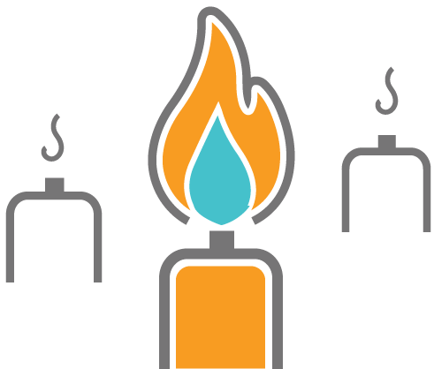
Do you feel like you’re about to burn out?

