Slide 1
End of Life Care
Malti Varshney, Associate Director
London Clinical Networks and Senate

Slide 2
NHS Mandate
Overall 2020 goals:
Significantly improve patient choice, including in maternity, end-of-life care, elective care and for people with long-term conditions.
2018-19:
Increase the percentage of people identified as likely to be in their last year of life, so that their End of Life Care can be improved by personalising it according to their needs and preferences.

Slide 3
The Need
We are all living longer. Over the next 15 years the number of people aged 65 and over is projected to increase by 40%.
The number of people with long term conditions will grow as a result of increased life expectancy. The latest research has found that 58% of those aged 60 and over report having a long term condition; with 25% of over 60s diagnosed with two or more.
This is all placing significant pressure on our local health and care systems. Currently around 70% of the total health and care spend in England is attributed to caring for people with long terms conditions.
We also have significant public health challenges. One in five of those aged over 16 smoke; two thirds of adults are overweight/obese and 45% of those who drink alcohol consume a third of their weekly limit on a single day.
40%
Number of people aged 65 and over will increase from 11.6 million to 16 million.
70%
of all inpatient bed days are due to long term conditions.
£££££ £££££
30% of the population accounts for 70% of health and care spend.
80%
Of children who are obese will grow up to be overweight/obese in adulthood.
Notes:
Number of deaths registered in England and Wales
2015 - 530,000 (5.6% more than in 2014)
Projected 628,659 by 2040
Scottish study – over 1 in 4 of hospital inpatients were dead within 12 months; a third of these died during index admission (Clark et al, 2014)
Projected number needing palliative care (Etkind et al, 2017):
Increase by 25 – 42%
Dementia and cancer will be main drivers of increased need
Size of older population over next 20 years (ONS):
Aged 85 or more: from 1.7 to 3.7 million
Aged 75-84: from 4.1 to 6.3 million

Slide 4
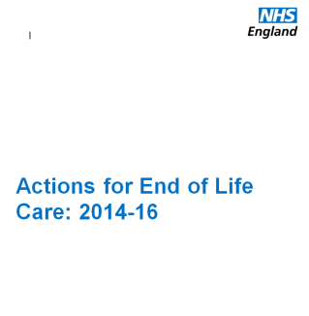
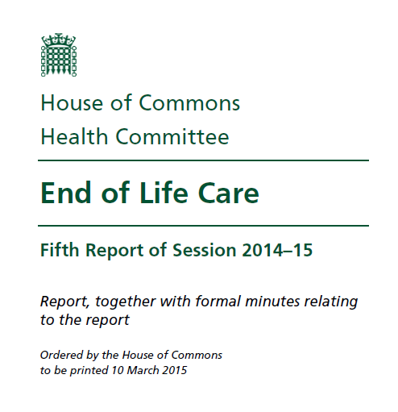
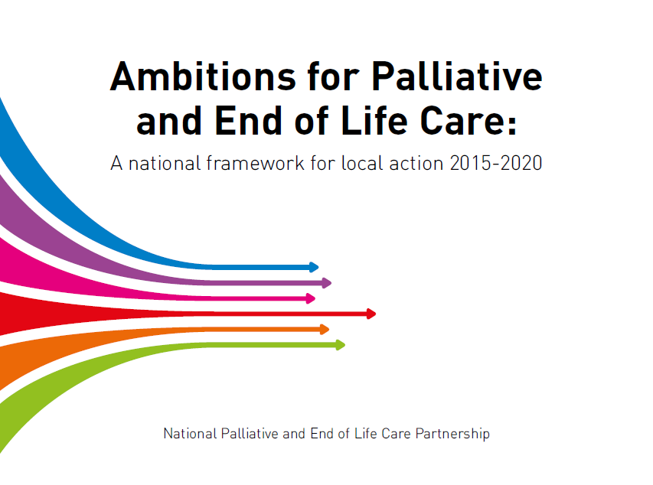
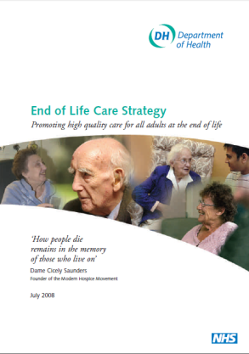
Strategic Drivers

Slide 5
Ambitions for Palliative and EOLC

Slide 6
Location of death data
Rolling annual Q1-4 2016/17 | Number of deaths | % deaths in hospital | % deaths in hospice | % deaths at home | % deaths in care homes
England | 500,133 | 46.7 | 5.6 | 23.4 | 22.2
London | 49,068 | 52.8 | 6.5 | 23.7 | 14.6

Slide 7
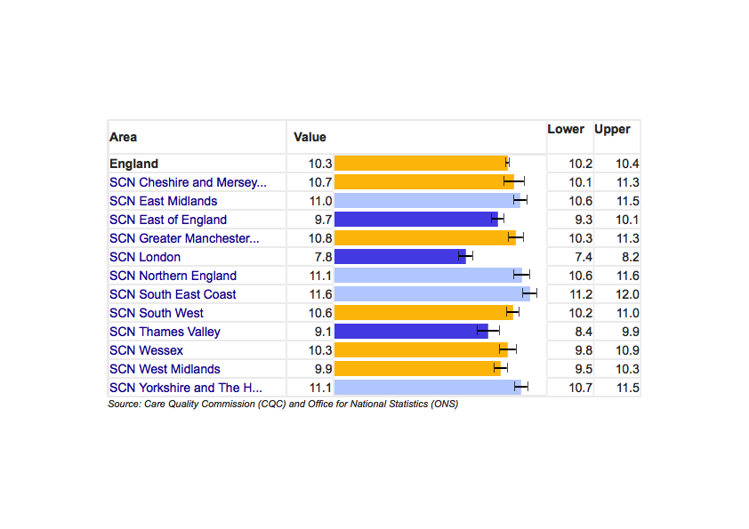
End of Life Care in Care homes
Care home beds / 100 75+ year olds

Slide 8
End of Life Care Clinical Network
We are working to improve the experience and care of Londoners who might be in the last year of life through supporting BETTER COMMISSIONING
Along with BETTER INFORMATION SHARING
And SUPPORT FOR PATIENTS, CARERS AND STAFF through
Publication of information related to the provision of essential and desirable elements of care important for EOLC, by CCG and by STP
Support of London Digital Programme and LHCIE teams to develop and optimise work / integration with, and use of CMC and other EPaCCS in all settings
Development and publication of a unified resource to support bereaved people
Working with HLPA and three AHSNs to develop and deliver a project focussed on care homes that will include a regional toolkit for STPs and CCGs on excellent EOLC for care home residents
Working with London Homeless Health programme to facilitate increased awareness and better care of homeless people approaching EOLC
Clinical leads working directly with STPs leads to develop high quality EOLC programmes
Support for CCGs through EOLC commissioners network meetings
Support the regional recommissioning of EOLC drugs in the community to reduce inequity of availability
Which leads to BETTER OUTCOMES IN EOLC
Better care for homeless people in London
More CCGs have 7 day a week specialist palliative care services and 24/7 availability of other services essential for EOLC
Fewer deaths in hospital – and more in preferred place to die
Better care and reduced non-elective admissions
by care home residents
Equitable access to drugs needed for EOLC throughout London

Slide 9
End of Life Care for Frail Care Home Residents
Dr Anna Gorringe EOLC Clinical Lead, UCLPartners
Chris Larkin EOLC Education Project Manager, UCLPartners
24 May 2018

Slide 10
Ambitions for Palliative and End of Life Care

Slide 11
Ambitions for Palliative and End of Life Care

Slide 12
Ambitions for Palliative and End of Life Care

Slide 13
UCLPartners End of Life Care Project
UCLPartners - Academic Health Science Network for North Central and North East London
Commissioned by Health Education England to develop educational resources supporting delivery of excellent EOLC in different settings:
Acute Hospitals – Milestones (2015)
Community – You Matter (2016)
Care Homes – What’s Best For Lily? (2018)

Slide 14
Milestones and You Matter
Milestones – EOLC in Acute Hospitals
UCLPartners film shows elderly man dying in acute hospital
Recognising deterioration
Effective communication
Making a plan of care
Physical care at the end of life
You Matter – EOLC in the Community
ELFT film shows elderly Muslim man dying in own home
Preparing for a death in the community
Effective communication
Making a plan of care
Physical care at the end of life
Advanced Care Planning (ACP)
Train the Trainer approach:
300+ Trainers have delivered education for ~3,000 learners in 26+ organisations
~20% increase in confidence sustained for 8 months

Slide 15
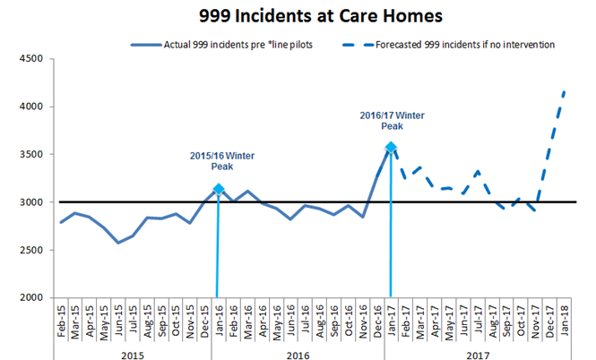
Why is EOLC in care homes a priority?
30.1k care home beds v. 29.7k acute beds in London
London has:
Fewer deaths in care homes (14.9% vs. 22.4% across England)
More deaths in hospital (52.5% vs. 46.0% across England)
Fewer deaths in usual place of residence (38.0% v. 46.0% across England)
87% of LAS incidents at London care homes result in ED conveyance
Projected 999 attendance at care home incidents will increase if there is no intervention to support care homes
Notes:
http://www.endoflifecare-intelligence.org.uk/data_sources/place_of_death

Slide 16
What’s Best For Lily?
Care home staff have different learning needs from acute / community staff:
Can’t assume they have clinical knowledge
Need to use less complex language to communicate ideas
Teaching Film
11 minute film shows last weeks and days of a resident’s life from different perspectives:
i.) Lily (care home resident with dementia)
ii.) Lily’s son
iii.) Care home carer
Lesson Planning Guide
4 thematic modules, including:
Gradual and sudden deterioration
Care in the last days of life
Looking after ourselves
11 learner activities, including:
Mapping changes in condition
Recognising non-verbal pain
Supporting a family member

Slide 17
What’s Best For Lily?

Slide 18
Models for Delivery of Care Home Education
Train the Trainer:
Approach used with UCLPartners EOLC resources in acute and community settings
Inexpensive, potential to be very effective
Often challenging to find ‘the right people’ as Trainers:
Requires confidence and subject knowledge to facilitate EOLC education
Delivering education often without protected time, on top of clinical day job
Champion Trainer:
Care Home identifies 2 ‘champions’ who attend extended Train the Trainer
Champions supported to deliver EOLC education for colleagues
Currently piloting approach in 3 care homes in NCL
Model has been successful but too resource intensive to work at scale

Slide 19
Focused System Support Offer
Improvement Team Facilitator delivery model
Targeted at 39 nursing homes in Barking & Dagenham, Havering & Redbridge (BHR)
2.5 – 4 hour educational session delivered for up to 12 learners at a time within nursing home
Educational sessions delivered by NELFT Band 7 Facilitator (post funded by UCLPartners)
Learners will include all care staff in nursing home, possibly other professional groups
Ambition for at least 70% of staff in target nursing homes to be trained by March 2019
Notes:
Jane to update based on comments from ES and recirculate
Re SLA between HLP/NELFT and UCLP discuss process with Geraldine then arrange meeting with appropriate people at UCLP/HLP

Slide 20
Proposed ‘Improvement Team’ Model
Hosted by Community Trust
CCG Quality & Safety Team
Community Matron
Band 8B
Admin Assistant Band 3
Sig 7 Facilitator
Sig 7 Facilitator
EOLC Facilitator
Peer Support Lead
(TBC)

Slide 21
Evaluation
Externally-supported, robust evaluation to be commissioned
“How effective is the Improvement Team service / delivery model at improving care for residents?”
Mixed methods approach
Evaluation to make recommendations for scaling up Improvement Team model across London

Slide 22
Pan-London Offer
Train the Trainer delivery model
Targeted at Top 100 care homes in London (as measured by highest LAS incidents / conveyances)
Trainers likely to be from NHS/local authority services working with target care homes
Ambition for at least 91 Trainers to be trained by March 2019

Slide 23
UCLPartners End of Life Care Resources
You Matter (community)
Stream Film: youtube.com/watch?v=il7dJMESCpY
Download Resources: uclpartners.com/case-study-eolc/
Milestones (acute hospital)
Stream Film: youtube.com/watch?v=Rwcykb47PgM
Download Resources: uclpartners.com/case-study-eolc/
What’s Best For Lily? (care homes)
Available free of charge from June 2018
Stream Film: youtube.com/watch?v=bRBbIrJ4ZNU
Download Resources: uclpartners.com/what-we-do/clinical-themes/end-of-life-care/

Slide 24
Chris Larkin
e: chris.larkin@uclpartners.com
t: 020 3108 2346

