Slide 1
What effective Healthcare in Care Homes Looks like
Dr Adam Gordon
Clinical Associate Professor in Medicine of Older People
adam.gordon@nottingham.ac.uk
@adamgordon1978

Slide 2
Optimal was funded by NIHR Health Service Delivery and organisation (HSDR 11/021/02) The views and opinions expressed herein are those of the authors and not necessarily reflect those of the NIHR HSDR or the Department of Health.

Slide 3
OPTIMAL TEAM
Sue L. Davies
Mel Handley
Andrea Mayrhofer
Brian Bell
Tom Dening
John Gladman
Justine Schneider
Maria Zubair
Clive Bowman
Julienne Meyer
Heather Gage
Jake Jordan
Steve Iliffe
Finbarr Martin
Christina Victor

Slide 4
The starting point….
There are between 415,000 and 450,000 care home residents in the UK.
They use healthcare resources frequently.
And not always effectively or efficiently.
Over 100 different “models” of healthcare provision but frequently ad hoc, reactive and chaotic.

Slide 5
The OPTIMAL study
Survey of Surveys
Interview Study
Literature Review
Case Studies

Slide 7
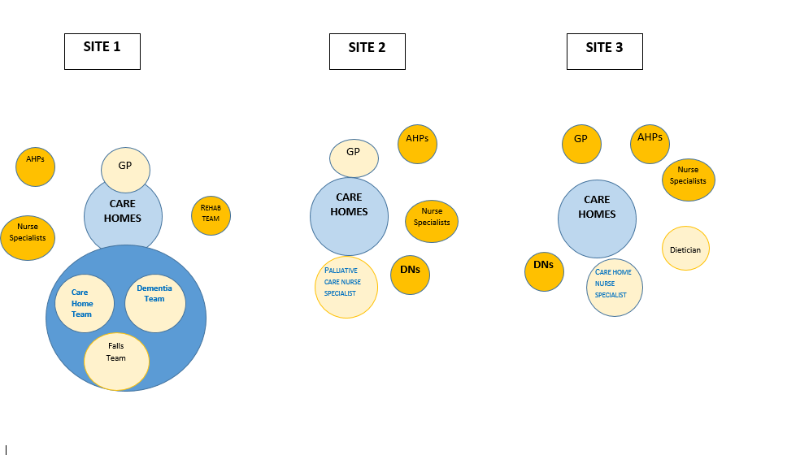
Continuum of integration and referral systems

Slide 8
Achieving Common Ground
Ask care homes, including residents and relatives, what works for them.
Consider that every care home will be different – avoid “one size fits all”.
Consider care home readiness for change.

Slide 9
Learning and Working
Find way to work with care homes at an institutional level, as well as engaging with individual resident.
Consider how the organisational structure of the care home can support care delivery, including education and training, and audit.
Consider badging jobs/services, or parts of them, as “care home specific”.

Slide 10
Wrap around care
Consider how care home staff trigger, refer to and interact with your service.
Consider how services with care homes interconnect, make referrals, share observations and exchange ideas.
You can’t write GPs out of service models – but you can make different (perhaps even better) use of their time.

Slide 11
Living and Dying with Dementia
Whatever you choose to do needs to work for residents with dementia.
And to link into dementia-specific care home services.

Slide 12
https://www.england.nhs.uk/wp-content/uploads/2016/09/ehch-framework-v2.pdf

Slide 13
https://www.ncbi.nlm.nih.gov/books/NBK459420/

Slide 14
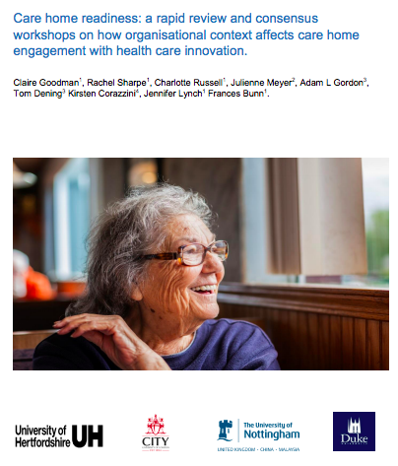
http://researchprofiles.herts.ac.uk/portal/files/11749027/Vanguard_Care_home_readiness_report_FINAL.pdf

