Slide 1
Welcome
Eugenia Lee, Chair and GP Lead, HLP
Tracy Parr, Head of CYP Programme, HLP

Slide 2

How to transform primary care for CYP
Welcome!
#CYPprimarycare
@HealthyLDN

Slide 3
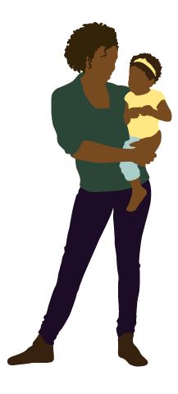
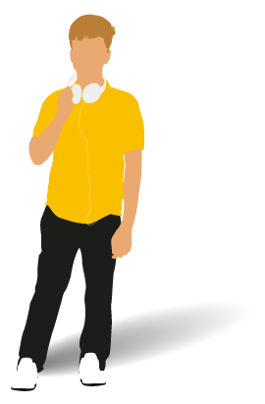
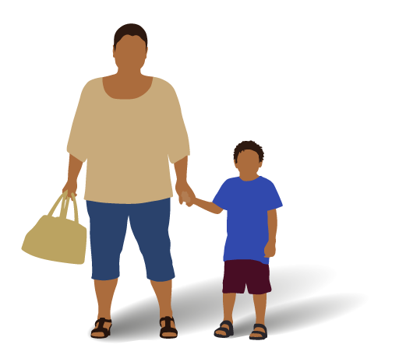
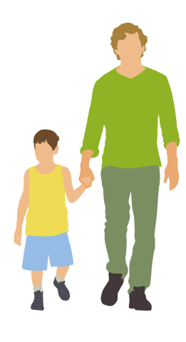
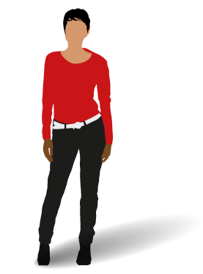
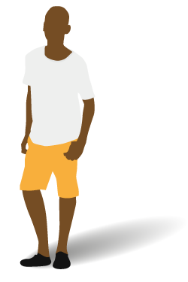
What do children, young people and families think?
Make sure the school can look after my son when he has an asthma attack
I want to know that my GP is experienced in caring for children
We need easier access to healthcare
Services are not joined up
I am worried about what will happen next year when I am too old for the children’s clinic
I need rapid access to someone I can talk to when I feel depressed

Slide 4
Issues: Primary care
CYP make up over 40% of the primary care workload – yet GPs tell us they see ‘very few young people’
0-25 years is a huge age range and there are significant differences in how young people need to access primary care
CYP are twice as likely as other groups to attend A&E or walk-in centres rather than see their family doctor
Navigating services for CYP is a challenge for patients and healthcare professionals
There is a lack of well developed models of care for CYP in the primary care setting
Status quo sustainability and the opportunity from at scale work
This is why we are here today: to support each other in the transformation of primary care services for CYP
And to launch a toolkit of resources to support this effort.

Slide 5
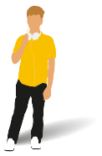
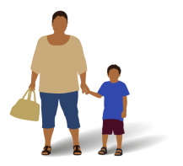
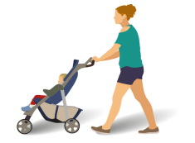


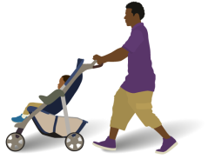


Healthy London Partnership –
Children and Young People’s programme
Key facts
8.2 million
people live in London
of which
20% of 4-year-olds are overweight or obese
2,049,576
are children aged 0-19
Mental Health conditions affect
1 in 8
Children
Emotional and
behavioural
problems affect
1 in 5
children
600,000
of London’s children
live in poverty
25% of 15-year-olds
LESS THAN HALF
of 11-15
year olds do
an hour of
exercise each
day
134,186
live births in
London in 2012
First smoked
AGED 13 or younger
40%
of 15-year-olds
drink alcohol
once a week
20%
of 13-year-olds
drink alcohol
once a week

Slide 6
Highlights of agenda
Giles Armstrong on what GP Networks can do to reduce ED admissions
Sam Everington on his experience of bringing about change in Tower Hamlets
Michael Marmot on equity of care from the start of life
PLUS – a marketplace of innovative models and tools
And a series of practical workshops to support you in your practice
  Managing guidelines
  Creating a young-person friendly environment
  Networked care and how it can meet the needs of CYP
  New and innovative ways of working with your pharmacist

Slide 7
Is it possible for GP networks to prevent ED attendances and admissions for CYP?
Giles Armstrong, HLP lead for CYP UEC

Slide 8
The story so far

Slide 9
21st Century Urgent & Emergency Care (so far)
NHS Direct obtained national coverage in 2000 (website go live in 1999)
Walk-in centres & minor injury units started to open from approx. 2000 onwards
GP contract changed in 2004, with provision for OOH care moving to PCTs
Introduction of the 4-hour target in 2004 (initially 98%, dropped to 95% in 2010) led to improved performance for most of first decade of 21st Century
NHS 111 launched 2013/14 (and NHS Direct closed 2014)

Slide 10
Current challenges in UEC
From 2011 onwards performance in ED against the 4-hour target has steadily deteriorated – including for CYP
Rising numbers of all ages attending ED, MIU, WIC – including for CYP
Increasing numbers of patients with long-term chronic health conditions who require repeated hospitalisation – including for CYP
General public confronted by an ever increasing number of routes to access UEC service – including for CYP
Particular challenge with people having an acute mental health crisis – including for CYP

Slide 11
Challenges for the Primary Care / UEC in CYP
Pressures on primary care in London
  More 0-14yr olds compared to rest of England
  Roughly equal numbers of GP / head pop across London as whole but huge variation within region
  Pressure to provide GP care in EDs
  Pressures to recruit and retain GP
  SO – Is it possible for GP networks to prevent ED attendances and admissions for CYP?

Slide 12
Alternative Models of Care (AMoC)

Slide 13


Slide 14
The AMoC report
Study published by HLP in May 2107 (https://www.healthylondon.org/resource/new-acute-models-care-children-young-people/)
Carried out in winter 2016 with prospective data collection over 2 weeks from 6 EDs in London.
Data collected on 3020 CYP (0-17yr) who attended EDs from 10:00-22:00
Looked at 9 models of care:
  Nurse-led acute illness team for CYP
  Nurse-led walk-in centre for illness in CYP
  Multi-speciality community provider for CYP
  Enhanced GP practice
  GP confederation CYP service
  Community walk-in centre for CYP
  Primary & acute care systems (PACS) acute health centre for CYP
  Community pharmacy
  Current GP practice

Slide 15
Study findings
All of the AMoC showed that some of the CYP patients presenting to ED in extended day time hours could be seen elsewhere
Percentages varied from 9.5% (community pharmacy) to 75.5% (PACS – GP practice on hospital site)
GP confederation CYP service = 44.6% (range of 34.5 – 55.9% across sites)
  APNPs & GPs
  Minor injuries & illness
  Appointment only
  Extended hours
  Regular support from paediatrician (support available within 48 hrs)
  Preliminary costings worked out as £108/pp

Slide 16
Opportunities for GP Networks

Slide 17
What are the opportunities?
Increasing pressures on EDs – including for CYP
Current focus more on adults & elderly rather than CYP
Move towards setting up GP networks / federations
AMoC Study shows viability of setting up CYP specific services within the networks

Slide 18
Time for a quick debate

Slide 19
Over to you
What are the barriers?
What are the enablers?
What are the next steps?

Slide 20
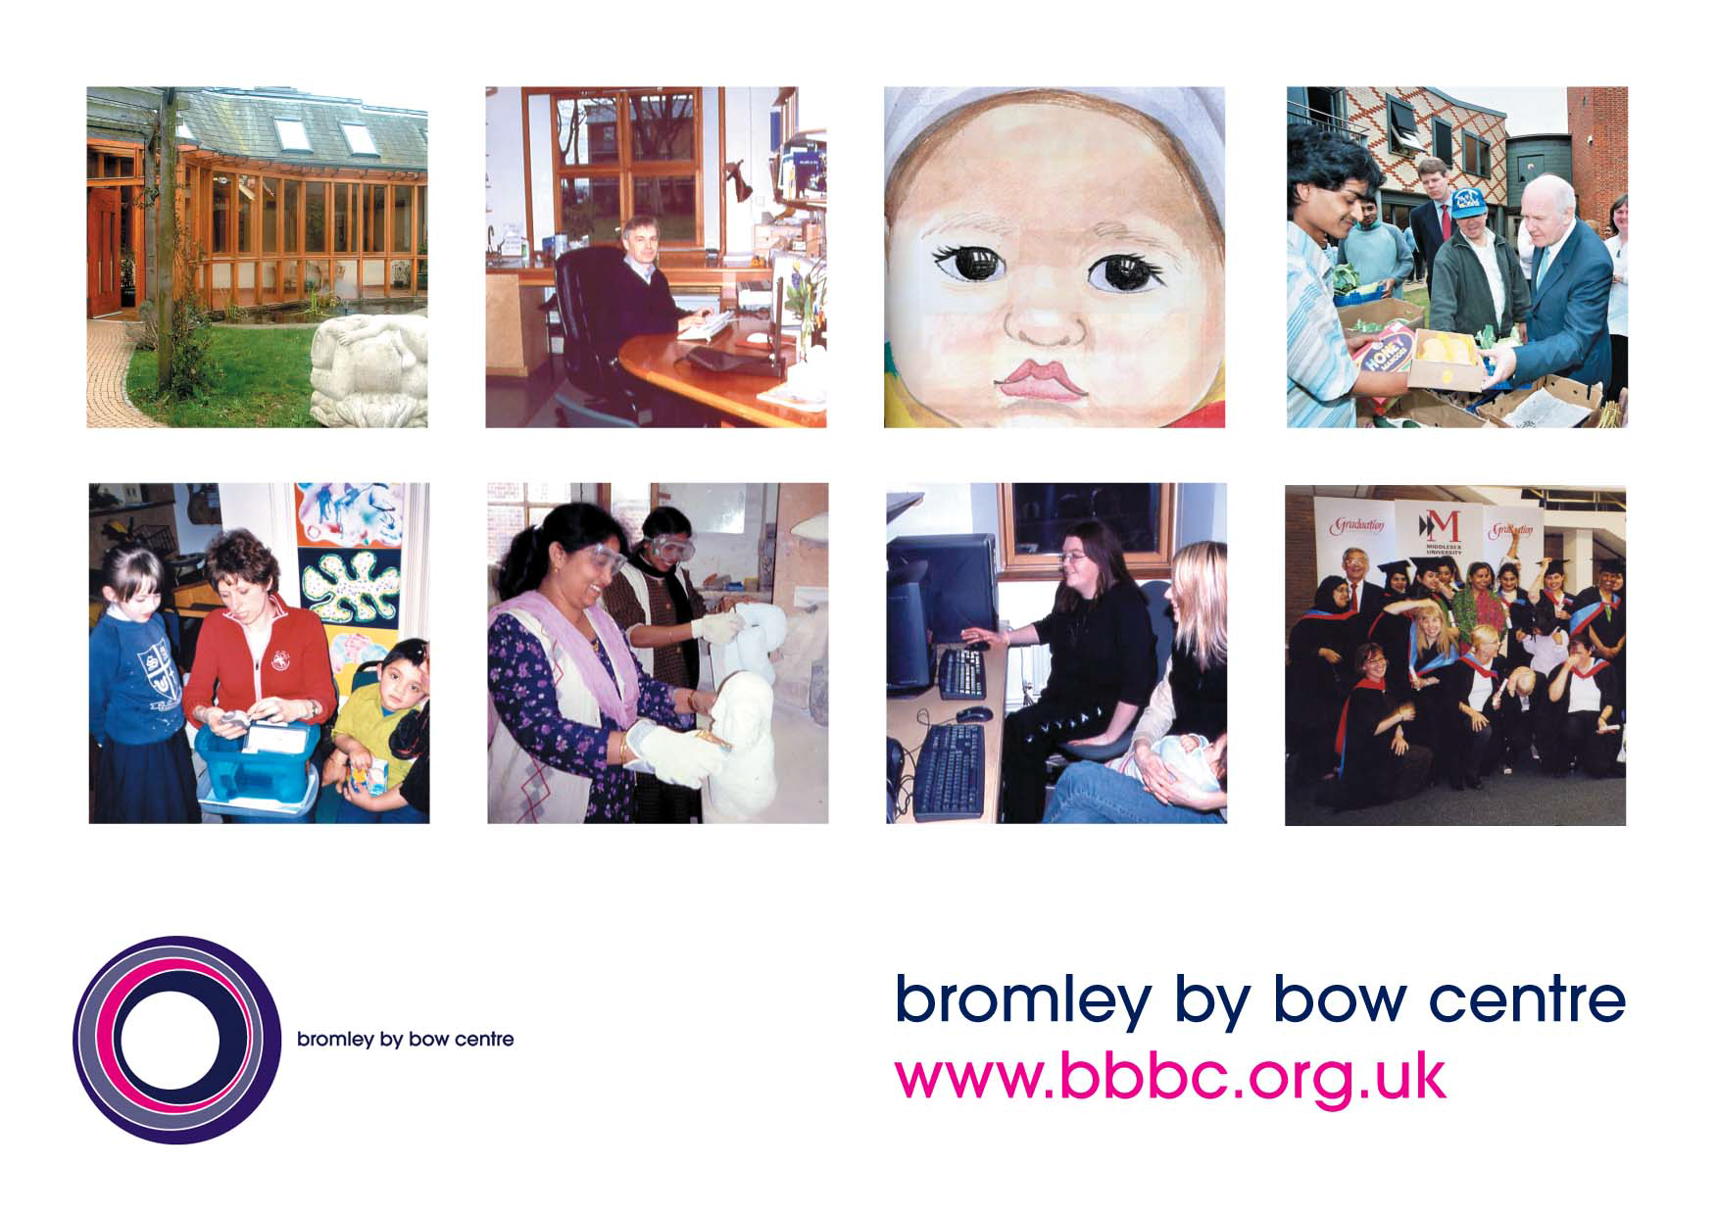
Sam Everington’s slides

Slide 21
Social determinants, health equity and young people
Prof Sir Michael Marmot
www.instituteofhealthequity.org
@MichaelMarmot
London
April 2018

Slide 22

What good does it do to treat people and send them back to the conditions that made them sick?

Slide 23
Aboriginal Youth Suicide by Factors Present
Cultural Factors:
Self-government
Land claim participation
Community Control:
Health services
Education
Cultural facilities
Police/fire services
140
120
100
80
Suicide Rate per 100,000.
60
40
20
0
0
1
2
3
4
5
6
Total Number of Cultural Factors Present
Chandler & Lalonde, 1998
Notes:
In the 5-year study window:
When no cultural factors were present a suicide rate of 137.5 per 100,000 was found
When all 6 cultural factors were present there were no suicides within the study time frame
Overall, their analysis found a strong linear relationship between suicide risk and the number of cultural factors present.
Source: Chandler, MJ, and Lalonde, C. 1998. Cultural continuity as a hedge against suicide in Canada’s First Nations. Transcultural Psychiatry, 35(2), pp. 191-219.

Slide 24
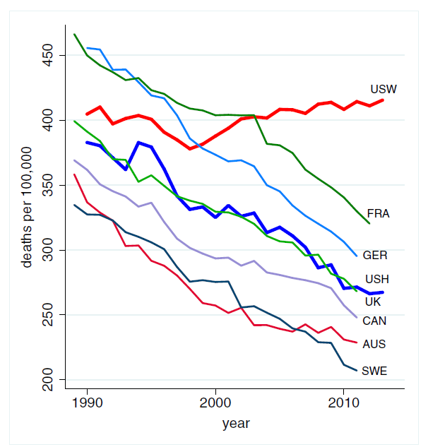
All-cause mortality, ages 45–54 for US White non-Hispanics, US Hispanics and 6 comparison countries
US White non-Hispanics (USW),
US Hispanics (USH),
France (FRA),
Germany (GER),
United Kingdom (UK),
Canada (CAN),
Australia (AUS),
Sweden (SWE).
Case & Deaton, PNAS, 2015

Slide 25
SMRs by cause, all ages:
Glasgow relative to Liverpool & Manchester
Source: Walsh D, Bendel N., Jones R, Hanlon P. It’s not ‘just deprivation’: why do equally deprived UK cities experience different health outcomes? Public Health, 2010
from H Burns, CMO, Scotland
Notes:
25

Slide 26
Health improvement in difficult times
A major element of the excess risk of premature death seen in Scotland is psychosocially determined
Study evidence of low sense of control, self efficacy and self esteem in population in these areas
H. Burns, CMO Scotland

Slide 27
The mind is gateway by which social determinants affect ill-health.
Mental illness and well-being.
Psychosocial pathways to physical illness
  Behaviours
  Stress pathways

Slide 28
Life expectancy and disability-free life expectancy (DFLE) at birth, males by neighborhood deprivation, England, 1999–2003 and 2009-2013

Slide 29
Long term outcomes associated with childhood behavioural problems (New Zealand study)
OR
Source: L. Friedli & M. Parsonage (2007) Mental health promotion: Building an economic case. Based on: Fergusson et al (2005) J. Child Psychl & Psych 46 (8): 837-849
Notes:
Longitudinal evidence on adult outcomes
A study by Fergusson et al (2005) provides data from a 25-year longitudinal study of a birth cohort of young people in New Zealand. Information was collected on child conduct problems at age 7-9 and subsequently on a wide range of outcomes in early adulthood, including crime, substance use, mental health, suicide, sexual/partner relationships and education/employment.
The sample population in the New Zealand survey can be divided into three broad groups, corresponding to:
• those with no conduct problems at age 7-9 years (50%)
• those with some conduct problems (45%)
• those with conduct disorder (5%)
The New Zealand figure of 5% for the size of the most disturbed group corresponds closely
with the estimate of 4.9% quoted above for the prevalence of childhood conduct disorder among
5-10 year olds in Great Britain. The New Zealand survey confirms the evidence of other longitudinal studies that conduct problems in childhood are associated with a wide range of adverse consequences in later life. This association holds true even after controlling for potentially confounding factors such as individual intelligence and socio-economic disadvantage in early life. It is found, for example, that those in the bottom 5% in terms of disturbed childhood behaviour are four times as likely as those in the top 50% to have committed a violent offence by age 25, three times as likely to have attempted suicide and nearly three times as likely to have become a teenage parent, after controlling for other potential influences in each case, and nearly one and a half times more likely to have no qualifications. Based on: Fergusson, D., Horwood, J., Ridder, E. (2005) Show me the child at seven: the consequences of conduct problems in childhood for psychosocial functioning in adulthood. Journal of Child Psychology & Psychiatry 46 (8): 837-849

Slide 30

Social justice
Material, psychosocial, political empowerment
Creating the conditions for people to have control of their lives
The CSDH – closing the gap in a generation
2005-2008
The Marmot Review – Fair Society Healthy Lives
2009/10
Notes:
30

Slide 31
Marmot Review: 6 Policy Objectives
Give every child the best start in life
Enable all children, young people and adults to maximise their capabilities and have control over their lives
Create fair employment and good work for all
Ensure healthy standard of living for all
Create and develop healthy and sustainable places and communities
Strengthen the role and impact of ill health prevention

Slide 32
Marmot Review: 6 Policy Objectives
Give every child the best start in life
Enable all children, young people and adults to maximise their capabilities and have control over their lives
Create fair employment and good work for all
Ensure healthy standard of living for all
Create and develop healthy and sustainable places and communities
Strengthen the role and impact of ill health prevention

Slide 33
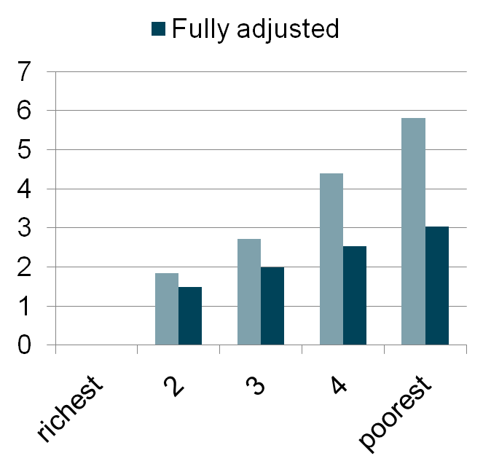
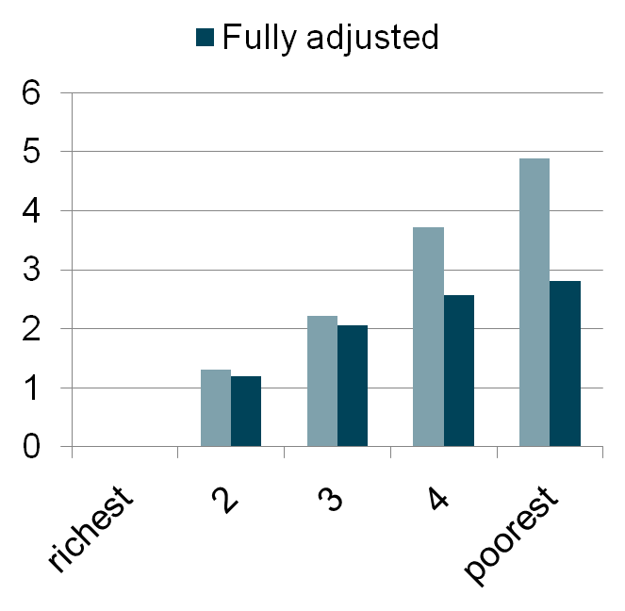
Socio-emotional difficulties at age 3 and 5:
Millennium Cohort Study
Age 3
Age 5
Fully adjusted = for parenting activities and psychosocial markers
Kelly et al, 2010
Notes:
Pale blue bars – adjusted for gender, mother’s age at birth of child, child is first born, languages spoken at home;
Fully adjusted – additionally adjusts for: someone reads stories to the child; someone teaches the child songs, the alphabet, counting; the child does painting activities at home; child is taken to the library; a parent has basic skills difficulties; the child has regular meal and bed times, additionally adjusts for: discipline scale; child-parent relationship (Pianta) scale; Mother's K6 score; HOME inventory score; Mother's parenting competence; family rules and enforcement of rules

Slide 34
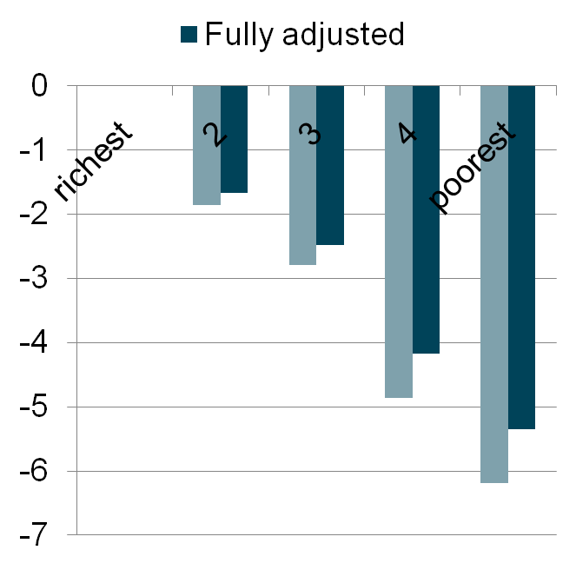
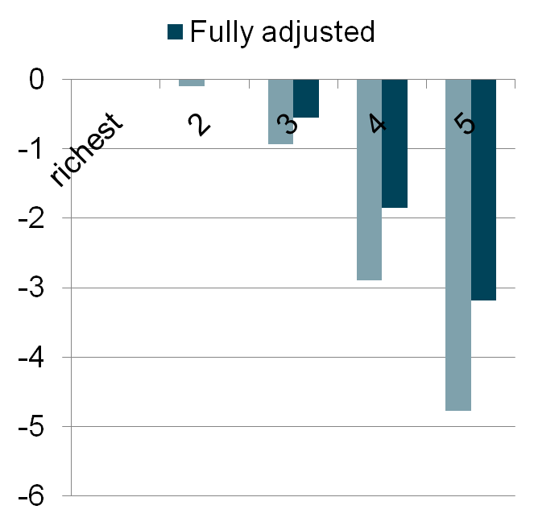
Verbal ability at age 3 and 5 by family income:
Millennium Cohort Study
Age 3
Age 5
Fully adjusted = for parenting activities and psychosocial markers
Kelly et al, 2010 in press
Notes:
Pale blue bars – adjusted for gender, mother’s age at birth of child, child is first born, languages spoken at home;
Fully adjusted – additionally adjusts for: someone reads stories to the child; someone teaches the child songs, the alphabet, counting; the child does painting activities at home; child is taken to the library; a parent has basic skills difficulties; the child has regular meal and bed times, additionally adjusts for: discipline scale; child-parent relationship (Pianta) scale; Mother's K6 score; HOME inventory score; Mother's parenting competence; family rules and enforcement of rules

Slide 35
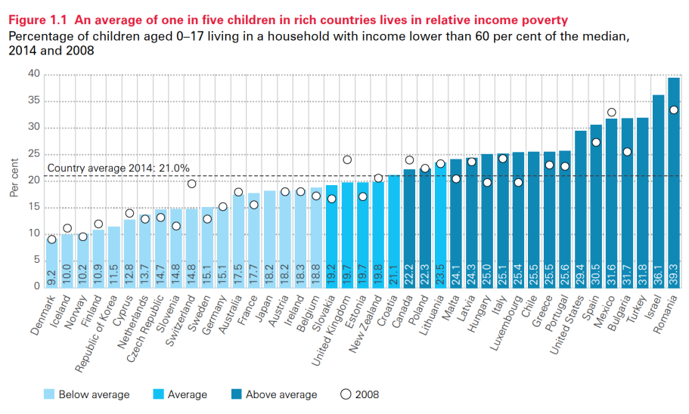
Child poverty (<60% median income)
UNICEF Report Card 14

Slide 36
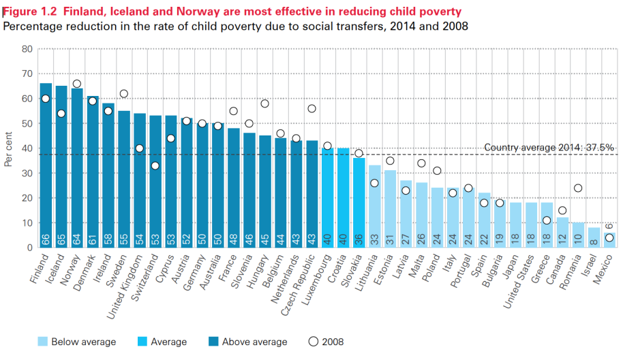
Reducing child poverty by social transfers

Slide 37
All cause mortality <50 years by prevalence of ACEs
Kelly-Irving M et al. EJ Epidemiology. 2011

Slide 38
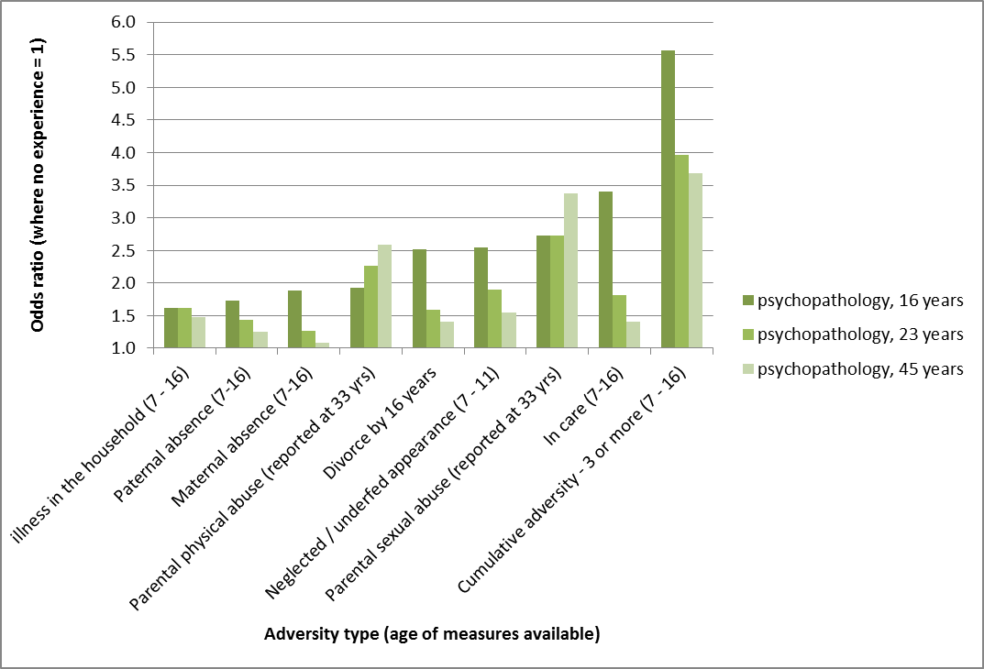
Increased odds ratio of psychopathology associated with various types of ACE, by age, UK, 2008
Clark C et al. Social Psychiatry and Psychiatric Epidemiology 2012.
Notes:
This is controlling for sex and socioeconomic status. There are higher rates for unadjusted rates.

Slide 39
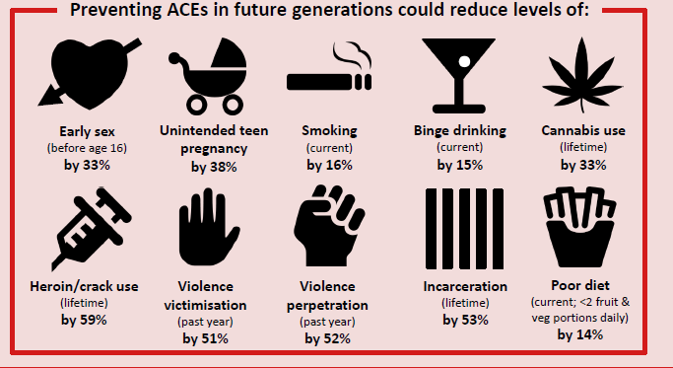
Adverse Childhood Experiences: England
Bellis et al., 2014

Slide 40
Marmot Review: 6 Policy Objectives
Give every child the best start in life
Enable all children, young people and adults to maximise their capabilities and have control over their lives
Create fair employment and good work for all
Ensure healthy standard of living for all
Create and develop healthy and sustainable places and communities
Strengthen the role and impact of ill health prevention

Slide 41
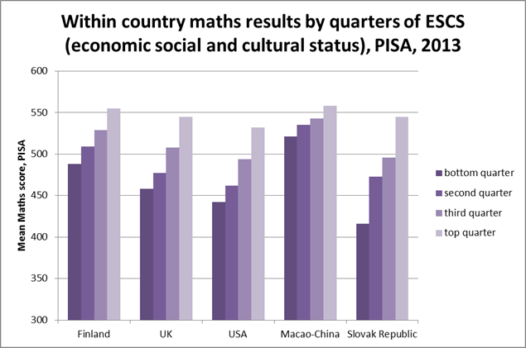
Source: PISA, 2013
Notes:
Health Gap Figure 5.6 Getting it all to add up… for everyone. Keeping up with the Chinese

Slide 42
Marmot Review: 6 Policy Objectives
Give every child the best start in life
Enable all children, young people and adults to maximise their capabilities and have control over their lives
Create fair employment and good work for all
Ensure healthy standard of living for all
Create and develop healthy and sustainable places and communities
Strengthen the role and impact of ill health prevention

Slide 43
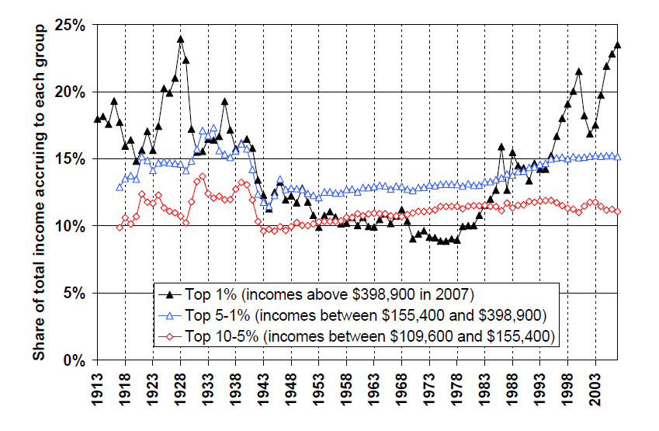
Trends in income share among top income decile, US: 1913-2007

Slide 44
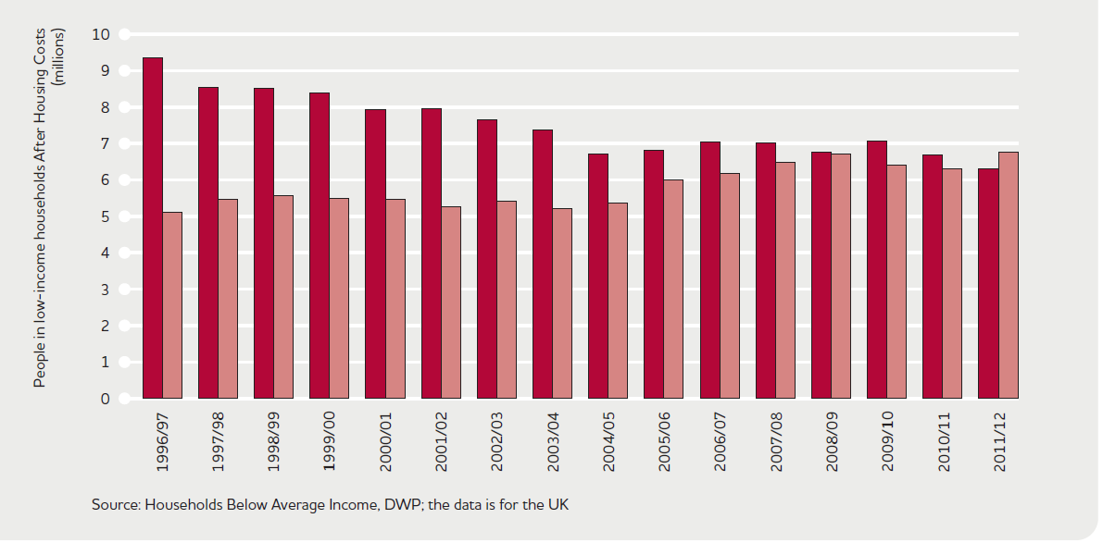
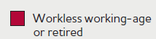

6.7 million of the 13 million people in poverty are in working households, UK 2011/12
(JRF 2013 using DWP data)
Notes:
6.7 of the 13 million people in poverty - surviving on less than 60% of the national median (middle) income - were from working families in 2011/12

Slide 45
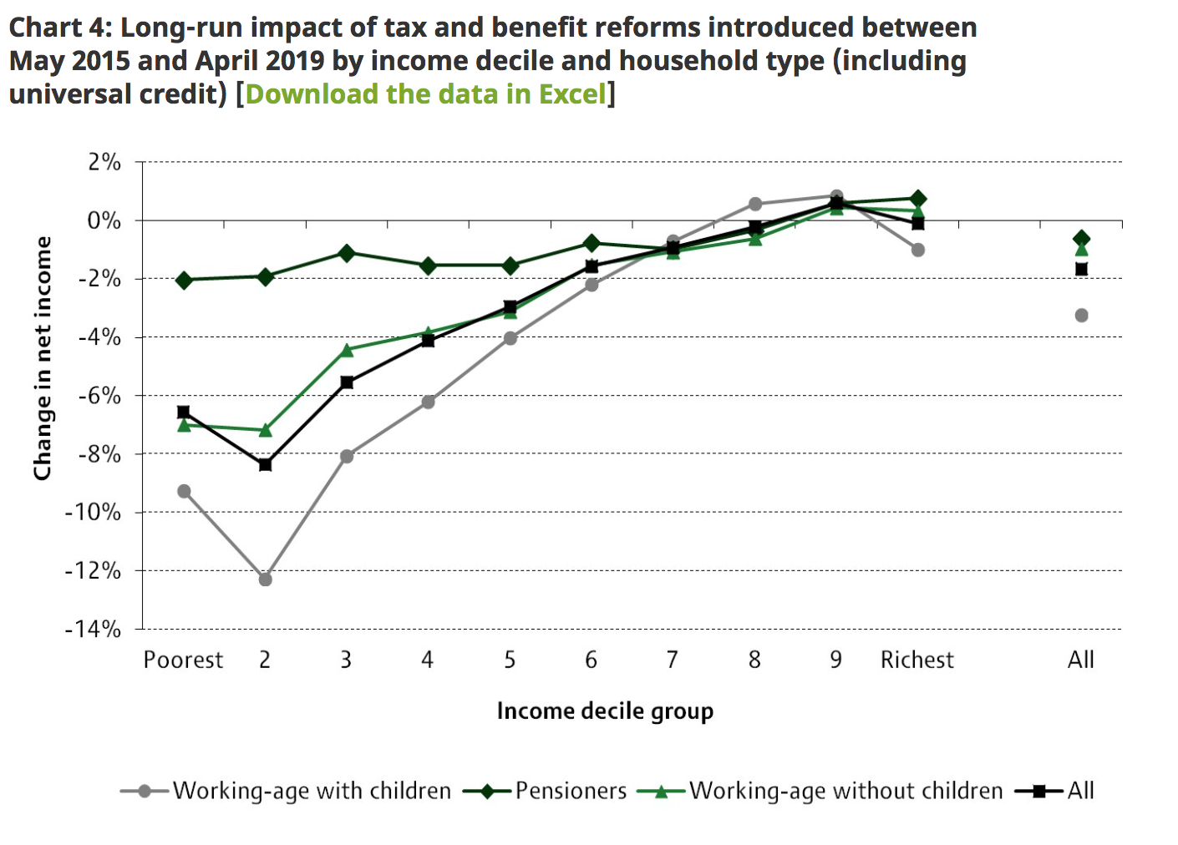

Slide 46
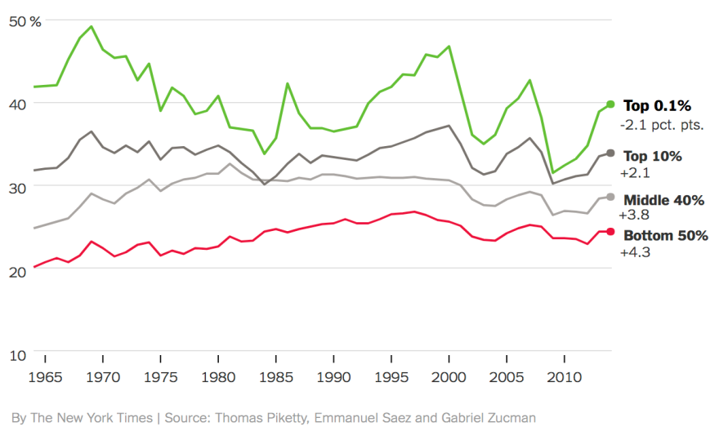
A Less Progressive Tax Code USA
Total tax rate by income group

Slide 47
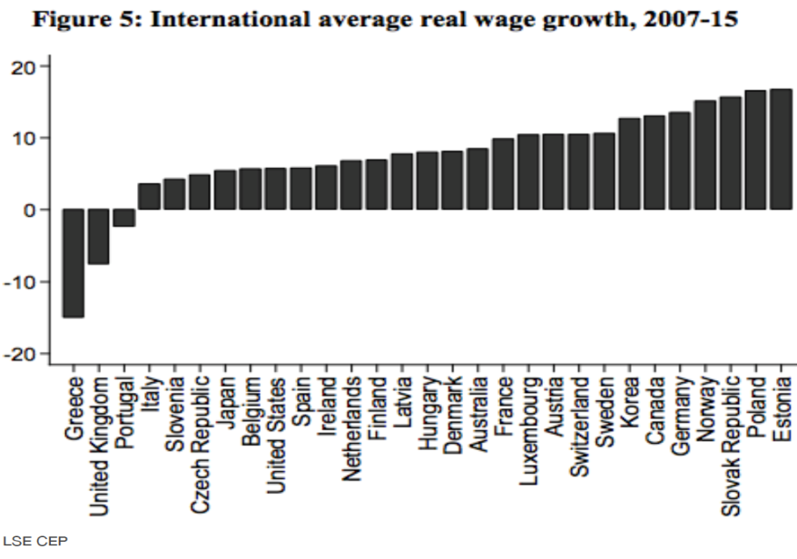

Slide 48
Tax havens increase inequality
50% of wealth in tax havens belongs to top 0.01% of people in advanced economies
That wealth is equivalent to 5% global GDP
Tax avoidance on massive scale
Added to that is avoidance of tax by multinationals
Zucman, G. Guardian 8 Nov 2017

Slide 49
Multinationals’ tax avoidance
€600bn a year shifted to world’s tax havens
€350bn into European tax havens – mainly profits from EU countries. Taxed at 0 to 5%
Deprives the EU of a fifth of corporate tax revenue: €60bn a year
For the UK €12.7bn a year
Cf £350m a week is £18.2bn a year
Zucman, G. Guardian 8 Nov 2017

Slide 50
My two messages in a world of post-fact politics
Evidence-based policy
Spirit of social justice
Remember: We said that
“Social injustice is killing on a grand scale”

Slide 51

Martin Luther King

Slide 52
Next steps
Eugenia Lee: Chair and GP Lead, HLP

Slide 53


