Slide 1
Mental Health Crisis Care Toolkit
Resources to support the quality and consistency of mental health crisis care services across London

Slide 2
Contents
01 | Training slides on the 2018 Mental Health & Emergency Departments: A workshop on the law and good practice | p. 5 – 28
02 | Section 136 pathway roles and responsibility briefings | p. 28 – 29
03 | Voluntary handover process for mental health crisis care patients brought to emergency departments by the police | p. 30 – 34
This resource pack has been developed to support London’s mental health crisis care system in providing high quality and consistent care across the capital.
It includes training materials from sessions delivered to almost 300 multi-agency staff across the capital in 2018 that focussed on the Mental Health Act, the Mental Capacity Act and the alignment of local policies to the pan-London s136 pathway. Also included are roles and responsibility briefings for staff along the s136 pathway, which summarise the key points from London’s s136 pathway guidance.
Lastly, a handover process for voluntary mental health crisis patients to support the safe handover of voluntary patients brought into the emergency department (ED) by the police has been included in the pack. This was developed through partnership between London’s Urgent and Emergency care system and the Metropolitan Police Service and piloted with great success at four EDs in London in 2017. Following approval by London’s Urgent and Emergency Care Transformation and Delivery Board, the handover process was rolled out across the capital from 1st March 2018 with all three of London’s police forces involved.

Slide 3
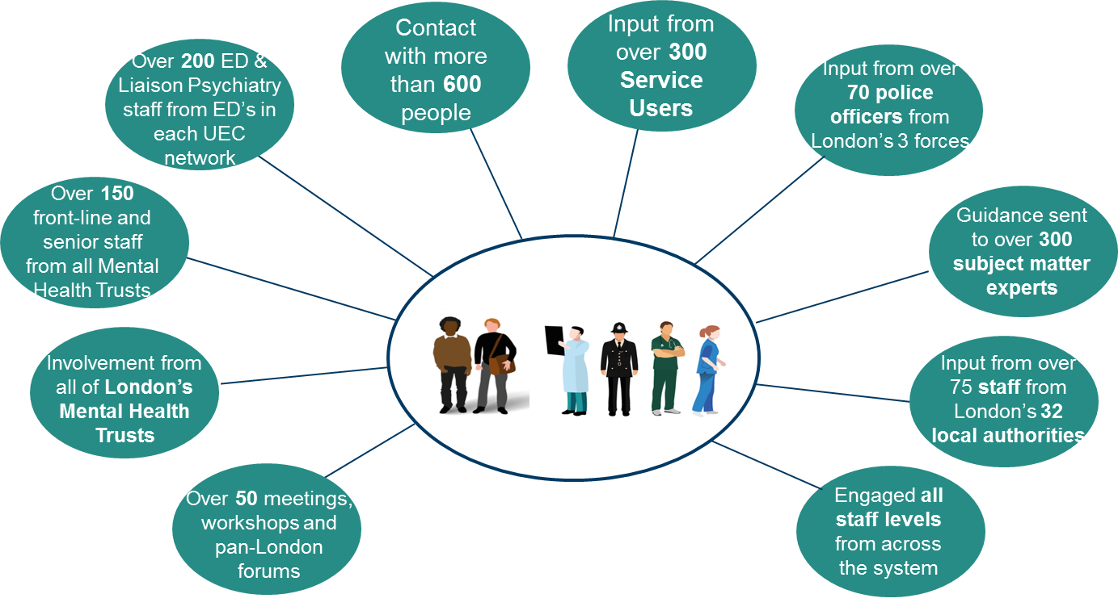
Context
The Better Health for London report (2014) stressed the need for improved mental health crisis care services in London, specifically ‘the development of a pan-London multi-agency model of care for child and adult mental health patients in crisis’.
Since 2015, Healthy London Partnership (HLP) and London’s crisis care system have worked together to develop London’s s136 model of care. It was decided that there should be a pan-London focus on the section 136 pathway and Health Based Place of Safety sites to improve the current inconsistencies across London and often inadequate care for those who are some of London’s most vulnerable.
Throughout 2016 , the Mental Health Crisis Care programme carried out significant engagement across the crisis care system to develop a multi-agency model of care for mental health patients in crisis.
The service user experience drove this initiative telling us what they believe crisis care services in London should look like…
When I am in crisis police presence is as low key as possible and there is no unnecessary use of restraint.
I am listened to and my voice is heard; at the point of crisis I might not be able to think clearly, make decisions or say everything I am feeling, but I am still a person and should not be ignored. If my behaviour is not appropriate I am not judged for this.
If I am taken to an emergency department or place of safety, I am let in straight away. I don’t have to wait in the transport or any other unsuitable place such as a general waiting room, corridor or outside, while staff negotiate whether or not I can go in.

Slide 4
Context
Healthy London Partnership in collaboration with London’s crisis care system has now developed the following guidance to improve the consistency and quality of care across the section 136 pathway:
The Health Based Place of Safety (HBPoS) Specification outlines the minimum standard of care London’s Health Based Place of Safety sites should offer. This includes details on staffing requirements, governance arrangements, environment and facilities and details on the mental health assessment process.
The Section 136 Pathway looks at the roles and responsibilities of all stakeholders involved across the pathway, it specifically focusses on the roles of the Police as well as the London Ambulance Service, AMHPs, ED staff (if physical health care is required) and staff at the Health Based Place of Safety.
The guidance was endorsed by all key partners and launched by the Mayor of London in December 2016 at a multi-agency stakeholder event at City Hall.
Click to view the guidance
Service user and partner satisfaction has driven further initiatives to support implementation of the s136 model of care as well as other improvements to London’s mental health crisis care system.
Multi-agency mental health training sessions at each of London’s Mental Health Trusts, Emergency Departments & London Ambulance. Over 600 staff trained to date from all the different agencies and 14 sessions are scheduled in London EDs in spring 2019.
See p5 for training slides
A handover process for voluntary mental health patients attending ED with police has now been implemented London-wide with all three of London’s police forces.
See p30 for further information

Slide 5
Training slides on the 2018 Mental Health & Emergency Departments: A workshop on the law and good practice

Slide 6
Scope of this presentation
ED staff may encounter
People who are brought to hospital by the police under s.136 of the Mental Health Act 1983 (‘MHA’)
People under arrest who have been brought by the police for health checks who exhibit symptoms of mental disorder
People who have ben brought in (or have presented themselves) for health treatment who lack the mental capacity to make safe decisions about their own care
People with mental health problems who have agreed to come in with the police (new voluntary handover process)
What does the law require of hospital staff in each case?
What are the issues & difficulties in practice?

Slide 7
Clinical responsibility & legal accountability
If someone at ED presents a risk to themselves, or to others, there are two accountabilities for them:
Who is responsible for their clinical treatment & care?
Who is legally responsible for keeping them safe & stopping them walking out?- The same person or someone else?
Problems arise when these accountabilities get blurred (see e.g. Webley v SW London & St George’s MH Trust, 2014)
At any given time it must be clear who is legally responsible for managing the person, as well as who has clinical responsibility

Slide 8
Parity of esteem
The principle of ‘parity of esteem’ says that everyone is entitled to equal treatment without discrimination
If person would be treated for their physical health, then in principle they are entitled to be seen for their mental health
A decision to exclude any patient from ED is a serious one and should be escalated to the senior person on call
The decision should relate to the specific risks that they present, and not to a particular diagnosis or presentation
Some mentally disordered people may need a high level of attention & input- this is a resource issue for the Trust

Slide 9
1: Patient brought in by police voluntarily
Voluntarily’ = has capacity to understand the implications of coming into hospital and has agreed it
Can sometimes be brought in in handcuffs for own protection- but does not mean they are in police custody
ED staff have no power to restrain a voluntary patient in their own interests (unless you decide they lack the capacity to make safe decisions around their own treatment & care).
If they freely choose to leave, you can’t stop them, even if you think it’s potentially dangerous for them.
But: if voluntary patient is putting (or about to put) other people at risk, ‘common law necessity’ allows you to use whatever force you think is necessary to deal with the risk.

Slide 10
2: Patient detained under section 136 MHA
S.136 MHA 1983: If a police officer believes that a person is mentally disordered and in immediate need of care & control, they can, if they think it is necessary, take that person to a ‘place of safety’ (PoS), so that they can be
- examined by a doctor, &
- interviewed by an Approved Mental Health Professional*, &
- necessary arrangements made for their treatment or care.
Until December 2017 the power was only used in a ‘public place’
Now it can be used anywhere except a place of residence
Someone under s.136 is under arrest (so not free to leave)
*Explained below

Slide 11
S.136 MHA (cont): timescales
S.136 detention lasts 24 hours from the moment of arrival at the PoS, unless it is extended by the doctor (see later)
‘Arrival’ means when the person walks through the door, not when ED staff receive them
It is therefore crucial that staff at ED record the time when the person arrives, not just when the person or paperwork is handed over
Police Form 434: The police use this for convenience- it is a record of who has done what when, but it is not a legal requirement- you can record the information somewhere else

Slide 12
Section 136 MHA (cont): ‘place of safety’
A ‘place of safety’ (PoS) is defined as a hospital, a care home, a police station (now only if risk of death or serious injury), or anywhere else if the person in charge agrees to it
Under normal circumstances police will use a designated ‘hospital-based place of safety’ (HBPoS- the ‘136 suite’) - but
They can use the ED (or an in-patient ward) where necessary, e.g. they need medical attention or the HBPoS is full.
Note:
ED can be used as the PoS even if the person does not need medical attention for their physical health
Hospital staff do NOT legally have to agree to the use of ED premises as a PoS

Slide 13
S.136- role of the doctor
Someone under s.136 must always have their mental state examined by a “registered medical practitioner”: this can be any doctor, but normally it is a psychiatrist (who may be approved under section 12(2) MHA- a ‘s12 doctor’)
They may also need attention from an A & E doctor, but this is not the doctor who makes the legal decisions
If the doctor assessing their mental state decides the person has no underlying mental disorder (e.g. they were simply intoxicated), they must discharge the s136 & let them go home
If they do not decide this, the person must also be seen by an ‘approved mental health professional’ (an AMHP)
It is the PoS’s responsibility to notify the local AMHP service that they are needed, so ED staff may need to do this

Slide 14
S.136- role of the AMHP
An “approved mental health professional” (AMHP) is normally a social worker or nurse (occasionally an OT) who has had specialist training. The Borough where the person is at the time the assessment is needed will provide the AMHP.
The AMHP’s role is to interview the patient, talk to the family, get a second psychiatrist involved where needed, and decide whether the person needs to be admitted for in-patient psychiatric treatment- if so, will they go in voluntarily, or do they need to be detained under the MHA (‘sectioned’)?
NB The AMHP is the ultimate decision-maker around hospital admission, but they do not find the bed. This is usually done by Bed Managers on behalf of the Mental Health Trust.
(Can be long delays, especially if patient is from out of area.)

Slide 15
S.136 assessments at ED
Police may bring someone under s136 to ED for two reasons:
The person needs medical attention which cannot be provided at the designated ‘health-based place of safety’ (HBPoS), or
The HBPoS is full and the ED is the next best place of safety
First situation: Patient could be treated at ED then taken or returned to the designated HBPoS for the mental health assessments, if still within the maximum 24 hour period. Transfers* are arranged by ED & HBPoS staff
If physical health treatment will take some time, their mental state can be assessed in parallel, by e.g. a liaison psychiatrist
Second situation: the person will have to be examined by the psychiatrist and seen by the AMHP at the ED
*Each transfer must be agreed by police if present, otherwise by an AMHP

Slide 16
Extending time
The 24 hour time limit can be extended at any time before the end of the initial period, by up to 12 hours (only), and only by the psychiatrist (or other doctor) who is carrying out the mental health examination
Ground for extension: if the psychiatrist thinks it necessary because “the condition of the person detained is such that it would not be practicable for the assessment of the person … to be carried out before the end of the period of 24 hours”
CAN extend if person is intoxicated, in physical pain, etc, & doctor cannot realistically complete their exam in 24 hours
CANNOT extend if they have completed the mental health exam but you are waiting for a bed to be found for the person

Slide 17
Who manages a s.136 patient at ED?
Someone on s.136 can be brought to ED as a place of safety- this doesn’t need ED staff’s consent
ED staff clearly have the clinical duty of care to patient
This does not mean that ED staff automatically have legal responsibility for managing patient- but
There is no national guidance on when police can leave ED! Needs working agreement locally between police & the Trust
If person needs extended physical health treatment, or if they are at ED because the HBPoS is full, it is often appropriate for ED staff to take over legal responsibility (i.e, for managing their behaviour) & accept the paperwork (Form 434)

Slide 18
Waiting for a bed - the legal position
If the professionals are agreed that the person needs a mental health admission, but no bed is yet identified, they may need to be kept under s136 for the full 24 hours
If no bed has been found after the 24 hours have elapsed (and extension cannot be justified), s.136 ends & the person can leave
If high risk: If person is in the custody of ED staff, they will have to decide
(i) does the person need to be stopped from leaving?
(ii) is there a legal basis for restraining them further?
It’s ED staff who are responsible for deciding whether to restrain, and if so, how to justify it (common law, MCA?)
Staff need a protocol and/or access to advice

Slide 19
Possible outcomes following assessment
Person is found to have no underlying mental disorder of any kind. In this case they should be sent home at the earliest opportunity. If on s.136, it is discharged by doctor at PoS.
Person does have an underlying mental disorder but does not need hospital admission. If on s.136, AMHP must see them & agree what they need- community referral etc. S.136 is discharged by ED staff when the AMHP is satisfied that any necessary arrangements are made (can be done by phone).
NB They can continue to be detained up to the full 24 hours while this is being done, if it can be justified (e.g. it would be too risky to let them go home sooner).

Slide 20
Possible outcomes (2)
3. Person has a mental disorder and needs hospital admission. If they have capacity to understand the full implications of going into psychiatric hospital, they can be admitted ‘informally’ with their consent.
If they are under s.136, it continues until it is formally discharged – so may be a good idea to leave it in place until they are actually en route to a hospital, in case they change their mind during the wait for admission to be arranged.
4. Person needs hospital admission, but lacks capacity to consent. If they are compliant with admission, and unlikely to resist treatment, they can be brought in under the MCA 2005.
S.136 can be kept in place until they are en route to hospital (as above).

Slide 21
Possible outcomes (cont)
Person needs hospital admission but is resistant, or a significant degree of control is likely to be needed. If the AMHP has two* ‘medical recommendations’- at least one from a ‘s.12 doctor’- s/he can apply for MHA admission, under
- s.2, which allows inpatient assessment and treatment, or
- s.3, if the treatment plan is already established.
A duly completed application gives the AMHP the legal authority (which they can delegate) to restrain the person and to convey them to hospital, using proportionate force.
*S.4 MHA allows for urgent admission on one medical recommendation if justified

Slide 22
3: Arrested person taken to ED by police
Person has been brought to ED by the police because they need medical attention.
They are in the legal custody of the police and are not detained by ED staff (who can assist police on request)
This means the police cannot normally leave the prisoner at ED but will need to stay with them throughout.
If person seems mentally disordered, they may need to be assessed at ED by a psychiatrist and seen by an AMHP (ED staff will need to ask AMHP to attend). See above.

Slide 23
Arrested person taken to ED (cont)
The power of arrest lasts for 24 hours* (like the s136 power)- person must then be either charged with an offence, or let go
ED staff can assist police but are not legally accountable for decisions about managing the person
If time runs out & person is high risk (see above): police must decide what to do
Decision to admit to an acute (or psychiatric) ward: police must agree it- needs discussion with lead clinician and/or AMHP
Any issues for you in practice?
*Can be extended by a senior police officer in limited circumstances relating to their alleged offending

Slide 24
4: Patients at ED who lack mental capacity
Someone lacks capacity to make a particular decision if
(i) they cannot understand the information about the decision; or
(ii) they cannot retain the information for long enough, or
(iii) they cannot use or weigh up the information in order to choose whether to say yes or no; or
(iv) they cannot communicate their decision in any way at all; AND
- their inability relates to an impairment of (on-going), or a disturbance in the functioning (temporary) of, their mind or brain
Capacity relates to the particular decision, i.e. you might have the capacity to make one decision but not another.
NB Mental Capacity Act starts at age 16. For children below this age, ask, are they competent (mature enough) to decide for themselves? If not, a parent usually makes the decision.

Slide 25
Mental Capacity Act - key principles
Start by assuming the person does have capacity to make the decision; if not sure, give them the benefit of the doubt
2. Don’t decide someone lacks capacity until you have done everything you realistically can, at that time, to help them make a choice (e.g. get family to explain things, use pictures, etc)
3. Just because someone makes an unwise decision does not mean that they lack capacity (we all make mistakes)
4. If you are satisfied, on balance, that a person lacks capacity, any decision you make must be in their best interests
5. Are there less restrictive ways of achieving the same result?

Slide 26
Testing patient’s capacity
First, be clear yourself: What are the risks if this particular person doesn’t stay in hospital & receive treatment?
Then do your best to explain the risks, in language they can understand (using pictures etc. if appropriate)
Check, after your explanation: do they understand the risks, & can they make a clear choice?
Sometimes a person appears to understand the information, but their delusional beliefs prevent them from considering making different (safer) choices.
If so, they are not using or weighing the information, and you can conclude they lack capacity to make a decision

Slide 27
Restraining patient lacking mental capacity
If you have checked person’s capacity and are satisfied that- on balance - they lack capacity to decide on risks, you must act in their best interests (part of your duty of care)
If you act reasonably, you have the same legal protection as if the person had given their informed consent (s.5 of the MCA)
You are also protected if you need to use restraint (physical force, locked door etc.) to stop them coming to harm, if the level of restraint is reasonable in view of the risk: s.6 of MCA
If the restraint goes on for a long time it may need further authorisation - but managing someone lacking capacity for a short period in ED to keep them safe from harm is legally fine

Slide 28
Staff roles and responsibility briefings for the s136 pathway

Slide 29
Section 136 roles and responsibilities
Alongside the training delivered across London, briefings outlining the roles and responsibilities of different staff groups along the s136 pathway were developed.
These briefings summarise the key points from the s136 guidance for each staff group into a one page A3 poster briefing.
Links to each briefing are included below:
HBPoS staff
ED staff
Police
London Ambulance Service
29

Slide 30
Handover process for voluntary mental health crisis patients in Emergency Departments

Slide 31
Handover process for voluntary mental health crisis patients
Following an investigation into a London homicide case concerning a mentally ill patient absconding from an ED, a key recommendation from the report was the need for an appropriate handover process when police attend ED with a person with mental health problems.
The report recommended ‘the need for a process by which the police and other emergency services are able to conduct, on arrival to the ED, an appropriate handover of the patient with appropriate health professionals regardless of the manner through which crisis mental health care is sought’.
It was therefore agreed by London’s Urgent and Emergency Care Clinical Leadership Group and the Metropolitan Police to develop and pilot a handover process for police officers and ED staff to use when the police present to an emergency department with an individual in mental health crisis who is attending voluntarily.
The handover process aims to support ED staff identify mental health patients brought in voluntarily by the police, improve information sharing and partnership working between the police and NHS staff and put in place a procedure to appropriately manage the attendance of vulnerable mental health patients to the department.
The following ED departments were involved in the pilot:
St Mary’s Hospital
Homerton University Hospital
Following the successful pilot and approval by London’s Urgent and Emergency Care Transformation and Delivery Board, the handover process was rolled out across the capital from 1st March 2018 with all three of London’s police forces involved.
King’s College Hospital
Lewisham Hospital
31

Slide 32
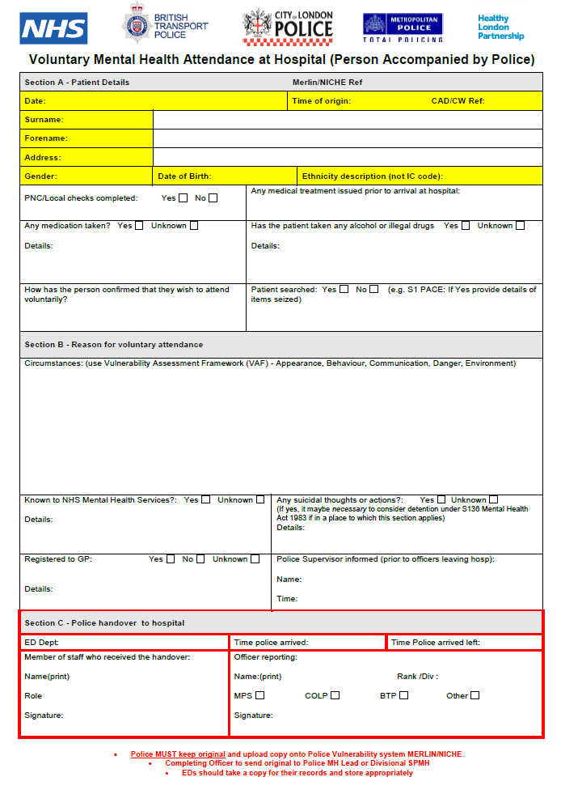
How does the process work?
Access to the form | EDs should hold copies of the form (electronic or paper) at the ED front desk.
Arrival at ED and handover of patient | The police should ask to see a clinician on arrival (this will usually be the nurse or doctor in charge) for the patient to be triaged. The form will be completed by the police and shared with the ED clinician. A verbal handover is also provided to enable the clinician to clarify any points/ask further questions. The clinician and police should discuss support that might be needed to manage the patient and assess whether other arrangements are required e.g. security or nurse to monitor the patient. Once the ED has arrangements in place, the nurse or doctor in charge, or a member of the liaison psychiatry team, will take responsibility for the patient and sign the handover form along with the attending officer. Given that managing individuals in mental health crisis in EDs can be challenging, it is advisable that police and ED staff discuss whether any further support is needed from the police within the department. A copy of the form is to be taken by ED staff.
Transfer of information | In ED, the copied form should be added to the patient record. Police will keep original form for upload onto the Police’s vulnerability database.
Click on the PDF icon to download the form
32

Slide 33
Handover process for voluntary mental health crisis patients
Feedback from police officers and ED staff outlined that the process significantly improves information sharing and patient safety through the effective handover of risks and care needs for voluntary mental health patients.
All patients are now handed over to a Senior Nurse or Doctor or MH professional when they present to the department rather than reception staff.
Across London for all mental health patients presenting to the Emergency Department there is a formal process and documentation. This includes those detained under s136 and those presenting to the department voluntarily with the police or London Ambulance Service.
‘It has made it safer because it has allowed the verbal and written transfer of information so that the ED staff can better understand not only the patient’s needs, but also any relevant background information from the police’. ED clinical staff
‘It has helped us focus on a vulnerable group very early on in their ED attendance’ ED clinical staff
33

Slide 34
Handover process for voluntary mental health crisis patients
Data from the pilot suggested a significant impact of the handover process on missing persons from ED. Initial data from the pan-London roll-out supports the pilot findings:
There are 83% fewer missing person reports for voluntary to hospital patients in March 2018 vs. March 2017
In March 2017, there was one missing person report for every six voluntary to hospital patients; in March 2018 this was one for every thirty-nine patients.
41% of the missing person reports for the Met Police in March 2017 were for voluntary to hospital patients, vs. 8.5% in March 2018.
-83%
“I found the process to be quick and positive both for us as the police, but also for the patient who often feels unsettled. Due to these incidents taking a short time police resources aren't drained and we are out of the hospital within the hour.” Front-line officer, Metropolitan Police
34

Slide 35
For further information on this work or the wider mental health crisis care programme, please contact the programme team:
hlp.londoncrisiscare@nhs.net

