Slide 1
Mental Health Act multiagency training evaluation
7th June 2017 – 21st August 2019

Slide 2







Summary
In 2017, London’s Crisis Care Programme developed multiagency training sessions to support the preparation of local systems for s136 Mental Health Act (MHA) legislation changes in November 2017. These were initially held in each of London’s mental health trusts and at London Ambulance Service (LAS). The training focused on MHA and aligning local policies to London’s section 136 pathway and Health Based Place of Safety specification. It covered the roles and responsibilities for staff along the s136 pathway, particularly in light of the legislative changes.
Recognising challenges for the care of s136 patients in emergency departments (EDs), Healthy London Partnership (HLP) also developed and carried out a series of bespoke training sessions in 2018-19 to specifically focus on the role of EDs.
An evaluation has been carried out to assess the effectiveness and impact of the training through attendee feedback, collected via tailored evaluation forms, and identify areas for improvement in future training opportunities.
Key findings from training evaluation
935 staff trained from Mental Health trusts, LAS and London’s EDs
94-95% attendee satisfaction across all sessions
Training is enhanced by bringing multiple agencies together to discuss different perspectives and clarify staff roles and legal responsibilities; 88% of participants in MH trusts felt sessions were an opportunity to build improve relations with other agencies
98% of participants in MH trusts felt the session provided fresh insight on legislation, how it is changing and highlighted the implications of changes
88% of ED participants felt the group discussions helped them explore their responsibilities for keeping patients safe. There is significant appetite for training around mental health in EDs with10 EDs booking repeat sessions
Shortage of beds, independent s12 Dr/AMHP, out of area patients requiring admission and delays in secure transport are key causes of s136 pathway delays. A number of national, regional and local actions are in place to address s136 challenges highlighted in the sessions as well as a toolkit to support local training
86-89% felt the training would make a difference to how they did their job
Thoughts from the trainer…
“What made [all the
sessions] enjoyable for me was
the engagement, the professionalism
and the dedication of the participants. I am in awe of the work done by front-line staff of all the agencies, day after day, with limited resources and not much appreciation. We are very
lucky to have them.”

Slide 3
Contents
 | Slide no.
Introduction | 4
Training objectives | 5
Mental Health Trust and London Ambulance Service Training | 6
Emergency Department Training | 7-9
Multiagency Mental Health Act Training: what went well and lessons learnt | 10
Action plan to address section 136 pathway challenges | 11
Recommendations for future developments | 12
Support for local sessions | 13
Appendices | 14-20

Slide 4









Multi-agency s136 training introduction
Throughout 2016, key partners across the crisis care system (including experts by experience, the NHS, London’s three police forces and London Ambulance Service) came together and developed London’s section 136 pathway and Health Based Place of Safety specification.
02
Section 136 Pathway
The guidance outlines the roles and responsibilities of all stakeholders involved across the pathway. It specifically focuses on the role of the police, as well as LAS, Approved Mental Health Professionals (AMHPs), ED staff (if physical health care is required) and staff at the HBPoS.
01
Health Based Place of Safety Specification
The specification outlines the minimum standard of care that London’s Health Based Place of Safety (HBPoS) sites should offer. This includes staffing requirements, governance arrangements, environment and facilities and details on the mental health assessment process.
Endorsed by all key partners
Launched by Mayor of London in December 2016
Multi-agency training sessions are one of the ways in which London’s crisis care system is working towards implementing the section 136 (s136) pathway and Health Based Place of Safety (HBPoS) specification. Between 2017-2019, Healthy London Partnership (HLP) developed bespoke training for London’s mental health trusts, London Ambulance Service, and London’s Emergency Departments (EDs) to support the preparation of local systems for s136 legislative changes and the care of s136 patients in EDs.
Delivered with legal expertise
To improve crisis care for Londoners
Developed with and for stakeholders
Multi-agency
CPD Certified
Facilitated by a mental health legal consultant
Focusing on the Mental Health Act and aligning local policies to new s136 / HBPoS guidance
With input from clinicians
Attendees including police, LAS, clinicians, AMHPs and security staff
Certified by the Royal College of Physicians for Continuing Professional Development

Slide 5
Training objectives
The training sessions aimed to:
01
Provide front-line staff from all agencies across the s136 pathway with a better understanding of existing and new legislation impacting on the delivery of mental health crisis care services, in particular the mental health act and mental capacity act.
02
Identify where regular challenges exist and provide clarity on different staff roles, responsibilities and legal powers when managing individuals in mental health crisis.
03
Provide a better understanding of the use of the Mental Capacity Act and the ‘best interests’ principle.
04
Discuss the use of lawful restraint, to enable an understanding of what is permissible and what might be challenged.
05
Provide an understanding of how local protocols are changing or need to change in response to legislative changes, pan-London guidance and identified challenges.
The training was adapted to be most effective for the different organisations to which it was delivered:
London’s 9 mental health trusts were the first to receive the training in preparation for the change in MHA legislation in December 2017.
The 3 sessions for LAS staff focused on the law relating to situations when ambulance crews are called out to someone with mental health problems or who lacks capacity to take decisions.
The ED sessions focused on the processes and time frames involved once a service user arrives in the ED.
Unique features of the training:
  Focus: There is little training available specifically related to the Mental Health Act, particularly for non-mental health professionals.
  Multiagency: It is rare that training involves a range of professionals with different roles, including clinical and non-clinical, and offers the opportunity for all to contribute and share their experience.
  Delivery: Interactive sessions delivered by a skilled trainer with expert legal understanding.

Slide 6
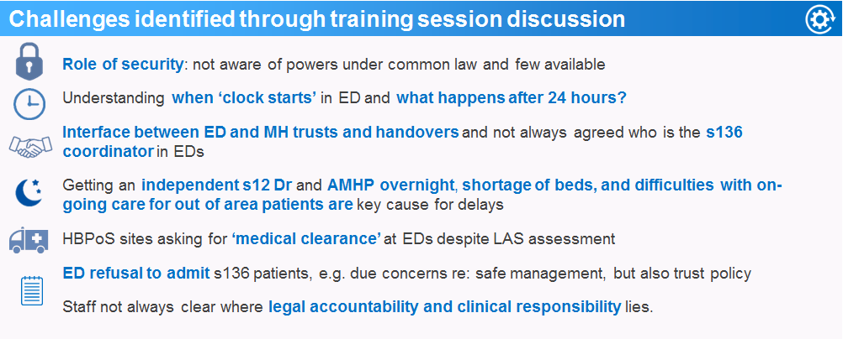

Mental Health Trust and London Ambulance Service training
All 9 of London’s mental health trusts received multiagency mental health act training from June to October 2017 in preparation for the change in legislation in December 2019. A further three sessions were held for London Ambulance Service (LAS). A total of 306 attended.
Group
discussion
Making a
difference
Overall
satisfaction
Fresh insight
94%
98%
86% & 89%
95% & 94%
felt group discussion helped explore how individuals under s136 may be affected by the new legislation and to
identify potential
challenges
felt sessions provided fresh insight on the legislation and how it is changing,
and highlighted the
implications of
these changes
felt the training will make
a difference to how they do
their job (MH trust /
LAS training
respectively)
were satisfied with the training overall (MH trust/LAS training respectively)
Full questionnaire results in appendix 1 and 2

Slide 7


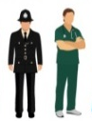


ED training sessions: scope
33 sessions delivered to:
22 out of London’s 27 EDs*
629 staff from EDs and external organisations
Multi-agency groups of both clinical and non-clinical staff
10 EDs requested repeat sessions
North Middlesex
Northwick Park
Whittington
Whipps Cross
Hillingdon
Homerton
King George
Ealing
Hammersmith
Queen’s
Charing
Cross
Newham
West
Middlesex
St Mary’s
C&W
St Thomas’
St George’s
King’s
Kingston
Lewisham
Police
7%
N/A
5%
Paed Clinical
1%
Psych
10%
St Helier
Safeguarding 0.5%
LAS
9%
Security 2%
Croydon
Student
4%
Voluntary 1%
Princess Royal
More than 1 session
ED Non-clinical 2%
AMHP
3%
Locations of London EDs in receipt of training
ED Clinical
55%
Proportions of staff that attended MHA ED training sessions in 2018-19
*All London hospitals with an ED were given the opportunity to receive the training.

Slide 8


ED training sessions feedback
The workshops intended to facilitate learning and discussion between the different agencies involved in managing individuals in mental health crisis, to strengthen working relationships and, where possible, identify potential solutions to regular challenges.
Group
discussion
Understanding s136 protocols
Making a
difference
Overall
satisfaction
88% felt the group discussions helped them explore their responsibilities for keeping
patients
safe
98% felt the session clearly explained London’s s136
protocols and
timeframes and
the role of
the ED
88% felt the training will make a difference to how they do their
job
94% felt satisfied with the training overall
A review of the feedback received during the autumn phase of training found that 21% of qualitative feedback included comments suggesting the sessions could be longer- reflecting their perceived value. In response, the length of the session was increased from 1.5 to 2 hours for the spring phase. The percentage of qualitative feedback commenting on time constraints reduced to just 14% in the spring phase of training as a result.

Slide 9
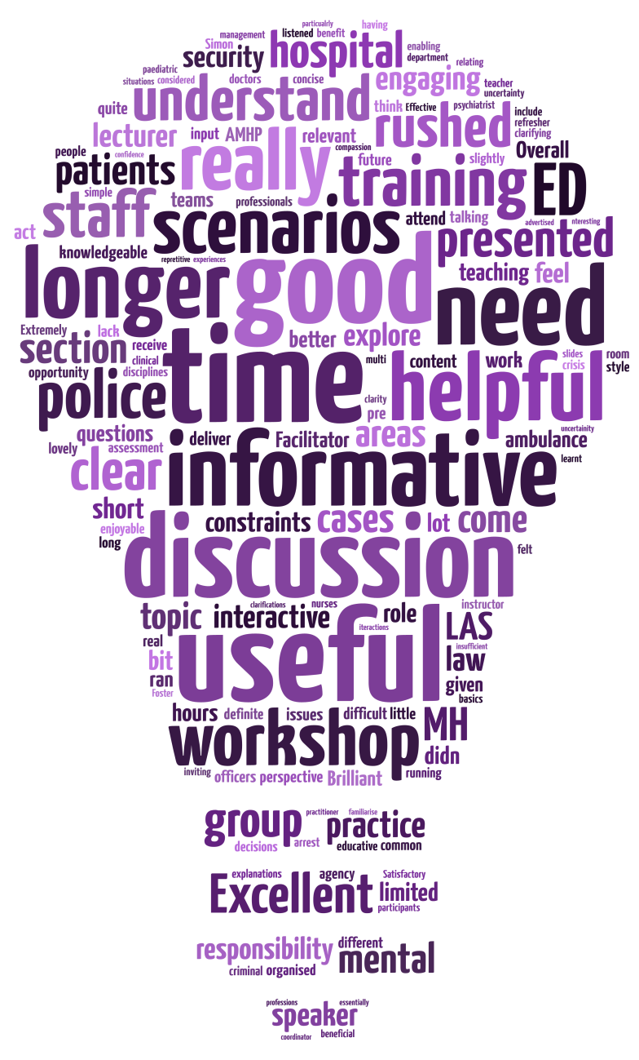
ED Training sessions: Qualitative feedback
02
Learning
Many attendees noted the training content was “good”, effective”, “well structured” and “interactive Respondents found it “helpful” to have the roles and responsibilities of all staff along the s136 pathway clearly defined. Some responses did indicate the content felt slightly “rushed”, but this is likely due to the time constraints of the session.
Themes from qualitative comments
01
Length of the session
Although the length of the sessions were increased for the spring-summer phase, many respondents still commented that a “longer” session would have helped their understanding. In particular, respondents noted that more time dedicated to group discussion of scenarios and cases would be beneficial.
Training design
Multi-agency participation was encouraged to facilitate knowledge sharing between professionals along the s136 pathway. Unfortunately, some agencies were not always represented. Some respondents felt that widening the session scope, with more focus on the “interactions between [agencies]” pre-hospital would improve the training.
04
03
Presentation style
Respondents repeatedly mentioned the “excellent”, “clear” and “passionate” style of the trainer. However, respondents did mention they would have liked a Q&A session to pose ‘what ifs’ to the trainer.
The frequency of descriptors used in qualitative feedback, with larger words representing higher frequency
Full questionnaire results in appendix 3

Slide 10


ED Training sessions: S136 challenges
01
Restraint
Lack of clarity on acceptable procedure
Safely caring for patients when police leave can be challenging due to small numbers of security staff and nursing staffing for 1:1 care
02
Delays
In secure transport and AMHP assessment
ED staff are often unaware of how security staff are able to support and they training they have received
Challenges exist around the number of AMHPs, particularly out of hours
03
Local policy
Variance in procedure between trusts
There is a need for agreed local policy on how to safely manage patients when the ‘clock runs out’
04
Awareness
of LDN’s s136 pathway and HBPoS spec. and the voluntary handover process could be
improved
Not all staff are aware of the guidance, and there is a perception that ED is used as the first option even in the absence of physical health concerns

Slide 11



Multiagency MHA Training: What worked well and lessons learnt
Delivery and content
All staff groups saw value in training on legal responsibilities and the training was able to clarify misconceptions around roles and responsibilities
There are ‘grey areas’ to the law where discussion and opportunity to ask questions is helpful for staff
There is significant appetite for training around mental health in EDs with10 EDs booking repeat sessions
Coordination
Notifying trainer of expected agency representation to ensure included in the discussion
Targeted promotion of guidance and handover process for voluntary patients at sites with poor uptake
The length of the session was increased between autumn and spring-summer, but many attendees still felt more time was needed for this important topic
Attendees
Training is enhanced by bringing multiple agencies together to discuss different perspectives
Senior managers and clinical decision makers, when in attendance, can action discussed solutions and further training (appendix 4)
Multi-agency attendance provided clarity on different staff roles and regular challenges
Highest attendance achieved through active promotion by hospital coordinator
S136 Challenges
Staff not always clear on their legal and clinical responsibility
Role of security: not aware of powers under common law and few available
Patients not always admitted to EDs and HBPoS in line with London’s s136 pathway
Key causes of delays: shortage of beds, independent s12 Dr/AMHP (particularly overnight), out of area patients requiring admission and delays in secure transport
Lack of local protocols for what happens after 24 hours
Not all staff aware of London’s s136 pathway and voluntary handover process
Thoughts from the trainer: “A large part of the workshops’ value was having a wide range of attendees, not just hospital staff, meaning that the discussions included the points of view of different agencies…. It was also very helpful to have the attendance of ED doctors at
some (although sadly not all) of the workshops; many of the difficulties encountered in ED can only be addressed by clinical decision makers and senior managers.”

Slide 12
Actions underway to address s136 challenges
Identified challenge | National, regional and local actions underway to address s136 challenges
Rising s136 numbers | Implementation of pan-London s136 new model of care: expected benefits include fewer repeat uses of s136. Serenity Integrated mentoring: plan for full London implementation by March 2020. MH training for frontline Metropolitan Police officers: one-day course for 8000 front-line officers focusing on MH legislation and MH conditions frequently encountered. Training will aim to support officers to use s136 services less. MH advice lines: A single pan-London number for officers routing to local Mental Health advice line rolled out in February 2019 to provide advice to front-line police when they encounter someone in crisis. NHS Long term plan commitments: 24/7 community-based mental health crisis response for adults and older adults available across England by 20/21 Single point of access for those in crisis through NHS 111 and timely, universal mental health crisis care for everyone. Increase alternative forms of provision for those in crisis. An additional 345,000 CYP (aged 0-25) will access support via NHS funded MH services and school/college MH Support Teams rolled out to between one-fifth and a quarter of the country (by 2023/24).
Staff not always clear on their legal and clinical responsibilities | Implementation of pan-London s136 new model of care: expected benefits include fewer A&E attendances and improved staff expertise MHA multiagency training evaluation, crisis care toolkit and roles and responsibility posters shared widely to support further local training. NHS Long Term Plan commitments: ambulance staff will be trained and equipped to respond effectively to people in a crisis
Delays in pathway | Implementation of pan-London s136 new model of care: expected benefits include fewer delays in getting care and reduced length of stay at a HBPoS NHS Long term plan commitments: specific waiting times targets for emergency mental health services will take effect from 2020. Mental Health Compact Implementation: setting out roles and responsibilities and principles for a London-wide approach to capacity management and escalation. UEC Accelerated Improvement programme: delayed transfer of care support in certain hospitals to improve flow through system.
Not all staff aware of London’s s136 pathway and voluntary handover process | MHA multiagency training evaluation, crisis care toolkit and roles and responsibility posters shared widely to support further local training.
Use of EDs for ‘medical clearance’ | Rotational Nursing Programmes between HBPoS sites and EDs: support for rotational programmes aimed to improve relationships between EDs and HBPoS sites and improve physical health skills and mental health skills of mental health nurses and ED nurses respectively.

Slide 13
Recommendations for future developments
Encourage other training
Highlighted the evaluation and toolkit to MHA offices who will have the expertise to deliver training
Shared with Health Education England London team.
04
03
Wider staff participation
Video footage of the training or online modules may be a way to reach less engaged EDs, avoid issues of limited attendance, and cater for busy schedules
Contacting security staff managers could help secure their valuable contribution of their team members.
Incorporate specific Q&A
Attendees had some questions left unanswered, which could be resolved with a dedicated Q&A/FAQ
02
01
Crisis care toolkit
Expand content
<18 patients and pre-hospital interactions between agencies could be a focus of further sessions
LAS attendees have expressed an interest in additional sessions to specifically cover the role of LAS and hospital handover.
The mental health crisis care toolkit is shared with hospital coordinators after each session for them to share amongst staff . This encourages further training and reinforces the teaching; the toolkit has been updated to ensure accuracy.
Thoughts from the trainer: “What the workshops highlighted for me were the practical problems for ED settings receiving increasing numbers of mentally distressed people without proper facilities to manage them……However, it was illuminating to hear how the different hospital trusts handled essentially the same issues so differently: in some places the participants seemed
satisfied with how local multi-agency arrangements were working, in others there was clearly great discontent on all sides.”

Slide 14
Support with running sessions locally
In order to keep staff up to date, reach those unable to attend and train new staff, organisations along the s136 pathway will need to continue to provide training on the topics covered within the multiagency training.
To support this, a toolkit has been developed.
London’s Crisis Care Programme can also be contacted for further advice and support with contacting local police, AMHPs and paramedics to join the training: hlp.londoncrisiscare@nhs.net.
“What made [all the
sessions] enjoyable for me was
the engagement, the professionalism and the dedication of the participants. I am in awe of the work done by front-line staff of all the agencies, day after day, with limited resources and not much appreciation. We are very
lucky to have them.”
Thoughts from the trainer
Other useful resources
London’s s136 pathway and HBPoS specification
Information of the handover process for the voluntary patients accompanied to ED by police and downloadable form
Briefing posters for roles and responsibilities along the s136 pathway to display in your organisations.
Many thanks to Simon Foster for his expert design and delivery of the sessions.
Also thank you to those that supported developing the content, all the local coordinators and session helpers, and all those who attended the training and contributed to the discussions.

Slide 15
Appendices

Slide 16


Appendix 1: Mental Health Trust training session feedback
95% felt satisfied with the training overall
98% felt the training met the objectives outlined
99% felt that the training was relevant to them and their organisation
"This was a good opportunity to talk through some mutually impactive issues. Generated some interesting questions, which is a good thing even if we don't get all the answers. Some real issues to unpick with A&E."
91% felt there was sufficient opportunity to learn and network with others
86% felt the training would make a difference to the way they do their job
93% felt session was interactive and there were actions they could take away
"A most enjoyable day, informative demonstrating sharing knowledge, experience and understanding of legal challenges."
98% felt session provided fresh insight on the legislation, how it is changing, and highlighted the implications of changes
95% felt the session provided fresh insight on London's section 136 pathway and where the clinical and legal responsibility lies
88% felt that the training provided an opportunity to build and improve working relations with other agencies
94% felt the group discussion was helpful to explore how individuals under s136 may be affected by the new legislation and to identify potential challenges
93% felt the presentation on local processes provided fresh insight on how the Trust is responding to the legislation changes / implementing the pan-London s136 pathway guidance
"Mr Foster was very good in his delivery and explained everything in layman’s language without jargon. His method of not skipping topics and dealing with each topic one by one was very good which makes it easy to assimilate and retain all the information he gave"
"Highly valuable,
informed. Really helped focus my mind on the key principles and challenges. Thank you!"
"Very useful and informative - I wish it was a full day!"
“Comprehensive training which is highly relevant to my work.”

Slide 17

Appendix 2: LAS training session feedback
100% felt the training met the objectives
94% felt he session provided me with a better understanding of lawful restraint
98% felt there was sufficient opportunity to learn and interact with others
"Useful to learn the new changes to the law. Also great discussion for grey areas between MHA and MCA. Good to have different teams together as well.”
100% felt that the training was relevant to them and their organisation
89% felt the training would make a difference to the way they do their job
85% felt the workshop provided an opportunity to build and improve on working relationships
“Was a very informative and good sharing session with organisations and helping to clarify any misunderstanding, Very well presented”
98% felt the session clearly explained s136 and provided fresh insight on MHA legislation, how it has changed implications of these changes
96% felt the session provided better understanding of what 'lacking capacity' means, the 'best interests' principle, their role in using the MCA
94% felt the group discussion was helpful to explore how individuals and staff may be affected by the new legislation and to identify challenges
79% felt the scenarios were interactive and I felt that there were actions that I could take away
84% felt scenarios were helpful in exploring the areas more fully and increased by understanding of the role of LAS crews
96% felt the session clearly explained the roles and responsibilities of the agencies involved in s136
"As the group included police, it was good to hear the police law and discuss different scenarios interprofessionally”
"Very useful to get a current update and how it impacts on staff role and responsibility in terms of caring for patients”
"Good, concise explanations of legal framework”
“Excellent clarity on many issues for my practice”

Slide 18



Appendix 3: Additional ED training sessions feedback
97% of respondents felt the training met the objectives
95% felt the training was relevant to them and their organisation
95% felt the session clearly explained the difference in procedure when someone under criminal arrest is having a mental health crisis
92% felt the session provided a better understanding of what ‘lacking capacity’ means, the ‘best interests’ principle and their role in using the MCA
91% of respondents felt they came away from the session with a better understanding of lawful restraint
88% thought there was sufficient opportunity to learn and interact with others
87% felt the scenarios were interactive and there were actions they could take away
85% thought the scenarios helped in exploring the MHA & MCA more fully, and increased their understanding of the role of ambulance crews
The slightly lower percentage of respondents who thought the scenarios helped in exploring the MHA and MCA more fully likely indicates the relevant principles were appropriately explained and understood, but more time could be spent practicing applying the knowledge to real-life situations.

Slide 19









Qualitative feedback
Illustrative examples of qualitative comments
A consultant in
emergency medicine
noted the timeliness of the training, stating “there is a clear need as systems [are] under a lot of strain with increased presentations to ED of patients in mental health crisis”.
A police liaison officer for mental health praised the clarity of presentation, stating: “[the] MCA is difficult for some people to understand compared to s136 and s135. [The] facilitator made it much clearer all round.”
A clinical lead stated
“this teaching is fantastic about the
s136 pathway and the MCA. It defined the clinical care and legal responsibilities for each team and gave some real life scenarios to put this into practice. What’s more Simon was really open to having all those slightly tricky questions thrown at him which made for a really good debate”.
An AMHP service
manager commented that “longer time for group discussion would have been helpful for further clarity and understanding, enabling participants to use life experiences to promote greater confidence in [their] role and responsibility”.

Slide 20
Appendix 4: examples of further learning
For the ED staff at Northwick Park hospital (London North West University Healthcare NHS Trust, LNWUHT), the MHA in ED training was a springboard for a wider learning programme around mental health for their ED staff.
In collaboration with Central and North West London NHS Foundation Trust, LNWUHT incorporated HLP’s MHA in ED training into a wider 3-month project on Urgent and Emergency Care, having secured funding from the UEC workforce collaborative for London.
Entitled ‘Health Based Place of Safety Training’ (HBPoS), the project aimed to:
  Improve the quality of care for mental health patients in crisis who attend Northwick Park Hospital’s ED and s136 suite
  Provide more integrated physical and mental healthcare in the ED and s136 suite
  Develop and maintain a workforce with the skills to provide this more integrated care (with a focus on staff wellbeing).
The programme included a bespoke curriculum put together to up-skill Registered Mental Health Nurses (RMNs) in physical health competencies and ED nurses in mental health competencies and rotational placements between the HBPoS and ED, alongside a programme of interagency, multidisciplinary training sessions open to all agencies along the s136 pathway.
Despite the 3 month project coming to an end, collaborative MH focused work is continuing across CNWL and LNWUHT, with re-invigorated monthly MH workstream meetings and auditing of s136 patients seen in the ED as part of on-going monitoring of compliance with HLP’s pan-London s136 care standards and HBPoS specification.
The work in these trusts is just one example of the wider impact the MHA in ED training can have to drive improvements in patient care across London.

Slide 21
All the work we do with our partners moves us closer towards our goal to make London the healthiest global city.
www.healthylondon.org
england.healthylondon@nhs.net
@healthyLDN

