Slide 1
Transforming Primary Care
Primary Care Home
Dr Nav Chana
2nd March 2017

Slide 2
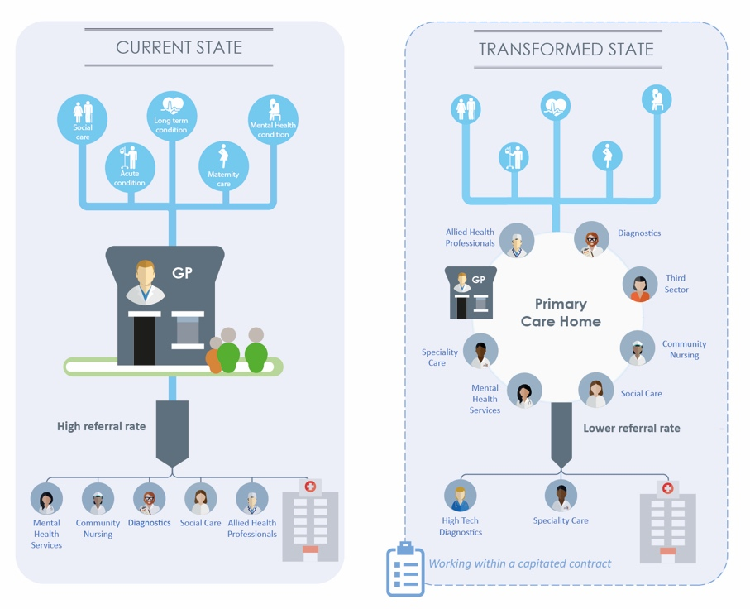
The NAPC describes four core characteristics of a Primary Care Home
1
Focus on 30,000 to 50,000 people
Population health planning, provision
and outcomes
An integrated, multi-disciplinary workforce,
Financial drivers aligned with the health needs of the whole population.
2
3
4
2

Slide 3
The PCH model will deliver multiple benefits in Primary Care
Improved patient care: proactive and person centred care by focusing on the needs of the person rather than the needs of the service.
Increased staff fulfilment: The PCH provides the environment and conditions for workforce development and effective team working.
Improved utilisation of locals resources: care teams that do the work take responsibility for a whole population budget for that registered community.
Delivers improvements in General Practice: multi-disciplinary teams in primary care will release more time for GPs
Helps to stabilise Primary Care: makes it easier for local providers to engage with each other and disparate units of Primary Care to coalesce into more robust units
3

Slide 4
The PCH model has spread to 92 sites so far
5

Slide 5
PCHs have been successful in releasing a range of benefits for patients, staff, practices and the wider system
Pilot Site Example Benefits
A&E Attendances |  | £27k of savings each year enabled by providing extended primary care access in Thanet
A&E Admissions |  | £295k of savings from reductions in A&E admission driven by Thanet Health
GP Referrals |  | 330 GP referrals to hospital avoided given a slowdown in the growth rate demonstrated by Beacon Medical Group
Prescribing Costs |  | £220k of prescribing savings demonstrated by Larwood and Bawtry
Staff Satisfaction |  | 67% of staff surveyed felt that PCH had improved their job satisfaction
Utilisation |  | 78% of staff felt PCH had decreased or not added to their workload
Staff Retention |  | 86% of staff regarded Beacon Medical Group as a good employer
Patient Experience |  | 82% of staff felt that PCH had improved patient experience
GP Waiting Time |  | 6 day reduction in the average time patients wait to see their GP
Population Health |  | 13% increase in flu vaccinations for patients with COPD registered with Beacon Medical Group
Length of Stay |  | 8 day reduction for admitted care home residents registered with Beacon Medical Group
Notes:
Speaker notes:
So, The PCH is a model of care but not a prescriptive one. It presents the opportunity and acts as a catalyst for PCHs to develop and roll out a broad range of initiatives that are relevant to their local population needs and the workforce that serves that population.
A lot is being asked of Primary Care in STPs and in the GPFV and the PCH is a way to deliver some these asks. As the table here shows…
Over the last month we commissioned a small piece of work to look at 3 of the PCHs and understand the impact they have been able to make on patient care, staff satisfaction, and wider system priorities including the triple aim

Slide 6
The characteristics of the PCH model and the environment that it creates enables rapid progress in addressing priorities for the local health economy
We have identified features that are important to enabling primary care transformation. These are aligned with the four characteristics that define the PCH model:
The PCH is developed, implemented and led by providers while being supported by commissioners
Providers release benefits by working at a the right level to effect change
The PCH model fosters collaboration throughout the system
Staff are activated to become the drivers of positive change
1
2
3
4
Notes:
Yes there is an overarching vision and support from the top down but this is about self-organising teams of providers who know their local challenges. E.g. Thanet were able to observe local needs across the system and agree to pool funding and staff to better meet patient need
The 30-50k is a good level to make a tangible difference. In turn this can energise CCGs, STPs and other primary care providers to see that it can be done e.g. In Beacon demonstrating through this work how they were making a tangible difference has opened up collaborative conversations previously not possible
Across primary care, with CCGs and STPs, with secondary and community care and with social care. L&B have collaborated with local voluntary and community prviders to bring on board a full time community advisor at no cost to the practice
We have seen that there is a real energy for change around PCH sites . In Beacon GP workload has decreased and morale is up. In Thanet and L&B retention is improved and recruitment is easier linked directly to the model

Slide 7
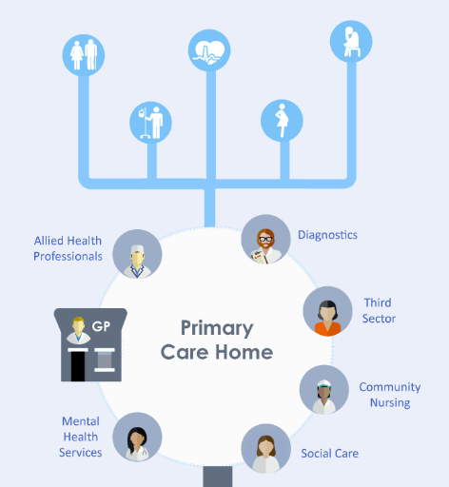
Some quotes from what we heard
This has opened numerous doors and conversations with patients and partners across the wider system to develop opportunities for more joined up care”
GP, Beacon Medical Group
“I feel that working collaboratively as part of an integrated, multi-agency team we have been able to make a real difference to the patient experience and in many cases we have had a huge positive impact on patients’ lives. How do we know this? Because the patients have told us so”
Partnership Officer, Bassetlaw Community and Voluntary Service
There's a real energy for change and new ideas can be implemented quickly”
GP, Larwood and Bawtry
“Working in this way has made me want to defer my retirement”
District nurse, Larwood and Bawtry
“I feel it makes a massive difference to patient care and patient experience. Our Meridian surveys confirms this”
Support Worker, Thanet
There is a 'happy buzz' at our practice since PCH has started”
Practice pharmacist, Larwood and Bawtry

Slide 8
Want to know more about
Primary Care Home?
Visit us at
www.napc.co.uk/primary-care-home
@NAPC_NHS #primarycarehome

