Slide 1
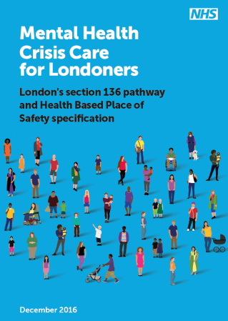
Improving London’s section 136 pathway and Health Based Place of Safety sites
Background
Healthy London Partnership (HLP) mental health crisis care programme is working with stakeholders and key partners across the crisis care system to improve crisis care.
It was decided in 2015 that there should be a pan-London focus on the section 136 (s136) pathway and Health Based Place of Safety (HBPoS) sites to improve the current inconsistencies across London and often inadequate care for those who are some of London’s most vulnerable.
Case for change
London service user’s continue to describe the poor quality of mental health crisis care largely due to services that fail to meet their needs and lack basic respect, warmth and compassion.
This is occurring whilst London has seen an 8% increase in section 136 detentions and this is expected to rise.
It is nonsensical that most mental health services operate Monday to Friday, nine to five. This is about the needs of staff who work in services, not people who use them’.
How is London’s crisis care system responding?
Only 27% of Londoners feel they receive help in a timely way.
The Health Based Place of Safety (HBPoS) specification outlines the minimum standard of care London’s HBPoS sites should offer. This includes details on staffing requirements, governance arrangements, environment and facilities, and details on the mental health assessment process.
The s136 pathway looks at the roles and responsibilities of all stakeholders involved across the pathway, it specifically focusses on the roles of the Police as well as the London Ambulance Service, AMHPs, A&E
More than 75% of Londoners taken to a HBPoS felt staff did not communicate effectively with each other to coordinate their care.
‘The room where I waited was so depressing.
It was bare with just a chair and a mattress against the wall. The door was left open and everyone stared as they went by’.
Only 36% of Londoners experiencing a mental health crisis feel they are listened to, taken seriously and treated with compassion.
‘Police and LAS waited five hours with a suicidal lady detained under s136 before being able to access a HBPoS. During this time the female who was extremely distressed and cold had no access to drink or toilet facilities.’ MET Police 2015
staff (if physical health care is required) and staff at the Health Based Place of Safety.
Extensive engagement across London’s crisis care system
Benefits of the new pathway and specification
Next steps
Input from over 75 staff from London’s 32 local authorities
Improved clarity of roles and responsibilities along the pathway
Streamlined pathway to reduce delays
Ensuring the individual is seen in the most appropriate environment and less inappropriate use of A&E
Parallel assessments of physical and mental health
S136 pathway:
The programme will work with London’s crisis care system to operationalise the pathway ensuring a consistent approach across the capital.
A London crisis care delivery plan is in development to identify work required to operationalise the pathway and align with existing crisis care programmes across London to provide overall improvements to the system.
HBPoS specification:
To support London in meeting the new HBPoS specification an options appraisal will take place specifically looking at HBPoS site configuration across London.
It will be informed by a baseline data collection and the evaluation of South London and Maudlsey’s (SLAM) new HBPoS model where they are consolidating four HBPoS sites into one site and piloting the new London HBPoS specification.
An investment case will be developed based on the preferred option which will look at the wider crisis care system. The investment case will support to Sustainability and Transformation Plan (STP) footprints to make local decisions regarding future HBPoS provision and other system changes.
Over 300 service users have been involved in developing the guidance
Input from over 200 staff from acute and mental health trusts
Ensuring dedicated 24/7 staff for HBPoS sites to ensure 24/7 access for patients
Greater collaboration across the system between mental health and acute trusts and key partners to improve joint working across the system.
Input from over 70 police officers from London’s three forces
Engaged all levels of the system, from frontline staff to CEOs

