Slide 1
AN OMNICHANNEL APPROACH
CONNECTED DIGITAL HEALTHCARE
Dr Minal Bakhai

Slide 2
In the next 30 minutes…
What does an omnichannel approach mean?
Why do we need it
What does the model look like
How does it work
Where is this going

Slide 3
What does it mean?

Slide 4
OMNICHANNEL
GP
Online
Pharmacist
Patient

Slide 5
Considering an omnichannel approach…..
Front half of the room
What are the benefits for patients?
Back half of the room
What are the benefits for GPs?
3 minutes

Slide 6


Why?
Sustainability of General Practice
Quadruple Aims
Access
Increasingly restricted
Quality
Standards variable
A&E and GPs overwhelmed
GP workforce diminishing
Waiting times for appointments often very long
Guilt less time to see the patient
Increasing complaints
Performance – diagnosis hinges on the patient’s ability to ‘to remember it all in 10 mins’
Symptoms focus – due to limited time and resource
Lack of consistency in service provision, single opinion
I often don’t bother and just wait to see if it will get better by itself
I’m standing there telling (the receptionist) all my private information in front of the whole waiting room, begging her to give me an appointment
They’re trying, but they’re just knackered!

Slide 7
How does it benefit us?
Patient
Increased access to NHS services
Locally provided services
Familiarity and personal care
Flexibility and choice
Better patient experience
General Practice
Re-directs demand appropriately
Effective collaborative working
Targeted intervention from a doctor
Increased layers safety
Better doctor experience

Slide 8
What matters to our patients
Health Insights
Traditional values of trust, familiarity and personal care
Having a physical place/person to go back to if something is not right
Less fragmentation of their care – a seamless patient journey
Choice
Access
Convenience
Speed
Safety

Slide 9

Traditional values are powerful when facing an emerging future

Slide 10
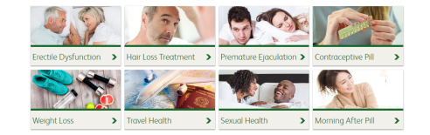
What is the online model?
Digital Triage
A series of expertly designed questionnaires
completed by patient
Self help
OTC Advice
Automated Diagnosis
Algorithm / AI - generated
Message / Phone / Skype / Face to Face / A+E
Escalated
Automated
Review
Pharmacy
Treatment/Check/Test
Delivery of medication
Signposting
Notes:
Message/Phone/Skype – doctor involved for the first time in the pathway

Slide 11
In General Practice
Contraception
Patient completion of online questionnaire
Exclude red flags
Check clinical suitability
(FSRH and NICE best practice guidelines)
Advice
Pregnancy Test
Condoms
Automated Diagnosis
Risk Stratification
Algorithm / AI - generated
Message / Phone / Skype / Face to Face / GUM
Escalated
Pharmacy
BP and BMI check
Contraception
Sexual Health Screen
Signposting
Automated
review of selected patients

Slide 12
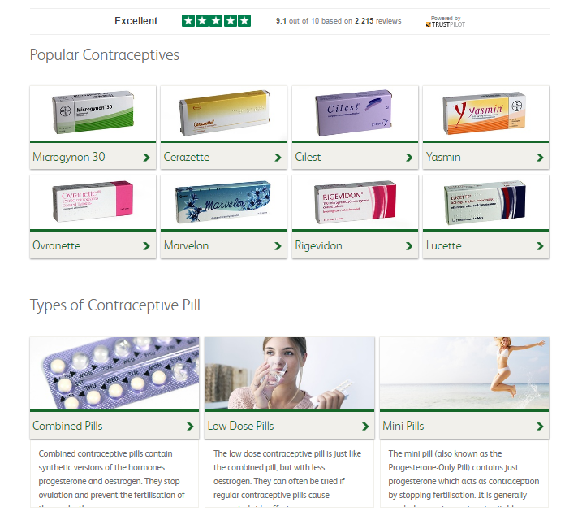
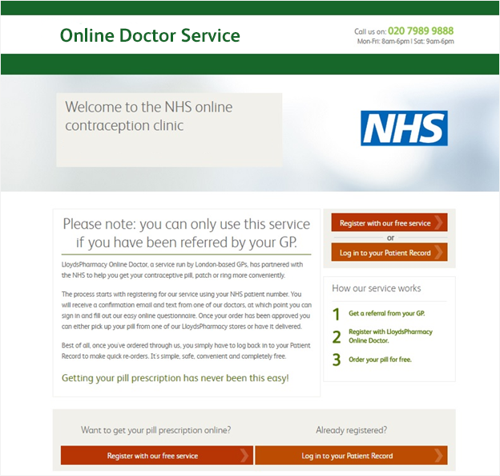

Slide 13
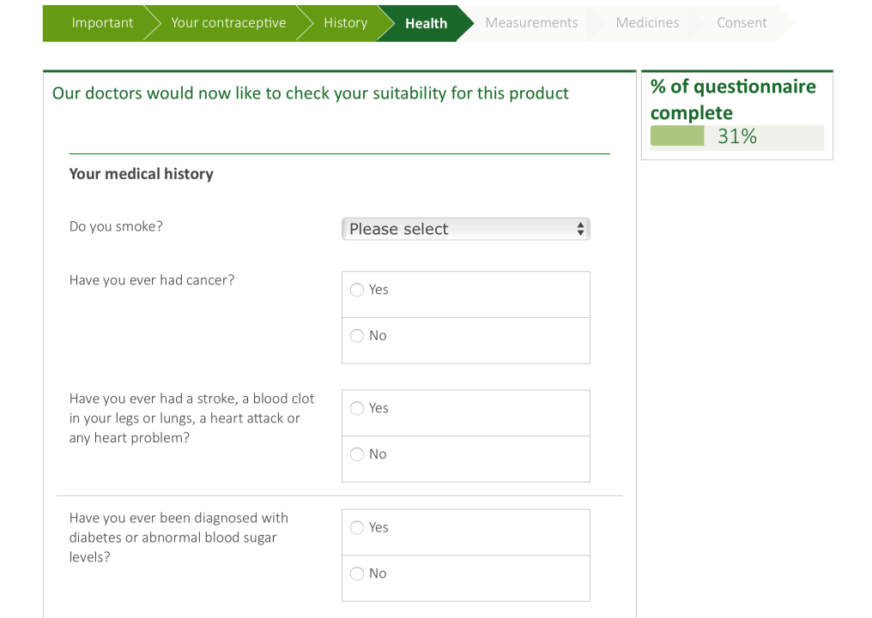

Slide 14
In General Practice
Contraception
Patient completion of online questionnaire
Exclude red flags
Check clinical suitability
(FSRH and NICE best practice guidelines)
Advice
Pregnancy Test
Condoms
Automated Diagnosis
Risk Stratification
Algorithm / AI - generated
Message / Phone / Skype / Face to Face / GUM
Escalated
Pharmacy
BP and BMI check
Contraception
Sexual Health Screen
Signposting
Automated
review of selected patients

Slide 15

How Does It Work?
Contraception
Treatment Prescribed Online
Advice on safe sex
Pharmacy check BP and BMI
Click and Collect same day
Repeat Reminder
Orders contraceptive
Prescription
Delivered to home
Follow up questionnaire remotely
Online Doctor
I need contraception
Coil/Implant
Referral to GUM Clinic / GP
Pharmacy
Depot Inj
Pharmacy to administer
GP Surgery
Suitable
Online Assessment triages suitability for remote treatment
Walk-in Centre
NHS Patient Record
GUM Clinic
Summary
Reinforce education
No action required
Managed remotely
Referral to F2F service
Data Storage Cloud

Slide 16
Digital Consultation
Follows Best Practice Guidelines
NICE, FSRH, BASHH
Peer Reviewed: 4 authors, 14 GPs, Panel of consultant specialists
Evidence based best practice
It’s essentially doing what the doctor does in face to face practice…!
Designed by a Panel of Experts
If multiple doctors have designed it they will have balanced each other out so it doesn’t make any mistakes
Accomplished GPs and Consultants
In depth user experience
Dedicated IT team
Extensive testing and monitoring
Robust Clinical and Information Governance
Consistent Attention to Detail
If it’s being done by computer it won’t forget any of the steps will it?
Data Analysis Team
Clinical Dashboards
Involved in high quality RCTs
Live Empirical Data
Presumably if there’s something going round (the area / country) it will know and take that into account?

Slide 17
Data
Data Points
Credibility
DIY recall
Q&A
DIY data
Personal Testing / Measurement
3rd Party
Pharmacy, GP / Hospital
NHS record
Automated
Health monitoring technology
Collated Over Time
I don’t want it to rely just on me... what if I forget something?
If they could send you a kit to test it to check that would be much better
If my pharmacist or GP does the check that would reassure me
I want it (tech guardian angel) to look out for the blind spots I can’t see

Slide 18
The Omnichannel
One-Stop Shop
Medically enabled to provide a prescription
Detailed consultation (without the pressure of the queue)
Broader advice
GP advice
Education
Pharmacy
Accessible Care
Physical examination, testing
Personal touch, support
Instant distribution
Administer treatments e.g. vaccinations
Demonstrate devices and education e.g. inhalers, glucometers
GP
Online Doctor
They’re like the 2 halves of the service…. (online) coming from proper pharmacy is much better that it being just online

Slide 19
Case Study: Online HIV testing service in London
Online STI testing to complement Central London GUM clinic
Website, an online consultation, supply of test kits and a results management service with full clinical and pharmacy support
35,000+ test kits issued to patients across a range of age groups (16-55+)
Boosted new diagnosis of HIV by 24%
Reactivity rate of 20 per 1000
Diagnosis: Black African heterosexuals in a higher proportion and MSM in a comparable proportion in comparison to GUM services
Test turn around time of 1.5 days

Slide 20
Outcomes
Effective
Better health outcomes
Extended reach of hard to reach groups
40k Patients/month using online service
Flexibility throughout patient pathway
Tailored health advice & opportunistic health education part of every consultation

Slide 21
Outcomes
Safe
Peer Reviewed, Best Practice
Responsible prescribing, antibiotic stewardship
Consistent delivery of care
Ability to respond to change fast
Feedback dashboards and data analysis
Pharmacy F2F arm incl. checks and safeguarding

Slide 22
Outcomes
Patient Experience
95% would recommend the service to friends/family
Dedicated patient support, clinical and tech teams
Extensive user testing
Access 7 days a week, pharmacy late opening, extensive geographical reach
Compatible on all devices
Delivery of medications

Slide 23
Outcomes
Efficient
Integrated service offering i.e. Screening, diagnosis, treatment & supply
Scalable - clinicians can manage >100 patients per hour
Provide rapid access to 1800+ pharmacies
Patient demand routed appropriately
Summary for faster F2F consults

Slide 24
What could be the barriers and challenges of this approach?
Discuss with your neighbour
3 minutes

Slide 25
Barriers/Challenges
Acceptability
Safeguarding
Verification of patient ID
Operational
Effective communication with multiple care providers
Integration of IT systems
Upskilling of pharmacists
Training in ‘online consulting’

Slide 26
Conditions
Lifestyle
Screening
Common
Personal
Long Term Conditions
Exercise
Nutrition
Smoking
Stress
Pre-Diabetes
Cholesterol
Blood Pressure
Colds, Flu
Allergies
Vaccines
Travel
Cystitis
Sexual Health
Contraception
Emergency Contraception
Erectile Dysfunction
Premature Ejaculation
Asthma
Diabetes
COPD
All commonly encountered in GP

Slide 27
Long Term Conditions: The Vision
Patient Self Management App
Symptom Diary
Pharmacy
GP
Initial Diagnosis
Online Doctor
Clinical Review
Medication
Education/ Advice
Self Tests e.g. Peak Flow, ACT
Prescribe emergency supply
Can Step Up treatment
Remote GP Consultation
Interpretation of diagnostics – FEV
Can Step down treatment
Smoking cessation, vaccinations
POC diagnostics e.g. bloods, spirometry, pulse oximetry
Respiratory Consultation including inhaler choice and technique
Face to face support
NMS/MUR Service
Data led consultation, IPP
Click and Collect
Administer vaccinations
Alerts
Predictive vs Reactive
Push/Pull of data
Overview
Targeted F2F consults to avoid inappropriate GP workload
Repeat prescriptions

Slide 28
Long Term Conditions
COPD and Asthma
Pilot: Working with the only
NHS accredited App shown to
Correct 98% of inhaler errors
Improve adherence to medication by 70%
Personalised education
Push/Pull of data into Clinical Support Systems
Individual patient management
Prioritisation: see who is exacerbating
Remote prescribing
Enables change of inhalers remotely
Education
Targeted messaging
Appointment booking
Geomapping

Slide 29
AN OMNICHANNEL APPROACH FOR CONNECTED DIGITAL HEALTHCARE
Sustain General Practice
Work Collaboratively
Work Resourcefully
Better access
Better efficiency
Better experience
Better outcomes
GP
Online
Pharmacist
Patient

Slide 30
Thank You
Minal.Bakhai1@nhs.net

