Slide 1
WELCOME
Our hashtag is #crisiscare16, please submit your thoughts and views on twitter throughout the morning.
Wi-Fi network: GLAguest
The team from Healthy London Partnership are on hand today to help you if you have any queries.

Slide 2
Welcome and outline of the day Conor Burke, Chief Officer, Barking and Dagenham, Havering and Redbridge CCGs and London’s Urgent and Emergency Care (UEC) Programme Senior Responsible Officer

Slide 4
Experiences of London’s crisis care Naomi Good, ‘Expert by experience’ and representative from NSUN voluntary organisation

Slide 5
Improving Londoner’s mental health Sadiq Khan, Mayor of London

Slide 6
Improving Londoner’s mental health Cllr. Sarah Hayward, Leader of London Borough of Camden and London Health Board Member

Slide 7
A whole system approach to change
John Brouder, Chief Executive of North East London Foundation Trust (NELFT), Provider Trust sponsor of London’s crisis care programme

Slide 8
Successes across London’s crisis care system Fionna Moore, Chief Executive, London Ambulance Service (LAS)
Cmdr. Christine Jones, Metropolitan Police and National Lead for Mental Health

Slide 9
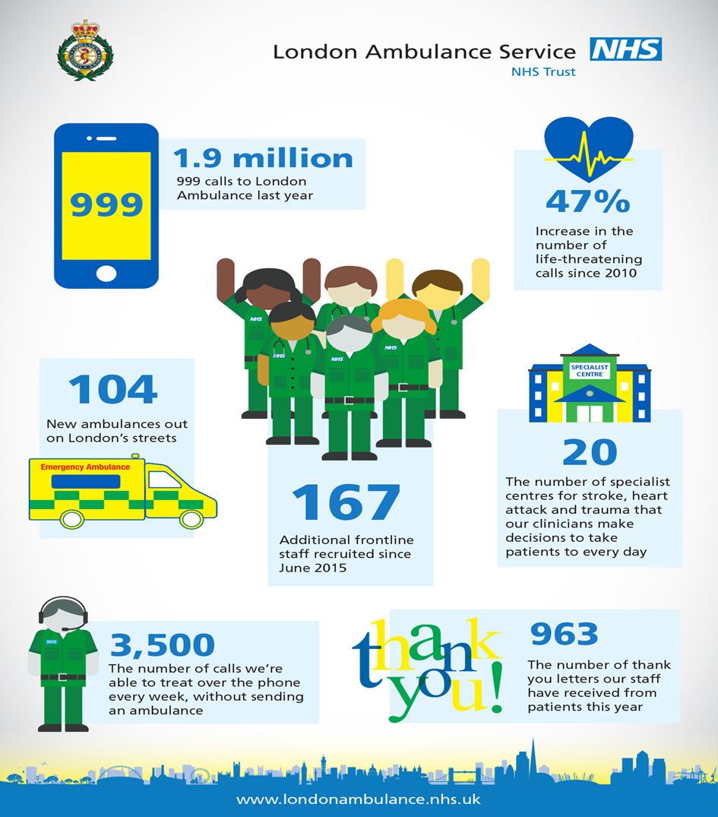
LAS overview
One of the busiest health services in the world catering to a large, complex and diverse population
An average day includes:
4,879 emergency calls (increase 6-7% pa)
2,971 patients
385 patients in mental health crisis
Close partnerships with key stakeholders across the health, social care and justice system is essential
Notes:
Mental health crisis calls are increasing, effective pathways is essential to offer these patients, the best possible care in the right place by staff with the right skills

Slide 10
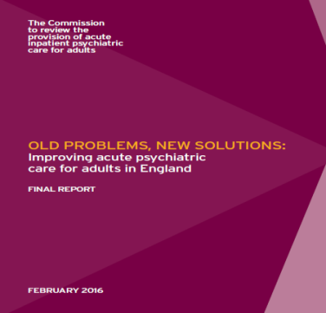
Policy drivers, reviews and publications
Powerful policy drivers, reviews and publications in the past few years have clarified the need to improve London’s mental health crisis services:
Notes:
A raft of guidance and strategy documents – the need is clear

Slide 11
Crisis care concordat
National agreement between services and agencies involved in the care and support of people in crisis. The Concordat focuses on four main areas:
Access to support before crisis point – making sure people with mental health problems can get help 24 hours a day and that when they ask for help, they are taken seriously.
Urgent and emergency access to crisis care – making sure that a mental health crisis is treated with the same urgency as a physical health emergency.
Quality of treatment and care when in crisis – making sure that people are treated with dignity and respect, in a therapeutic environment.
Recovery and staying well – preventing future crises by making sure people are referred to appropriate services.
Notes:
Might not need this??? We are key partners and are engaged with each of the MH Trusts across London and their concordat groups – haivng a pan London focus provider offers a unique perspective

Slide 12
London’s case for change
London s136 use – 10 year projection
One in five Londoners will have a mental health problem in their lifetime and are more likely to be sectioned under the Mental Health Act than the rest of England
Over 75% of s136 detentions occur out of hours yet the majority of sites do not have dedicated 24/7 staffing and the numbers are growing
Almost two thirds of those detained do not feel safe once they arrive at a ‘place of safety’, only 14% of Londoners feel they had the support they needed in a crisis
It is anticipated the number of detentions will increase with new legislation being introduced mid 2017 – as a system we have to do better
Notes:
Key London data related to 136 detentions – the case for change – we need
to do something different

Slide 13
Pathway issues – we need to work together improve
Patient detained under s136, police request LAS attendance and a place of safety is arranged.
Refused at HBPoS as concerns patient under the influence of alcohol and a request for physical clearance
Refused by A&E 1 as too busy to safely accept
Refused by A&E 2 as concerned the patient was out of area and should have been accepted at A&E 1
Total time spent by MPS and LAS >6 hours
Impact on availability for those resources to attend multiple other calls restricting capacity in the area
‘Police left waiting 13 hours in A&E with a 35 year old suicidal male detained under s136 as no bed spaces’. MPS Escalation Log
‘It took 16 hours for officers to access a HBPoS with a 15 year old suicidal female they had detained under s136’. MPS Escalation Log
Notes:
A case study we presented in relation to one patients journey – it wasn’t an isolated incident…

Slide 14
Pathway improvements
London Ambulance Service:
Joint processes and training with the Met Police
Revised mental health and s136 protocols in the control room to ensure the right response is dispatched in the right time frame resulting in a significant decrease in patients detained under s136 conveyed in a police vehicle
Mental health nurses in the control room
Patient representatives – focus groups and development of expert patients
Third sector partnerships – Samaritans, Mind
Mental Health Trusts – Standardisation and data sharing systematically identifying which crisis services work and which don’t to improve services
Alternative transport pathway introduced for planned community sections to ensure a timely response
Healthy London Partnership s136 programme: Development of a consistent s136 pathway and an all-age Health Based Place of Safety specification
Notes:
We have worked extremely collaboratively with the MPS – simulation training in Lambeth as an example?
We did a deep dive into S136 calls where the LAS response had been delayed and as a result reviewed our 136 protocol in the control room and agreed with the MPS key words to use to ensure the right response was mobilised (police weren't always using the words 136 or section for instance or indicating that restraint was being used which would give an 8 minute response. This has improved our timeliness of response to these calls significantly.
We have been working closely with MH Trusts, the commitment is there to share data and standardise access to make the experience better for patients
The 136 specifications help address:
Intoxication, physical health assessment skills in POS, the role of the ED, clear roles and responsibilities for all members of staff involved

Slide 15
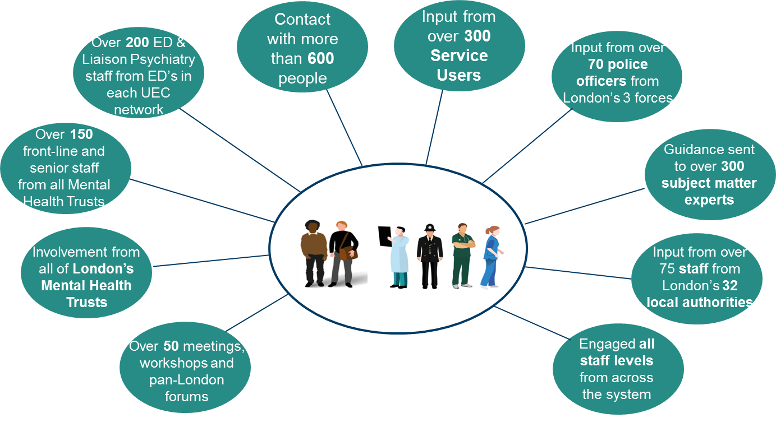
Summary of Engagement
Notes:
It has been a massive undertaking that we have fully committed to – real partership working delivering a standardised patwhay that everyone is signed up to and has co-produced in the true meaning of the word

Slide 16
Summary
Continual improvement in the care we deliver to mental health patients is an absolute priority for the LAS
Internally we have made improvements such as the introduction of mental health nurses & joint working with the MPS
It is absolutely essential we work as a whole system to address the wider challenges
The s136 pathway has been an exemplar of stakeholder engagement and commitment to change resulting in tangible improvements
The Healthy London Partnership team have been inclusive and responsive and it has been an inspiring programme of work
With demand continuing to increase on all of our services we must continue to work together – that is how we will deliver better services, better care and better outcomes
THANK YOU

Slide 17
Successes across London’s crisis care system Fionna Moore, Chief Executive, London Ambulance Service (LAS)
Cmdr. Christine Jones, Metropolitan Police and National Lead for Mental Health

Slide 18
Q&A Panel
Naomi Good (‘Expert by experience’ and NSUN representative), John Brouder (NELFT), Fionna Moore (LAS), Cmdr. Christine Jones (Met Police), Simon Pearce (Association of Directors of Adult Social Services - ADASS, Mental Health Lead)

Slide 20
Next Steps and Close
Conor Burke, Chief Officer, Barking and Dagenham, Havering and Redbridge CCGs and London’s Urgent and Emergency Care (UEC) Programme Senior Responsible Officer

Slide 21
Thank you
Healthy London Partnership is a collaboration of London’s health and care system to support the delivery of better health in London.

