Slide 1
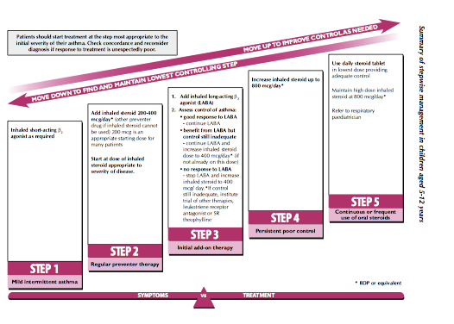
BTS 5-12 years old

Slide 2
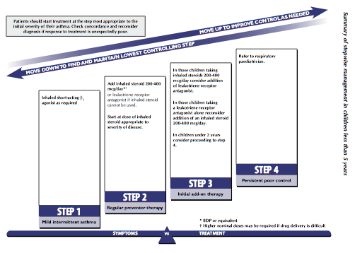
BTS <5years old

Slide 3
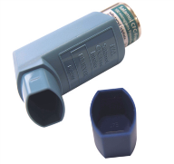
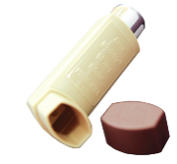
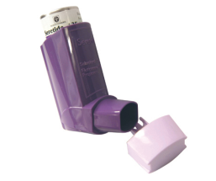
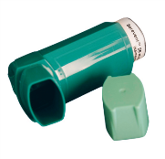
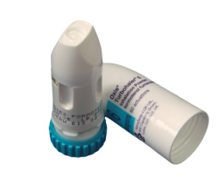
Which Inhaler & What Strength?
Bronchodilator
Inhaled corticosteroid (ICS)
ICS/LABA
LABA
Salbutamol
100mcg
Fluticasone
50, 125 & 250mcg
Seretide
50, 125 & 250
Plus 25mcg Salmeterol
Salmeterol 25mcg
Meter Dose inhaler
Always with Spacer
Beclometasone 50mcg
Beclometasone
100mcg
Salbutamol
200mcg
Fluticasone
50, 100 & 500mcg
Seretide
100, 250 & 500
Plus 50mcg Salmeterol
Salmeterol
50mcg
Accuhaler
Symbicort
100/6, 200/6 &
400/12mcg
Formoterol
6 & 12mcg
Bricanyl
500mcg
Pulmicort
100, 200 & 400mcg
Turbohaler
Nb: Fluticasone is twice the potency of beclamethasone
Image courtesy of UCH

Slide 4
Referral criteria
Referral to secondary care if:
Diagnosis unclear or in doubt
Symptoms present from birth or perinatal lung problem
Excessive vomiting or posseting
Persistent wet or productive cough
Family history of unusual chest disease
Failure to thrive
Nasal polyps
Referral to secondary care if:
Unexpected clinical findings eg focal signs, abnormal voice or cry, dysphagia, inspiratory stridor
Failure to respond to conventional treatment (particularly inhaled corticosteroids above beclometasone 400 mcg/day (or equivalent) or frequent use of steroid tablets)
Parental anxiety or need for reassurance

