Slide 1
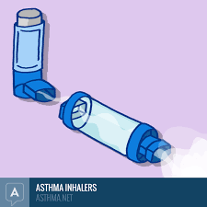
Asthma Friendly Schools karen.rodesano@nhs.net

Slide 2
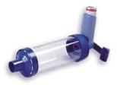
Child Asthma
24,752 children go to school in Islington
12% of these children currently have asthma approximately 3000 children.
1.1 million children in UK have asthma
17 deaths last year in UK from child asthma 12 of these deaths occurred in London

Slide 3

AIMS: To improve outcomes for children with asthma by enabling schools to achieve a benchmark/standard for asthma
Objectives: Achieve a standardised approach to asthma management in schools.
Less days missed from school and less hospital presentation due to asthma
Increased knowledge for staff and confidence in managing asthma in school
Increased knowledge for students, parents/carers

Slide 4

Improve school attendance less days off school due to asthma.
Reduce admittance to hospital due to poorly controlled asthma.
Increase knowledge and confidence in schools students, parents and teachers on asthma management.

Slide 5
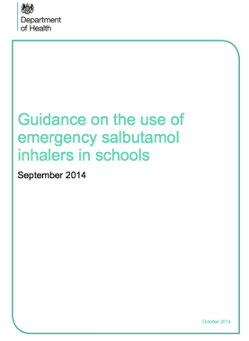
KEY DOCUMENTS
1. Supporting Children with Medical Needs (2015)
2. Guidance on the use of Emergency inhalers in school. (2014)
3.Keeping children safe in schools. (2016)

Slide 6
Five gold standards
To achieve asthma friendly school status
Five gold standards of care are:
POLICY
REGISTER
CARE PLANS
EMERGENCY PROCEDURES
ASTHMA LEAD

Slide 7
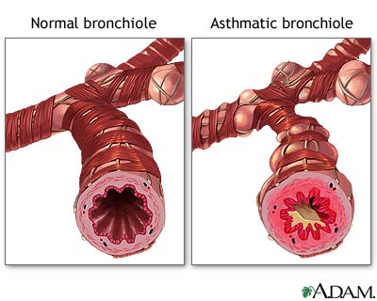
WHAT IS ASTHMA ?

Slide 8
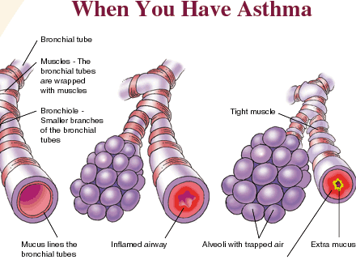

Slide 9

What is Asthma
https://www.youtube.com/watch?v=2ur1xRET1NG+feature=player-detailpage

Slide 10
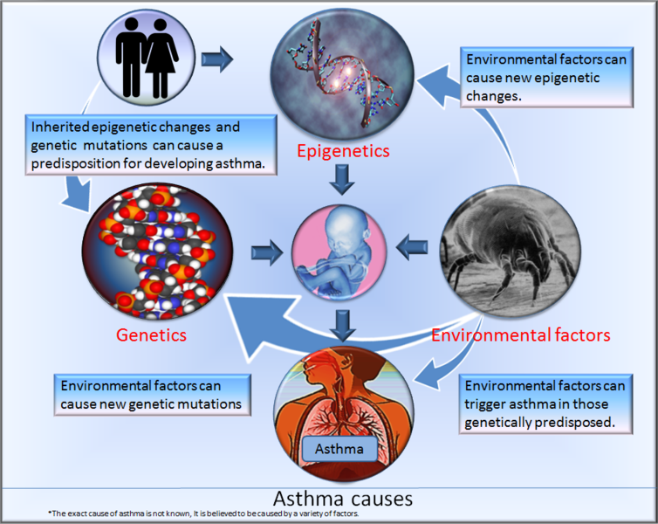

Slide 11

Asthma
How many children in this school have asthma ?
How many children in the UK have asthma?
How many asthma related child deaths last year ?

Slide 12

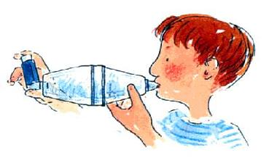
Inhaler and Spacer technique
1. How to use Inhaler and Spacer
2. When to use an preventer.
3. When to use a reliever.

Slide 13
What does it feel like to have an asthma attack?
https://m.youtube.com/watch?v=EK8nzKzdnIM

Slide 14
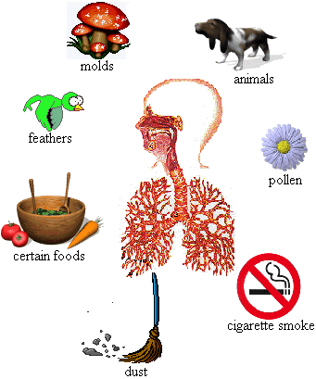
COMMON
TRIGGERS
Smoking
House Dust Mite
Pollen
Common Cold
Exercise
Emotions
Chemicals
Pet Dander
Weather: thunder
Pollution
Medicines

Slide 15
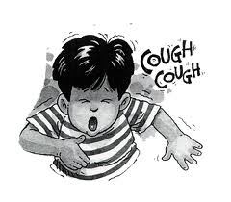

How would you know a child is having an asthma attack ?

Slide 16
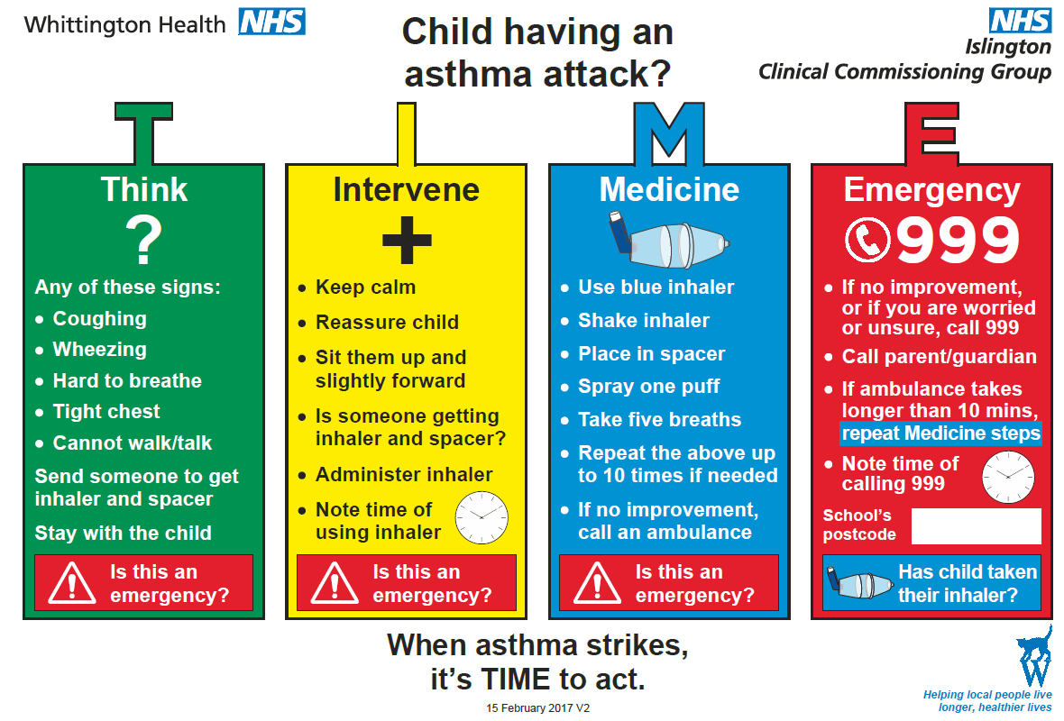

Slide 17
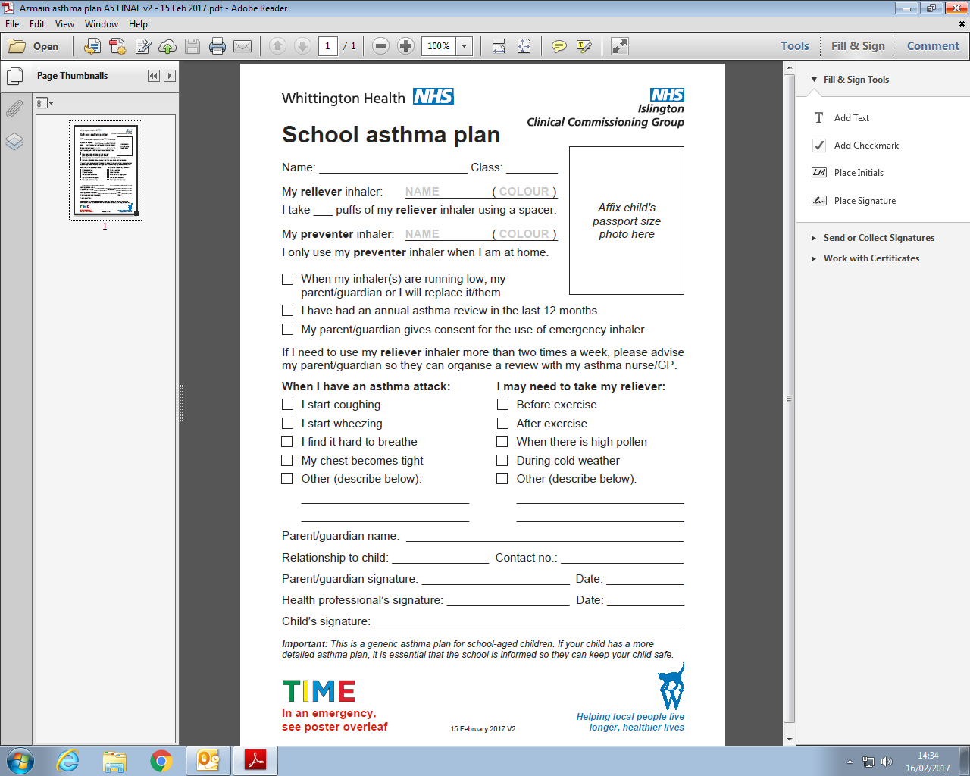

Slide 18
Do you know your school ?
Asthma Emergency Kits
Asthma Policy
Copy of the asthma register
Identify asthma champions
Named child's school asthma plan spacer and inhaler
Write down two things you liked about the asthma teaching

Slide 19

ANY QUESTIONS

Slide 20


Slide 21
Whittington Health
Magdala Avenue
London
N19 5NF
7272
Tel: 020 3070
Fax: 020 7288 5550
Website: www.whittington.nhs.uk

