Slide 1
It’s the workforce, stupid
Hilary Cass, Senior Clinical Advisor, Children’s Health & Wellbeing, Health Education England

Slide 2
It’s the workforce, stupid
Hilary Cass
Senior Clinical Advisor, Children’s Health & Wellbeing

Slide 3
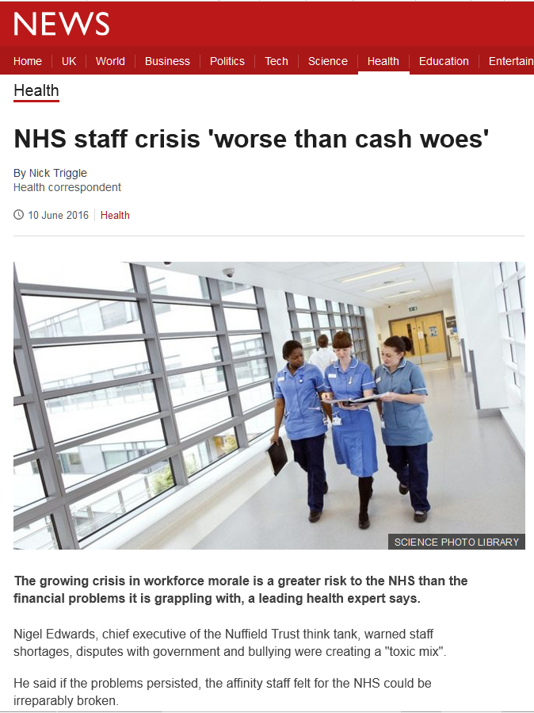

Slide 4
Children & Young People’s HealthCARE

Slide 5
Ingrid Wolfe, Lancet, Mar 2013

Slide 6
Asthma mortality and children with wheeze
Ingrid Wolfe, Lancet, Mar 2013

Slide 7
Percentage of children and young people aged under 25 years with diabetes, HbA1c measurement<58 mmol/mol (7.5%): progress

Slide 8

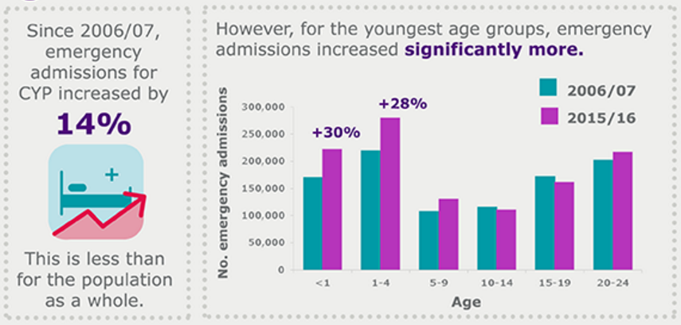

Slide 9
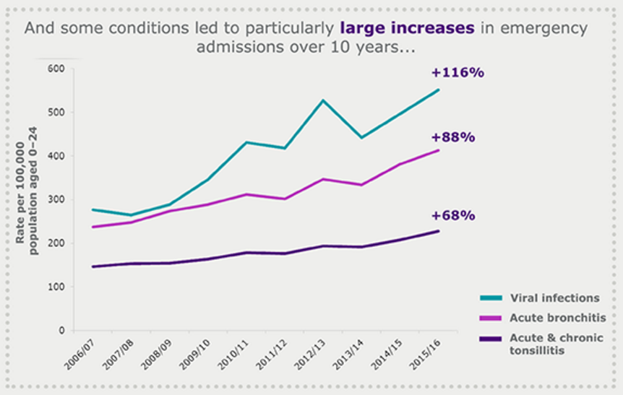

Slide 10
Our children deserve better
Outcomes for children are poor
  Higher mortality c.f. other countries
  Poor long term condition management c.f. other countries
  Unwarranted variation
  Major deficits in mental health services

Slide 11
Our children deserve better
Outcomes are suboptimal
Paediatric model is not sustainable
Our professional silos were designed around our historical roles, and not the contemporary needs of children and families
WE HAVE TO BE PREPARED TO THINK DIFFERENTLY

Slide 12
If you always do what you always did, you’ll always get what you always got.

Slide 13
OUTCOMES

Slide 14
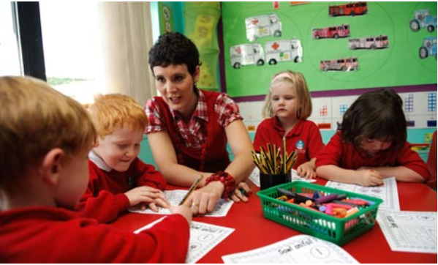
WHAT IS THIS?
Key healthcare outcome for children

Slide 15
TWO ASPECTS TO IMPROVING CHILD HEALTH OUTCOMES
Health service design
  Redesign
  Capacity building in community
Training and sustaining child health workforce
Broader environment for CYP
  School
  Social Care
  Youth justice
Training and equipping the wider children’s workforce INCLUDING families and CYP.

Slide 16
Whole workforce solutions
OUTCOME | WHO AND WHAT
Neonatal mortality | GP: Spotting sick child | Youth worker: Support re substance dependence | Teacher: SRE and PSHE lessons | FNP: Support for young mothers
Teenage suicide | GP: Primary care management of MH problem, communication skills with teenagers | Youth worker: Recognise range of MH problems, knowledge of resources and networks | Teacher: Recognise range of MH problems, knowledge of resources and networks | Paediatrician: Understand and anticipate MH problems in children with LTC’s

Slide 17
HEALTHCARE SYSTEM

Slide 18
The Primary-Secondary Gap
Minor
SHORT-TERM
CONDITIONS
Serious
PRIMARY CARE
Day-to-day
LONG-TERM
CONDITIONS
Strategic
Minor
ACUTE
ILLNESS
Serious
SECONDARY CARE

Slide 19
The Primary-Secondary Gap
Minor
SHORT-TERM
CONDITIONS
Serious
PRIMARY CARE
Day-to-day
LONG-TERM
CONDITIONS
Strategic
Minor
ACUTE
ILLNESS
Serious
Rising consultation rate, reduced funding, staffing shortfalls, and recruitment challenges
Changing expectations, changing demographics, changing disease profile and prevalence
Less experienced junior staff, nursing shortfalls, unsustainable workforce model
SECONDARY CARE

Slide 20
Out-of-Hospital Services
Minor
SHORT-TERM
CONDITIONS
Serious
PRIMARY CARE
Day-to-day
LONG-TERM
CONDITIONS
Strategic
Minor
ACUTE
ILLNESS
Serious
OUT-OF-HOSPITAL PAEDIATRICS
HOSPITAL CARE

Slide 21

A SEMI-PERMEABLE MEMBRANE BETWEEN PRIMARY AND SECONDARY CARE?
Secondary Care
Primary Care

Slide 22

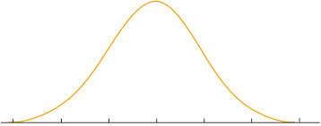

Where could we add most value?
Very unhealthy
Mostly healthy
Very healthy

Slide 23
Inputs
Interventions (Processes)
Contributing factors (Outputs)
Outcomes
1
4
4 X Asthma Specialist Nurses
Planned Care for Long Term Conditions
(Asthma & Epilepsy)
1
Clinicians provide better Treatment for CYP with LTCs
Planned Care & MDT working
Improved CYP Health
2
CYPHP will evaluate the impact on child centred outcomes
2 X Epilepsy Specialist Nurses
3
1
Identify CYP with LTCs attending A&E, work with them to create Care Plans
2 X Mental Health Nurses
Health-related quality of life ⬆
4
2
Pharmacist
CAMHS support for CYP with LTCs to identify and manage mental health
5
5
Consultant Psychiatrist
3
Medication reviews for CYP with LTCs
Improved Quality
2
Improve Self-Management and awareness for CYP with LTCs
6
Social and Youth worker training
7
Better Health Outcomes for CYP
Fewer episodes of illness requiring hospital intervention
Evidence based care ⬆
7
Improve Community support for CYP health
Schools Training
(Emotional Wellbeing)
1
NEL Admissions
4
Schools Training
8
Asthma and Allergy training & Schools
5
9
Social Worker Training
3
20% ⬇
Commissioning Toolkit for schools
Earlier Diagnosis and Treatment of CYP in Primary Care
Consultant time for in-reach clinics
(Patients & MDT sessions)
Increase support to General Practice to treat CYP
10
8
6
Primary Care is upskilled and holds more patients
Episodes of illness are managed out of hospital
(Channel Shift)
2
Consultant Paediatricians and Specialist Paediatric nurses see CYP in GP practice (in-reach clinics)
A&E Attendance
Reduce CYP Activity level in Hospital
4
Nurse time for in-reach clinics
Improved Professional Confidence of GPs and PNs in Primary Care
11
7
MDT Education sessions as part of in-reach programme
Decision support tools/Guidelines (DST)
8
10% ⬇
12
DSTs support GPs to follow NICE guidance
Hotline
9
GPs can access Consultant advice in real time via hotline
Practice Nurse Training
Sustainable and Efficient
13
5
10
Asthma Diploma training for Practice Nurses
CYP seen by specialists in in-reach clinics
Teen Health Check and GP training
3
14
Outpatients
11
Specialist nurses deliver targeted training to GP practices
E-learning for GP practices
15
12
Teen Health Check supports earlier diagnosis of CYP
LAC nurse
32% ⬇
6
16
Strengthened CYP health system
Youth Friendly Services
6
17
Improve CYP & Family confidence in Primary Care
CYP and Families access Primary Care
(vs Hospital)
Online Signposting
18
CYPHP will evaluate the impact on professional competence and networks
Behavioural Change Support
13
Training GP Practices – Youth Friendly Services
Professional competence and parental confidence ⬆
19
14
Online signposting to Primary Care

Slide 24
Asthma clinical pathway
Diagnosis of probable reversible airways disease
Contacted and linked to App for information and data entry
Physical, mental and social health RISK ASSESSMENT
Mild
Moderate
Severe
Asthma care programme 1
In primary and community care settings
Asthma specialist nurse, peers
App based education
Smoking cessation
Structured annual asthma review
Peer or family support group
Asthma care programme 2
In primary and community care settings
Asthma specialist nurse, mental health nurse, peers
Asthma care programme 1 and -
MH nurse in depth assessment, sign posting to legal, housing or social services and assessment for CAMH, CBT, family therapy
Asthma care programme 3
In joint respiratory paediatric and mental health clinics
Asthma specialist nurse, respiratory paediatrician, peers
Asthma care programme 1 and 2 and –
Specialist asthma and mental health care
Location
CYP Health
Team
Care package

Slide 25
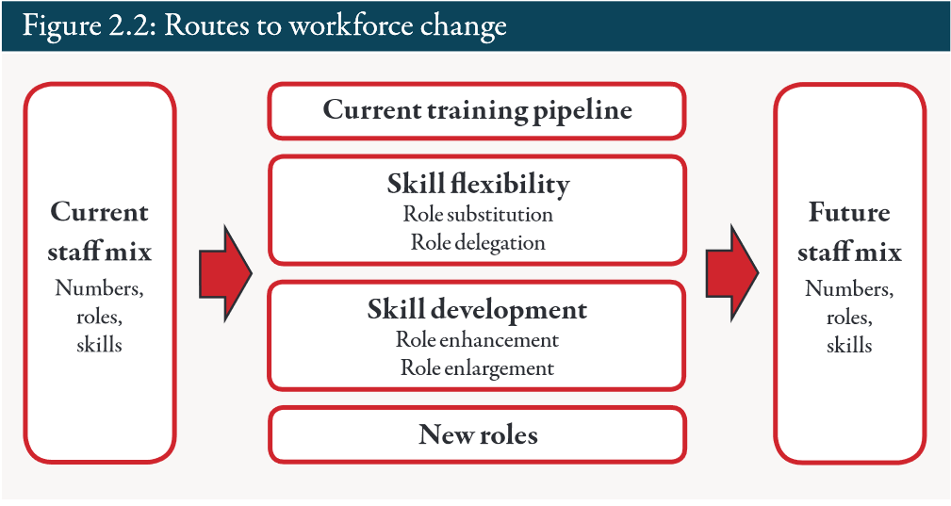
Reshaping the workforce to deliver the care patients need
Candace Imosen, Nuffield Trust
Most of workforce present in 10 years time is here today!!

Slide 26
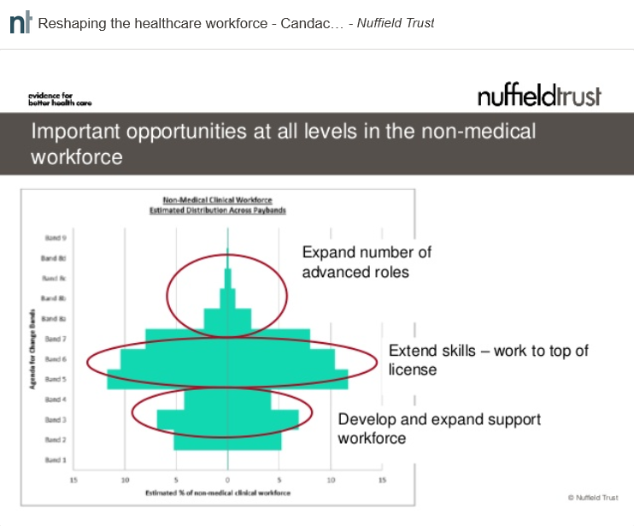

Slide 27
What are the 5-10 high impact changes?
HEE CYP Programme
Children’s nursing roles – extend within existing license c.f. advanced roles?
Assistant / associate practitioners?
Changes to medical training – GP / paediatric / CAMHS?
  Duration?
  Content?
  Location?
New roles? e.g. physicians’ associates
Apprentices?
Non healthcare workforce?
Learning resources c.f. curriculum changes?

