Slide 1
Transforming care: the Out of Hospital Standards
Michelle Johnson, Chair HLP Out of Hospital Standards Group, Director of Nursing (Babies, Children and Young People), Barts Health NHS Trust

Slide 2
Out of Hospital Care for Children and Young People
Healthy London Partnership (HLP) Children and Young People’s Programme have developed a portfolio of products which aim to drive improvements in the quality of out of hospital care
These include:
Out of hospital care standards for London’s children and young people
  Compendium: New models of care for acutely unwell children and young people - aimed at commissioners and providers of out of hospital healthcare services for children
  Alternative models of care for children and young people
  Opportunities for pharmacy to support out of hospital care (in development)
Notes:
The compendium brings together models of acute care that can be delivered within ambulatory settings within hospitals or in community and home settings. Many of the case studies included illustrate how these standards can be used to drive improvements in quality and assist commissioners to identify opportunities within their own areas.
This suite of documents will help organisations to develop place-based models of care treating the children and young people in the most appropriate location for their needs.

Slide 3

The Standards
Brought a number of children’s standards into one document
Consultation with external partners and national bodies
Designed to promote quality and standardisation across London
For commissioners and providers
Providers can undertake a self-assessment
They can be used to validate, challenge, to quality assure services and improve quality.
Notes:
Reviewed by members of Healthy London Partnership’s Clinical Leadership Group
The standards are designed to promote quality and standardisation across London, for out- of-hospital healthcare provision for children and young people. They are aimed at addressing the needs of physically unwell children and young people (with or without a long term condition) or those with continuing/complex care needs, who can receive safe health care at home or in settings outside of hospital. The role of the nurse has been clearly identified in the evidence for out-of-hospital care, but there is a shift and growing body of evidence considering other professions undertaking responsibility for delivering acute health care out-of-hospital, for example community pharmacists and allied health professionals (AHPs).2, 3
The standards outlined represent the minimum quality of care that children attending at any out-of-hospital care setting (including in the home) should expect to receive in London. All standards apply to seven day services. There is no difference in the provision of services during the week compared to those at the weekend. All services must meet section 11 of the Children Act (2004) as well as the 2013 document on interagency Working Together to Safeguard Children (WTtSC). 4, 5

Slide 4
Principles of the Standards
Children should not be admitted to hospital if can be avoided - minimises distress, impact of hospitalisation & time lost from education
Out of hospital care = any care not undertaken in a traditional hospital setting - healthcare in community, at the patient's home, school, workplace or in GP practice
Defined as the needs of physically unwell children and young people (with or without a long term condition) or those with continuing/complex care needs, who can receive safe health care at home or in settings outside of hospital
Workforce – As well as the role of the nurse, other professionals are delivering acute health care out of hospital, eg community pharmacists and AHPs
All standards apply to seven day services - no difference in the provision of services during the week compared to those at the weekend
Need to be able to share information so families can reduce the number of times they share the child or young person’s history
A whole system approach is needed to move health care out of hospitals and redesign services for children within community settings, with learning from the 5 year Forward View Vanguards on new models of care

Slide 5
Standards Framework
Children
should not be admitted
to hospital if it could be possibly avoided
Ministry of Health Report, The Welfare of Children in Hospital (Ministry of Health, 1959) Platt Report
Organisation of care
Quality governance and accountability – Patient safety, patient experience and clinical effectiveness
Connection and care coordination and multidisciplinary team
Child and family support
Acutely sick child Complex needs Long term conditions Palliative care
Resuscitation and emergency support, medicines optimisation, discharge and care planning
Transitional care
Workforce and education and training
Safeguarding

Slide 6
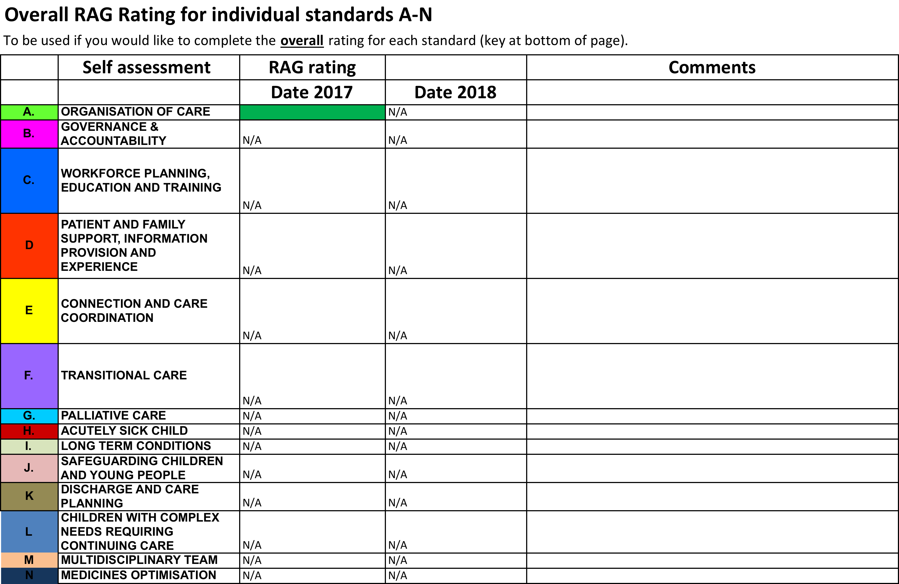
How can they be used to improve care
Used with Compendium of Models of Care to redesign services
Commissioner led requirement for providers to self assess and peer review services across STP population to promote quality and standardisation
NHS Providers can use the standards to undertake a self assessment of their ability to deliver the required quality of care
To validate, challenge and quality assure services and improve quality
Template available - HLP interested to see completed self assessments - hlp.cyp-programme@nhs.net

Slide 7
Tips for implementation
Benchmarking across organisations
Services delivered by different providers
Basis for peer review
Conversations with commissioners and system leaders
Used alongside HLP Models Compendium
Measurement for existing services
Training and competencies
Building business cases and
Size of standards broken down for ease of use – considered separately
Notes:
My one blue on the horizon for the standards is how we work in partnership to measure against the standards. There are many providers for one geographical area and may only provide one small element so how we make this a focus of importance for them.

Slide 8
Thank you questions
Thank you
Michelle Johnson
Michelle.johnson2@bartshealth.nhs.uk
Mobile Number 07946839079

