Slide 1
Healthy London Partnership
Children & Young People’s Programme
Transforming Out of Hospital Care for Children and Young People
June 22nd 2017

Slide 2
Welcome and introduction to HLP
Eugenia Lee, GP Lead, Healthy London Partnership

Slide 3
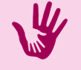

Welcome
www.menti.com
Code 594231
What type of organisation do you represent?
What are you hoping to gain from today's event?
#CYPOOH
@HealthyLDN

Slide 4


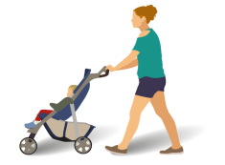
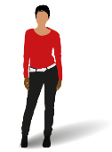

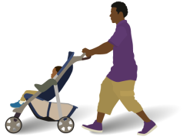


Healthy London Partnership –
Children and Young People’s programme
Key facts
8.2 million
people live in London
of which
20% of 4-year-olds are overweight or obese
2,049,576
are children aged 0-19
Mental Health conditions affect
1 in 8
Children
Emotional and
behavioural
problems affect
1 in 5
Children
600,000
of London’s children
live in poverty
25% of 15-year-olds
LESS THAN HALF
of 11-15
year olds do
an hour of
exercise each
day
134,186
live births in
London in 2012
First smoked
AGED 13 or younger
40%
of 15-year-olds
drink alcohol
once a week
20%
of 13-year-olds
drink alcohol
once a week

Slide 5
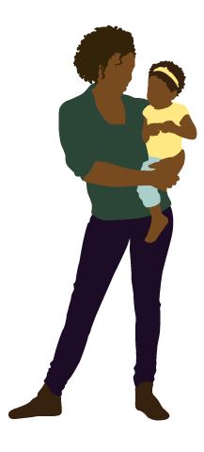
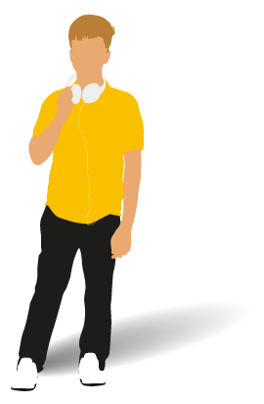




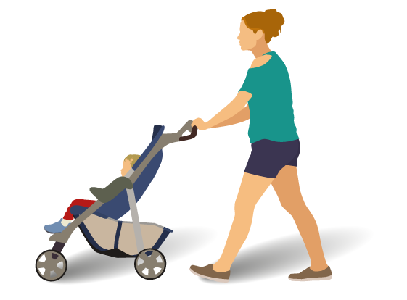
What do children, young people and families think?
I want to know that my GP is experienced in caring for children
We need easier access to healthcare
Make sure the school can look after my son when he has an asthma attack
Services are not joined up
I am worried about what will happen next year when I am too old for the children’s clinic
I need rapid access to someone I can talk to when I feel depressed

Slide 6




London Health Commission
Healthy London Partnership –
The delivery arm of the London Health Commission

Slide 7







Whole System Approach to Transformation for Children and Young People’s Health
System Leadership (CYP Board and clinical leadership group)
Long Term Conditions
Asthma standards
Asthma toolkit
Asthma baseline audit
Epilepsy standards
Primary Care
GP federation pilot model care CYP
Population based data
Toolkit for GP federations
Prevention and self care
NHSGo
Marketing campaign
Community Pharmacies
Audit of CYP with asthma
Online learning hub for MURs
Audit CYP with dental pain
Role of pharmacists CYP health
Mental health
LTP refresh support
Guidance for mental health crisis
Models of liaison psychiatry
Benchmarking/KPIs
Eating disorders CoP
Thrive (Mayor)
Learning disability (theatres)
Out of Hospital care
Compendium models of care
Standards for OOH care
Modelling impact different models
Urgent and Emergency Care
Acute care standards
Peer review
PAU standards
L1 and 2 PCC standards and education
CDOP
Baseline audit
Suicide prevention
Bereavement
Sharing data and learning
Cluster level working
Schools
Models of school nursing
Guidance for management CYP asthma and diabetes
Improved integration of care across the system for CYP
System wide enablers
Place based care and planning (data packs, support for networks)
Workforce
January 2017
Commissioning development programme

Slide 8
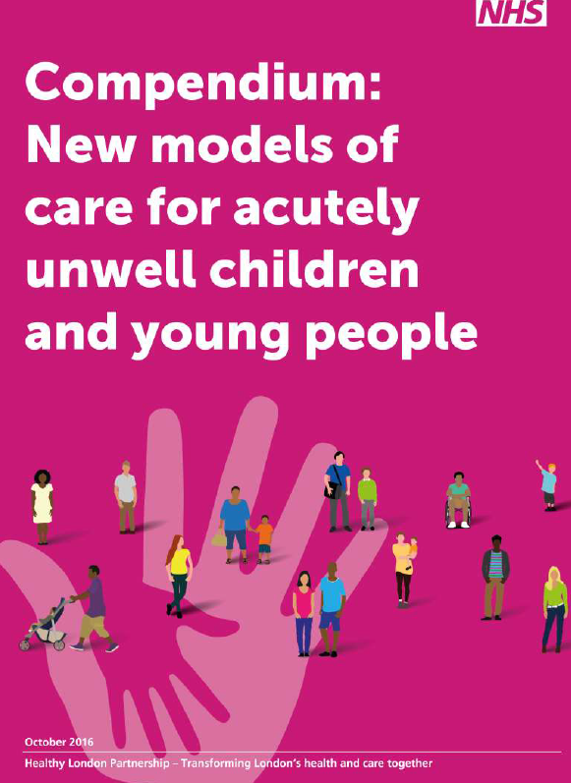

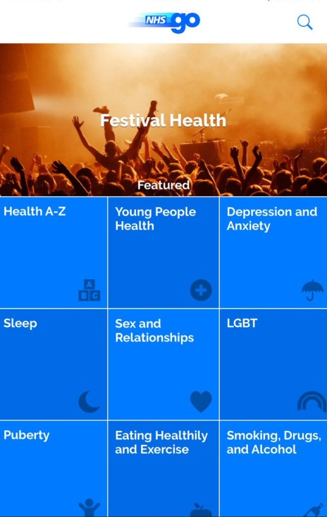


Publications and products

Slide 9
Background
Important to avoid admitting children to hospital unless absolutely necessary
Whole system approach needed to move health care out of hospitals. Need to redesign services to allow caring for children within community settings – FYFV vanguards
Today is about raising awareness of out of hospital healthcare services for CYP
HLP has supported the development of standards for out of hospital care of CYP – aimed at commissioners and providers
Today will support dissemination of learning from HLP’s Compendium: New models of care for acutely unwell CYP and to raise awareness in relation to new models of care for children and young people more widely
Marketplace exhibition of the organisations that were showcased in the compendium, allowing you an opportunity to understand how the services were developed and explore the learning and possible pitfalls

Slide 10
You told us…. we listened
At our last primary care event you told us
You wanted more time to network = today we have increased the amount of time for networking
You loved the speakers but there wasn’t enough time to hear them in a morning = today we have made it a whole day event

